Slide 1

Project Pegasus
Package Delivery System
Team A
Tushar Agrawal
Sean Bryan
Pratik Chatrath
and Adam Yabroudi

Slide 2
What we’re doing
Problem
Delivering packages to a house using UAVs
Problem Description
Given the coordinates of the house, a UAV with a package takes off from point A, autonomously reaches close to the house, scans the outside of the house for a visually marked drop point, lands, drops off the package, then takes off again to land on another platform at point B.

Slide 3
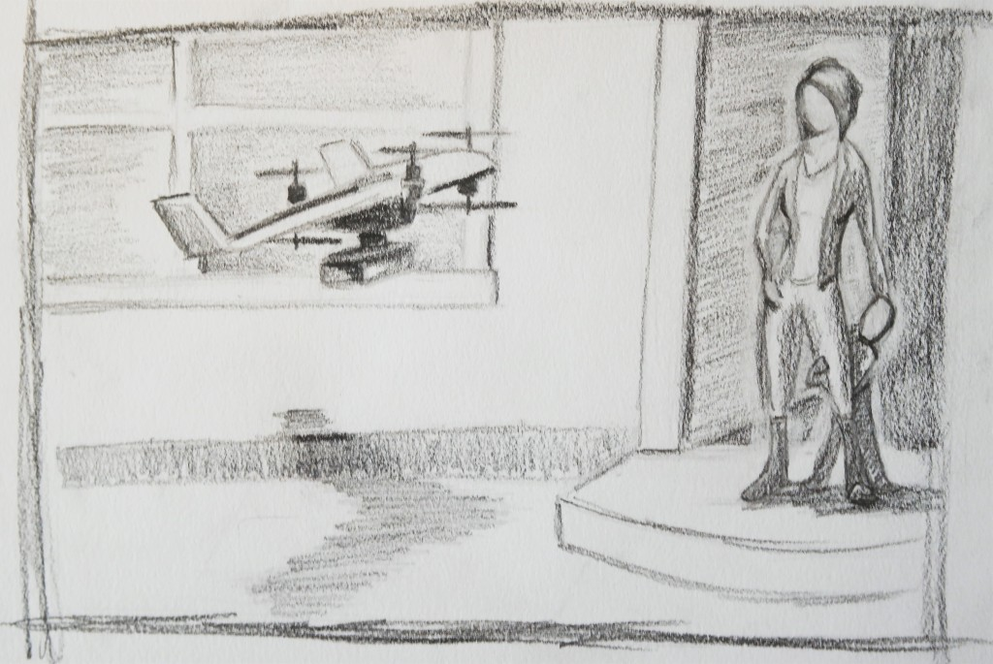
Use Case

Slide 4
System Requirements
Mandatory Functional Requirements
Mandatory Non-Functional Requirements
Desired Requirements

Slide 5
Mandatory Functional Requirements
M.F.1 - Hold and carry packages with a maximum size of 30cm x 30cm x 20cm, weighing up to 400g.
M.F.2 - Autonomously take off from a visually marked platform.
M.F.3 - Navigate to a known position close to the house.
M.F.4 - Detect and navigate to the drop point at the house.
M.F.5 - Land at visually marked drop point (with an open landing column of 2m radius).
M.F.6 - Drop package within 2m of the drop point.
M.F.7 - Take off, fly back to and land at another visually marked platform.
M.F.8 - Takes coordinates as input from the user.
M.F.9 - Communicates with platform to receive GPS updates (intermittently).

Slide 6
Mandatory Non-Functional Requirements
M.N.1 - Operates in an outdoor environment.
M.N.2 - Operates in a semi-known map. The GPS position of the house is known, but the exact location of the visual marker is unknown and is detected on the fly.
M.N.3 - Avoids static obstacles with a minimum cross-sectional dimensions of 1.5m x 0.5m.
M.N.4 - Not reliant on GPS
M.N.5 - Sub-systems should be well documented and scalable.
M.N.6 - UAV should be small enough to operate in residential environments.
M.N.7 - Able to carry packages.
M.N.8 - Recognizes visual markers that are located at least 10m apart.

Slide 7
Desired Requirements
3.2.1 Functional
  D.F.1 Pick up packages.
  D.F.2 Simulation with multiple UAVs and ground vehicles.
  D.F.3 Ground vehicle drives autonomously.
  D.F.4 UAV and ground vehicle communicate continuously.
  D.F.5 UAV confirms the identity of the house before dropping the package (RFID Tags).
3.2.2 Non-Functional
  D.N.1 Operates in rains and snow.
  D.N.2 Avoids dynamic obstacles
  D.N.3 Operates without a GPS system.
  D.N.4 Has multiple UAVs to demonstrate efficiency and scalability.
  D.N.5 Compatible with higher weights of packages and greater variations in sizes.

Slide 8
Functional Architecture

Slide 9
Cyberphysical Architecture

Slide 10
Subsystems Descriptions
Electro-Mechanical Subsystem
Obstacle Avoidance Subsystem
Vision Subsystem
Ground Platform Subsystem
Flight Control Subsystem

Slide 11
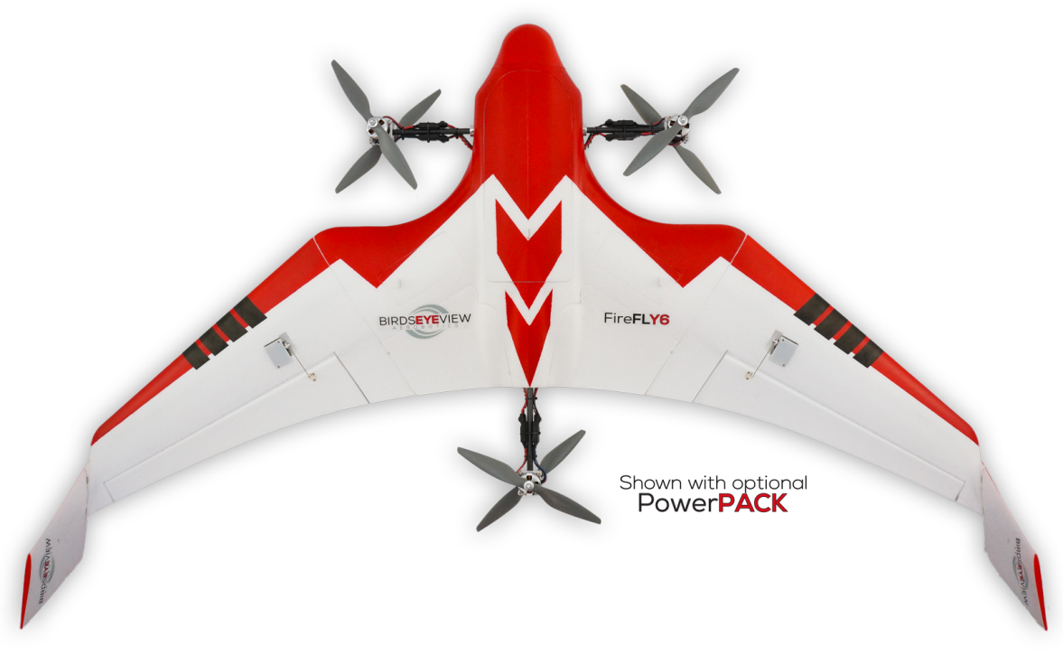
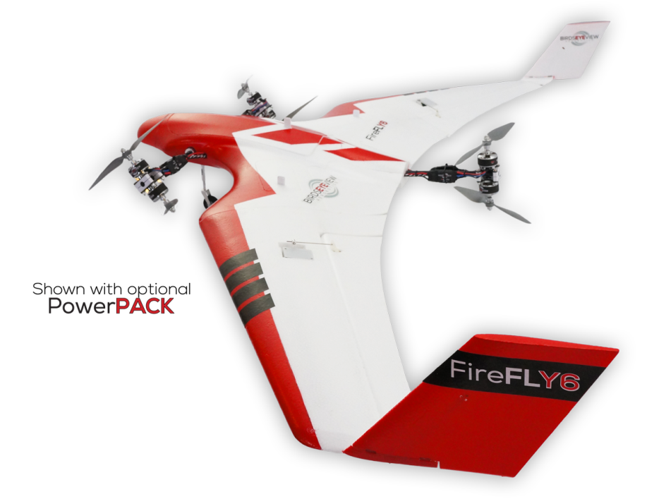
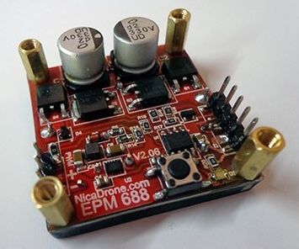
Electro-Mechanical Subsystem

Slide 12
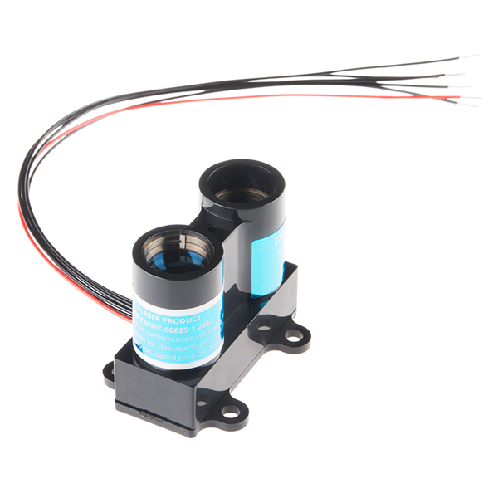
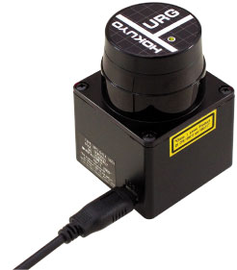
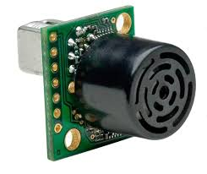
Obstacle Avoidance Subsystem

Slide 13
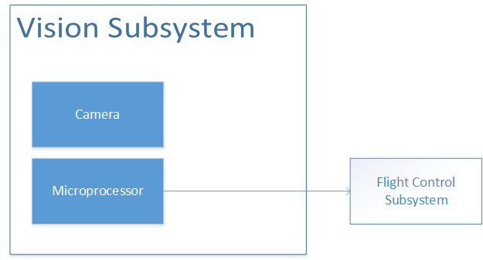
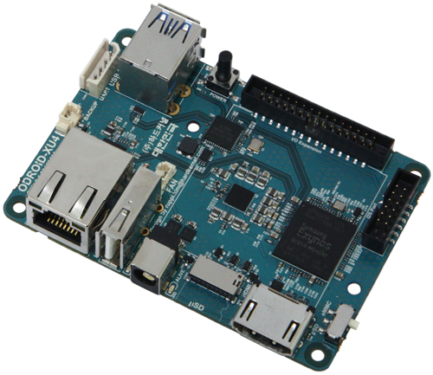
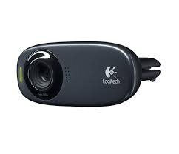
Vision Subsystem

Slide 14
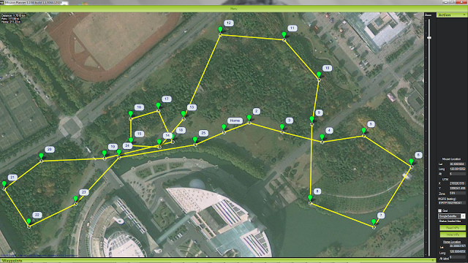
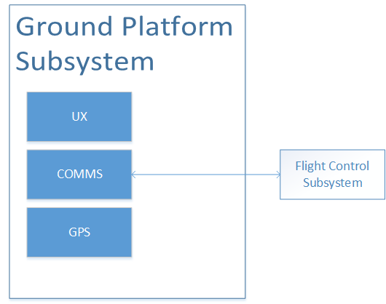
Ground Platform Subsystem

Slide 15
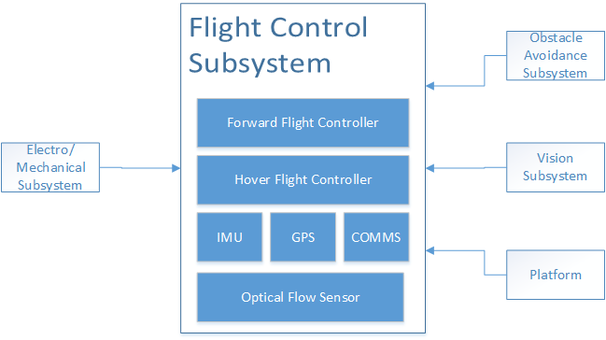
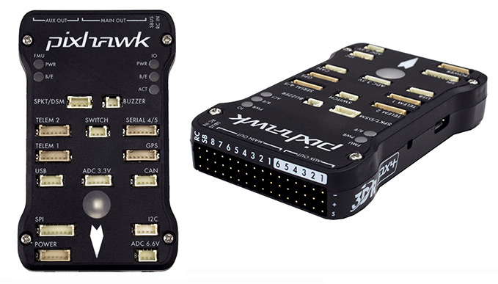
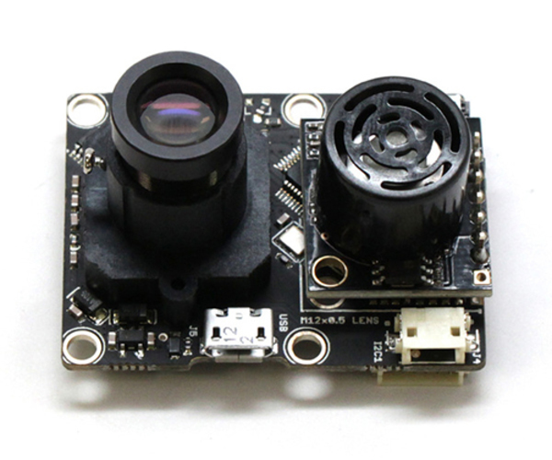
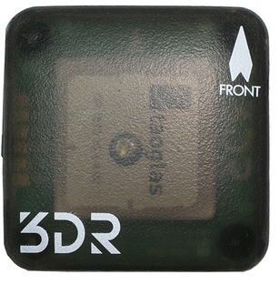
Flight Control Subsystem

Slide 16
Current Status
Flight Controller
Gripping Mechanism
Obstacle Detection
Vision Subsystem

Slide 17
Current Status – Obstacle Detection
Sensors tested
IR sensors (Sharp GP2Y0A02)
Ultrasonic sensors (Maxbotics LV, Maxsonar EZ MB1040 and EZ MB1010)
Inferences
IR has thin pencil size detection width
Ultrasonic sensors has wide detection width
IR can detect maximum upto 250 cm whereas ultrasonic can detect upto 600 cm
No major difference in operation of IR indoors or outdoors
Ultrasonic sensors give inaccurate readings in presence of motors
No significant interference exists between two IR sensors, IR and Ultrasonic sensor or between two Ultrasonic sensors
Ultrasonic sensors works best with median filter in Pulse Width mode

Slide 18
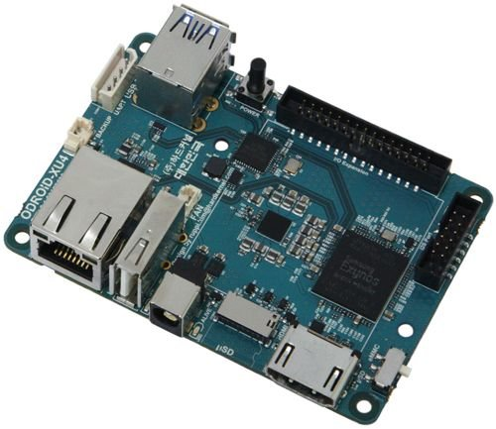
Current Status – Vision System
SBCs
  BeagleBoard xM
  BeagleBone Black
  Ordoid XU4

Slide 19
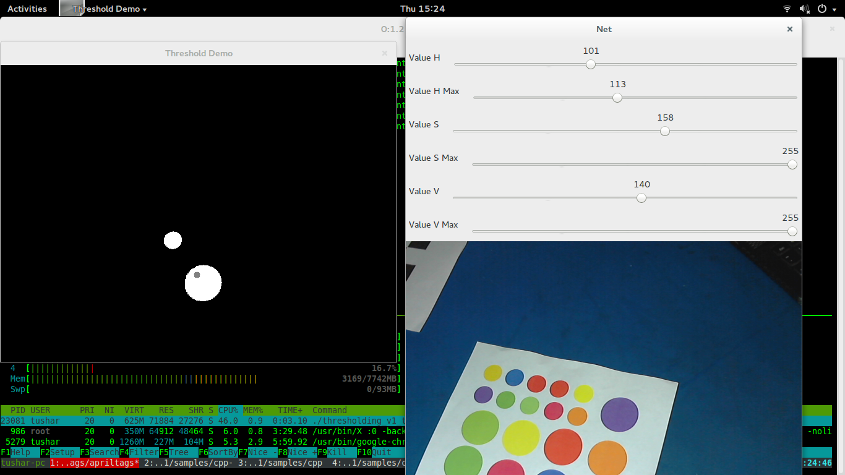
Current Status – Vision System
Algorithms Tested (Performance on Laptop)
  Blob detection : 25 fps

Slide 20
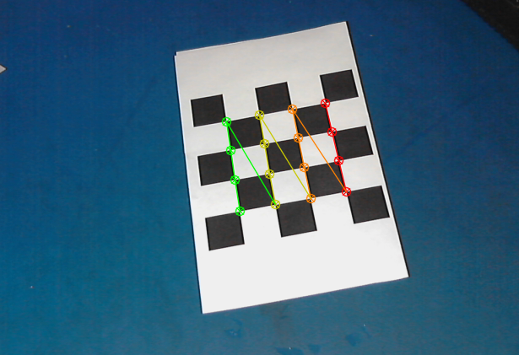
Current Status – Vision System
  Checkerboard pattern detection (Best 14 fps, Worst 4 fps)

Slide 21
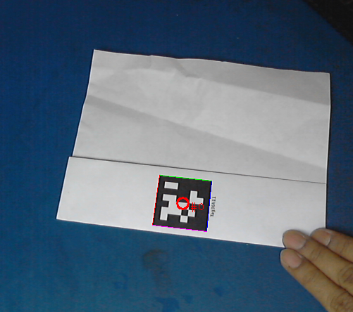
Current Status – Vision System
  April Tag detection (14 fps)

Slide 22
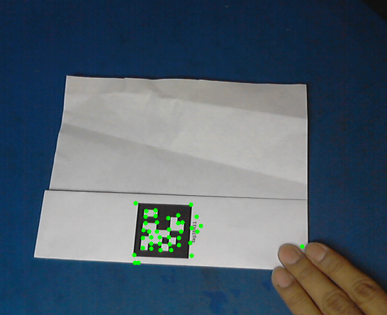
Current Status – Vision System
Lucas Kanade tracking for features (29 fps)
  To be coupled with a detection algorithm

Slide 23
Project Management
Work Breakdown Structure
Schedule
High-Level Test Plan
Budget
Risk Management

Slide 24
Work Breakdown Structure
1 | Systems Design |  |  | 2 | Procurement and Assembly |  |  | 3 | Testing & Integration
1.1 | Project Planning |  |  | 2.1 | Drone |  |  | 3.1 | Project Planning
1.1.1 | Design System Architecture | 25 days |  | 2.1.1 | Procure Drone | 2 wks |  | 3.1.1 | Build Test Environment | 1 week
1.1.2 | Design Test Environment | 1 day |  | 2.1.2 | Assemble Drone | 1 wk |  | 3.1.2 | Full Scenario Test | 2 weeks
 |  |  |  | 2.1.3 | Procure Flight Controller | 2 wks
1.2 | Drone |  |  |  |  |  |  | 3.2 | Drone
1.2.1 | Choose Drone | 1 day |  | 2.3 | Ground Platform |  |  | 3.2.1 | Test Flight Controller | 1 week
1.2.2 | Select Flight Controller | 1 day |  | 2.3.1 | Build Ground Platform | 3 wks |  | 3.2.2 | Test Drone R/C-only Control | 2 days
1.2.3 | Design Drone Underbelly | 2 wks |  |  |  |  |  | 3.2.3 | Test Drone Waypoint Following | 2 days
1.2.4 | Design Marker Search Algorithm | 4 weeks |  | 2.4 | Vision System |  |  | 3.2.4 | Test Visual Landing of Drone | 1 wk
 |  |  |  | 2.4.1 | Procure Camera | 2 wks
1.3 | Ground Platform |  |  | 2.4.2 | Procure Vision Board | 1 week
1.3.1 | Design Base Station | 1 week |  | 2.4.3 | Fabricate Visual Markers | 3 days |  | 3.3 | Vision System
 |  |  |  |  |  |  |  | 3.3.1 | Test Camera and Board | 3 days
1.4 | Vision System |  |  | 2.5 | Obstacle Avoidance |  |  | 3.3.2 | Test Camera, Board, and Gimbal | 1 week
1.4.1 | Design Vision System | 1 day |  | 2.5.1 | Procure Obstacle Avoidance Sensors | 1 week |  | 3.3.3 | Integrate and test Visual system on board (Mech & Elec) | 4 days
1.4.2 | Select Camera | 3 days |  | 2.5.2 | Procure Optical Flow | 1 week |  | 3.3.4 | Test Visual Markers with Vision System | 3 days
1.4.3 | Select Vision Board | 1 day
1.4.4 | Design Visual Markers | 1 day |  | 2.6 | Communications System |  |  | 3.4 | Obstacle Avoidance
 |  |  |  | 2.6.1 | Procure Radio Module | 2 wks |  | 3.4.1 | Integrate Optical Flow | 3 weeks
1.5 | Obstacle Avoidance |  |  |  |  |  |  | 3.4.2 | Integrate and test obstacle avoidance system with drone | 1 week
1.5.1 | Analyze Obstacle Avoidance Sensors | 1 wk |  | 2.7 | User Interface |  |  | 3.4.3 | Table Test Obstacle Avoidance Sensors and Algorithms | 3 wks
1.5.2 | Design Obstacle Avoidance | 2 months |  | 2.7.1 | Build User Interface | 1 week |  | 3.4.4 | Test Waypoint Following with Obstacle Avoidance | 1 month
1.5.3 | Design Sensor Layout | 1 wk |  |  |  |  |  | 3.4.5 | Test Visual Landing with Obstacle Avoidance | 2 months
 |  |  |  | 2.8 | Package Handling
1.6 | Communications System |  |  | 2.8.1 | Build/Procure Gripper | 1 month |  | 3.5 | Communications System
1.6.1 | Design Communications Systems | 3 days |  |  |  |  |  | 3.5.1 | Electronic Test of Radio Module | 1 day
1.6.2 | Select Radio Module | 1 day |  |  |  |  |  | 3.5.3 | Data Test of Radio Module | 1 week
1.7 | User Interface |  |  |  |  |  |  | 3.6 | User Interface
1.7.1 | Determine User Inputs/Outputs | 4 days |  |  |  |  |  | 3.6.1 | Test User Interface | 2 days
1.7.2 | Design User Interface | 2 weeks
 |  |  |  |  |  |  |  | 3.7 | Package Handling
1.8 | Package Handling |  |  |  |  |  |  | 3.7.1 | Test Gripper Electronics | 2 days
1.8.1 | Design Gripper System | 3 weeks |  |  |  |  |  | 3.7.2 | Test Gripper and Package Modifications | 1 week
1.8.2 | Select Gripper Mechanism | 1 day |  |  |  |  |  | 3.7.3 | Integrate and test gripper with drone | 1 week
1.8.3 | Design Package Modifications | 1 wk

Slide 25
Schedule – Design Phase
CDR
PR #5
PR #4
FVE

Slide 26
Schedule – Procure/Build Phase
CDR
PR #4
PR #5
FVE

Slide 27
Schedule – Integrate and Test
CDR
PR #5
PR #4
FVE

Slide 28
Tests – FVE Test A
Test ID | A
Test Name | Real time vision test
Test Description | Validates a working embedded vision system which can detect and track visual markers in real time
Equipment Required | Vision microprocessor and Camera system set up on a table, Visual Markers
Step | Step Description | Success condition
A.1 | Attach visual marker to a wall in view of the camera
A.2 | Initiate program | Marker should be detected and demarcated using computer vision
A.3 | Move the visual marker either direction in X and Y while in camera view | Marker position should dynamically update

Slide 29
Tests – FVE Test C
Test ID | C
Test Name | UAV navigation test
Test Description | Validates the flight control and navigation of the UAV (GPS allowed)
Equipment Required | UAV, Laptop for waypoint control.
Step | Step Description | Success condition
C.1 | Place UAV on the ground. Assign waypoints for the UAV to cover
C.2 | UAV takes off and flies to the first waypoint | The UAV takes off smoothly and maneuvers to the waypoint
C.3 | UAV goes from waypoint to waypoint as instructed | All waypoints are reached using a direct path and with a maximum error of 3m.
C.4 | UAV returns to staring waypoint and lands | Final UAV position is within 5m of the starting UAV position

Slide 30
Tests – FVE Test D
Test ID | D
Test Name | Static obstacle detection test
Test Description | Validates that static obstacles are detected at least in one direction accurately
Equipment Required | Desk, Proximity sensing system communicating to the flight controller, two sizes of obstacles (can be boards with cross sections 1.5x0.5m and 2x2m)
Step | Step Description | Success condition
D.1 | Setup desk with proximity sensor and controller system
D.2 | Initiate system with configurations
D.3 | Bring 2mx2m obstacle in front of the system | Obstacle is detected in a range of 50cm to 1.5m from the system and distance is identified with a maximum error of 20 cm.
D.4 | Bring 1.5mx0.5m obstacle in front of the system | Obstacle is detected in a range of 50cm to 1.5m from the system and distance is identified with a maximum error of 20 cm.

Slide 31
Tests – SVE Test B
Test ID | B
Test Name | Package carrying mechanism test
Test Description | Validates the package carrying and dropping capabilities of the UAV
Equipment Required | UAV fitted with the package carrying mechanism, Small package.
Step | Step Description | Success condition
B.1 | Place the UAV with the package attached to the carrying mechanism
B.2 | Initiate take off manually
B.3 | UAV lifts off and hovers 5m over the ground for 1 minute | The package remains securely attached to the UAV
B.4 | UAV descends and lands | Package still attached
B.5 | UAV drops package onto the ground | Package is released and lands on the ground

Slide 32
Tests – SVE Test E
Test ID | E
Test Name | Obstacle-less package delivery test
Test Description | Validates that packages can be delivered to a house without any obstacles in the path
Equipment Required | Platform, Open space (outdoor environment), Fully equipped system.
Step | Step Description | Success condition
E.1 | Place UAV with package at platform with visual marker
E.2 | Initiate system by entering GPS coordinates for the house and GPS coordinates of the return to point | Delivery begins
E.3 | UAV takes off autonomously towards the house
E.4 | Reaches waypoint near the house using GPS | Autonomously and accurately navigates using GPS to reach near given GPS coordinates
E.5 | Identifies and navigates to the visually marked drop off point (with no obstacles in the path) | Identifies the visual marker near the GPS destination and autonomously navigates to it
E.6 | Lands and drops the package | The package should be upto 2m from the center of the visual marker
E.7 | Autonomously takes off and navigates to the GPS of the return back point (communicated in the beginning) | Package should remain delivered. UAV departs
E.8 | Detects, navigates and lands at the platform with the visual marker | Should land within 2m of the center of the visual marker

Slide 33
Tests – SVE Test F
Test ID | F (uses E)
Test Name | Package delivery test with obstacles
Test Description | Validates that packages can be delivered to a house even with static obstacles in the path
Equipment Required | Platform, Open space (outdoor environment), Fully equipped system, Obstacles (cross section: 1.5m x 0.5m, 2m x 2m).
Step | Step Description | Success condition
E.1 | Place UAV with package at platform with visual marker
E.2 | Initiate system by entering GPS coordinates for the house and GPS coordinates of the return to point
E.3 | UAV takes off autonomously towards the house
E.4 | Reaches waypoint near the house using GPS
F.1 | Identifies the marker and plans path to navigate to it | Identifies the visual marker near the GPS destination.
F.2 | Place an obstacle (2mx2m) in the path of the UAV | Avoids the obstacle
F.3 | Place an obstacle (2mx2m) on the side of the UAVs intended path | Avoids the obstacle
F.4 | Repeat with 1.5m x 0.5m obstacles | Avoids the obstacle
F.5 | Repeat with both obstacles, placed in the front and the sides | Avoids the obstacle
E.6 | Lands and drops the package
E.7 | Autonomously takes off and navigates to the GPS of the return back point (communicated in the beginning)
E.8 | Detects, navigates and lands at the platform with the visual marker

Slide 34
Budget
Component | Price
FireFly6, batteries, spare components, extra Pixhawk | $1198
Gripper System | $100
Vision System (gimbal, vision boards, spares, camera) | $859
Sensor (Hokuyo, lidars, and ultrasonic to cover entire vehicle) | $1300
 | $3457

Slide 35
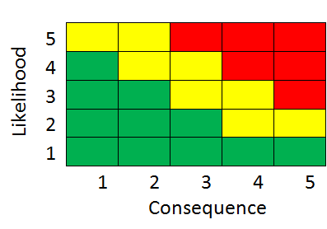
Risk 1: BeagleBoard-xM
Type: Technical/Procurement
Description:
  BeagleBoard-xM is no longer sold
Consequence:
  If board fried we would have no backup
Mitigation:
  Changing to BeagleBone Black/Odroid for remainder of the project

Slide 36
Risk 2: FireFly6 Firmware
Type: Technical
Description:
  Using proprietary firmware which isn’t well tested but provides high value to project
Consequence:
  Might create unforeseen coding and debugging issues
Mitigation:
  Working with head firmware engineer of FireFly6 as second sponsor (in addition to UTRC).
  Test code immediately (already procured Pixhawk in anticipation of this problem)

Slide 37
Risk 3: NicaDrone Gripper Failure
Type: Schedule
Description:
  NicaDrone fails to function when received in December
Consequence:
  New gripper design must be manufactured leading to delay in schedules.
Mitigation:
  Accounted for risk in schedule in advance (removed from FVE)
  Created preliminary backup designs
  Triple check NicaDrone specs online to ensure it integrates into our architecture

Slide 38

Questions?

