Slide 1
Progress Review - 3 MRSD Project - 1 11/12/2015
Team HARP
(Abhishek, Alex, Feroze, Lekha, Rick)
Carnegie Mellon University

Slide 2
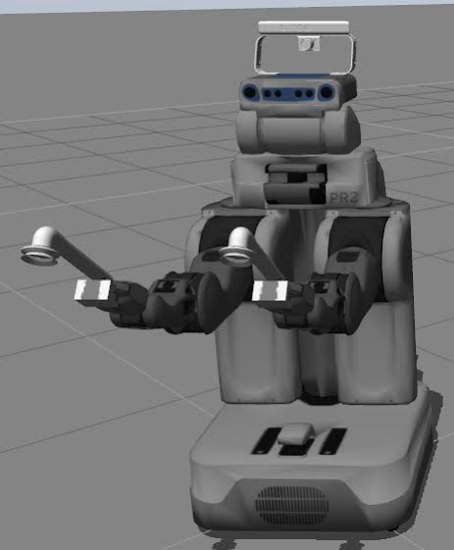
Suction
Acquired shop vac for final suction system.
Re-iterated on the prototype suction gripper design.
Added the custom gripper in simulation.

Slide 3
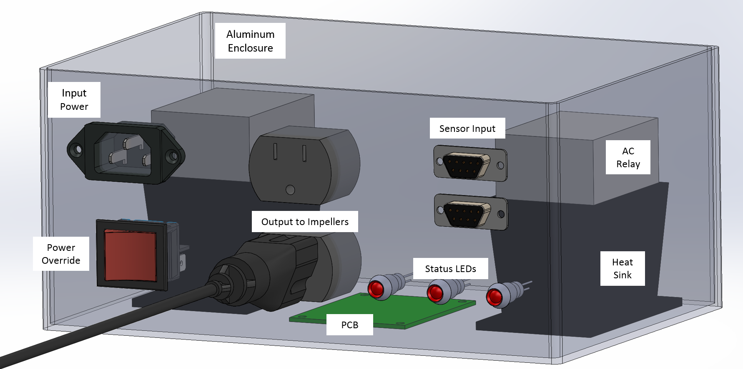
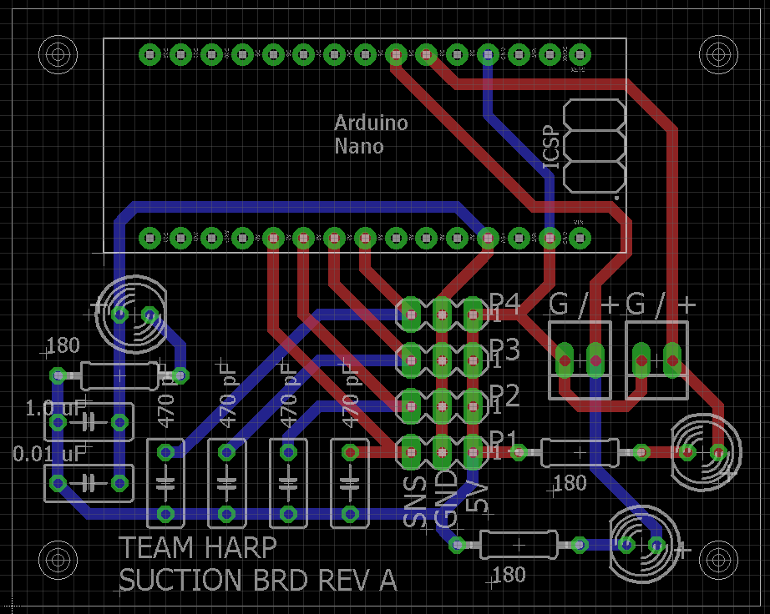
Suction
Finalized PCB design
Designed and ordered components for electronics enclosure

Slide 4
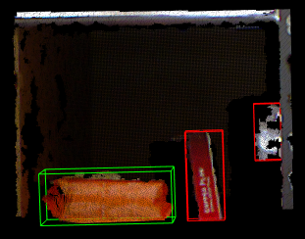
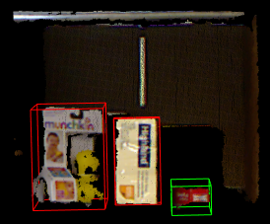
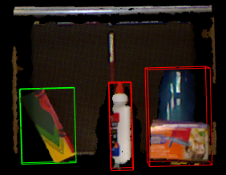
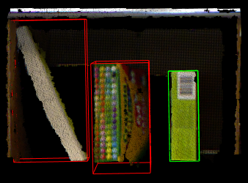
Perception
Developed algorithm to remove shelf from point cloud
Improved clustering by switching from color-based to euclidian
Estimated object based on bounding box dimensions compared to ground truth
Compiled all vision subsystems into one complete pipeline

Slide 5
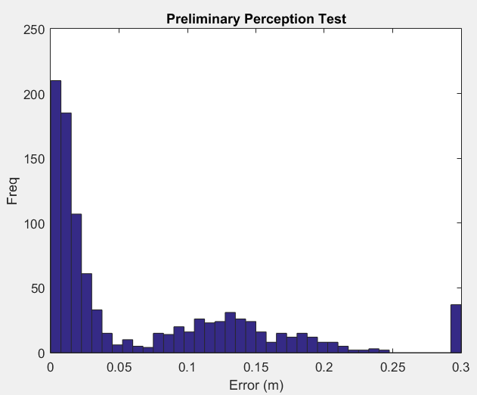
Perception
Ran 1000 image test on point clouds from Rutgers database
Accurately identified grasp position within 3 cm on over 56% of attempts
Investigating results to identify ways to improve algorithm (70% required by FVE)

Slide 6
Platform
Move actual PR2 arm using Inverse Kinematics action
The Inverse Kinematics arm motion in simulator was tested on the actual robot
The program was loaded to the robot’s computer and executed.

Slide 7
Platform
Smach state controller was used to call MoveIt planner
The target pose was defined using the movable interactive marker inside rviz
The arm was moved to target pose successfully
Eventually, the perception algorithm will return the target pose to smach which will then be used to plan and execute arm motion

Slide 8
Goals for next week:
Suction
Final PCB and enclosure.
Create test circuit with components and build final hardware.
Perception
Procure computer for Kinect2.
Run algorithms directly grabbing real-time data from Kinect-2.
Platform
Use moveit_pr2 to avoid collisions.
Demonstrate a simulation that can move the arms to an item, move base and move the arm to order bin.

