Slide 1
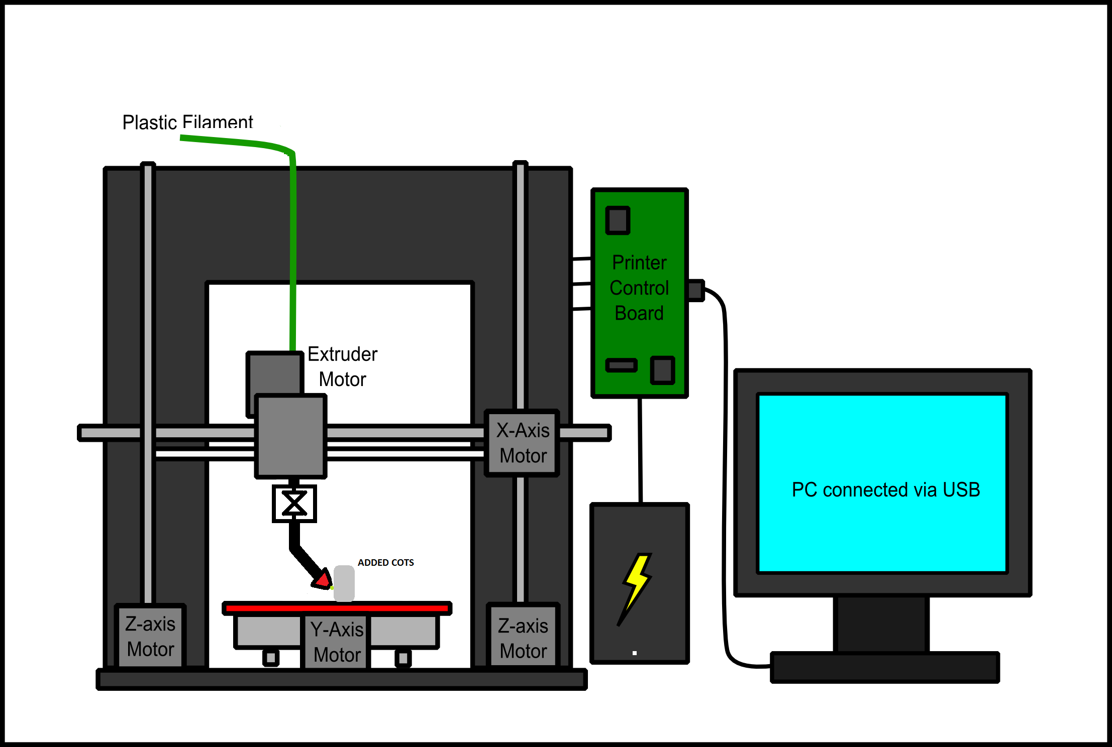
Team f : ADD_IN
Prof. David Bourne
Astha Prasad
Dan Berman
Ihsane Debbache
Nikhil Baheti
4DOF

Slide 2
PROJECT Description
“By adding an additional degree of freedom, ADD_IN proposes to develop a 3D printer that can enclose COTS items, thus rapidly producing strong, useful and low cost parts.”
Notes:
Adding rotation joint to enable:
COTS items – Commercial off the shelf items – Screw inserts, stiffeners, sensors, etc
3D printed parts are low cost, but they are also low quality which limits their usefulness. Our goal is to make strong and useful parts for a similar cost
Strong + Useful – Where traditional 3D printers fail. Parts are good dimensional approximations, but strength limitations prevent widespread use

Slide 3
Standards and regulations: OUTLINE
Description of Standards
Targeted Markets
Standard Prescription
Standards and ADDIN

Slide 4
Standard 1: ASTM F2971-13
“Standard Practice for Reporting Data for Test specimens Prepared by Additive Manufacturing”

Slide 5
Standard 1: ASTM F2971-13
Describes a standard procedure/format for reporting results obtained by testing specimens produced by additive manufacturing.
Purpose:
To establish further data reporting requirements
Provide information to build material property databases
Describes the format for reporting the units of the above mentioned results.

Slide 6
Standard 1: ASTM F2971-13
Need
Intent
Establish minimum requirements for reporting material & process data
Consistently document material and processing history for future use
Different AM processes introduce unique variables
Critical to standardize descriptions used to report data obtained during preparation, processing and post processing of specimens

Slide 7
Standard 1: ASTM F2971-13
Key descriptions:
Material and Process Reporting Requirements
Test and Inspection Reporting Requirements
Template for reporting data

Slide 8
Standard 2: ASTM Jte20150317
“Recommended Protocols for Round Robin Studies in Additive Manufacturing”

Slide 9
Standard 2: ASTM Jte20150317
What is Round-Robin testing?
Experimental methodology to determine reproducibility of a process or test method
Tests are performed independently multiple times
Results are analyzed statistically to assess variability
Aka. Interlaboratory study (ILS)

Slide 10
Standard 2: ASTM Jte20150317
What are the benefits of Round-Robin Testing?
Testing can include multiple participants, spread across locations
Generates large data sets while distributing the cost among participants
Provides Top-Down evaluation
Captures sources of variability in results that may not be visible to only one user

Slide 11
Standard 2: ASTM Jte20150317
Current roadblock hindering widespread adoption of AM:
“Lack of confidence in materials, processes and parts”
Possible solution:
“Generate more high-quality data describing performance of AM processes and parts”

Slide 12
Standard 2: ASTM Jte20150317
Problem with that is..
- AM is rapidly evolving and extremely diverse
End products are complex and highly customized vs standard mass produced high-volume products
Cost of producing hundreds/thousands of test pieces is prohibitively expensive

Slide 13
Standard 2: ASTM Jte20150317
Solution?
Round Robin Testing!
ASTM International Committee on Additive Manufacturing and ISO identified the need for high-level round-robin standards for Additive Manufacturing.
National Institute for Standards and Technology (NIST) organized and participated in several round-robin AM studies
These studies form the basis of the recommended standardized protocols for AM RR.

Slide 14
Standard 2: ASTM Jte20150317
Round Robin Manufacturing plan documents:
Procedures and parameters needed to produce a part (expected to be followed by each participating entity)
Centralized procedures performed by the study coordinator

Slide 15
Standard 2: ASTM Jte20150317
Examples of AM Round Robin Studies

Slide 16
Standard 2: ASTM Jte20150317
AIM: Study nominally identical laser-based powder-bed-fusion machines
Results of a Cobalt Chrome study conducted by NIST
Data collected from all participating labs
Graph shows Stress vs Strain curves for all samples produces by the labs
All testing conducted by one entity

Slide 17
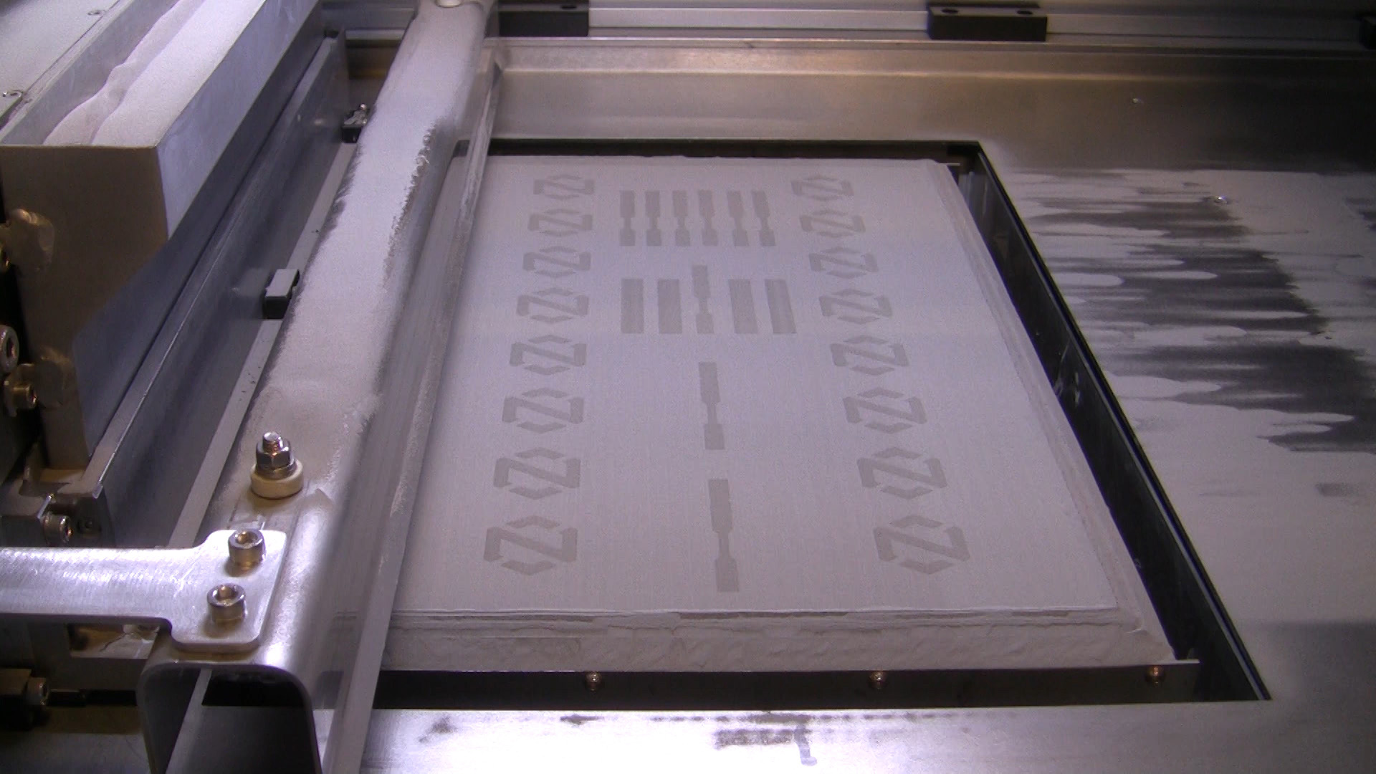
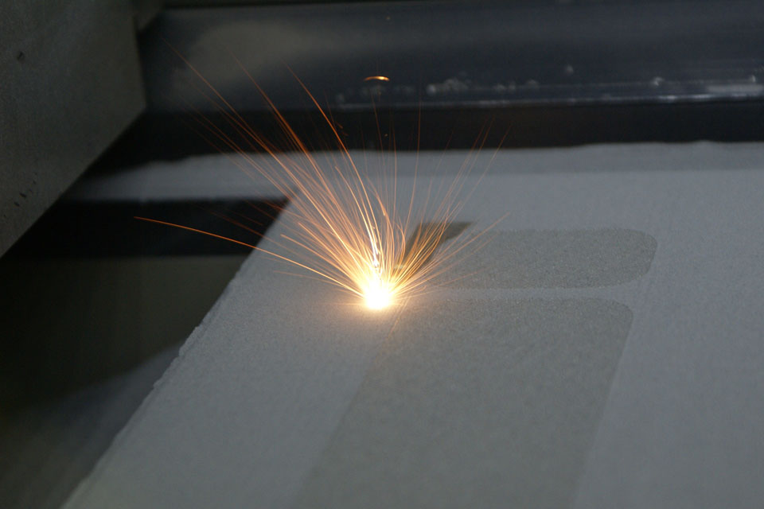
TARGETED MARKETS
Additive manufacturing
Binder Jetting: liquid bonding agent is selectively deposited to join powder materials.
Directed Energy deposition: focused thermal energy is used to fuse materials by melting as they are being deposited.

Slide 18
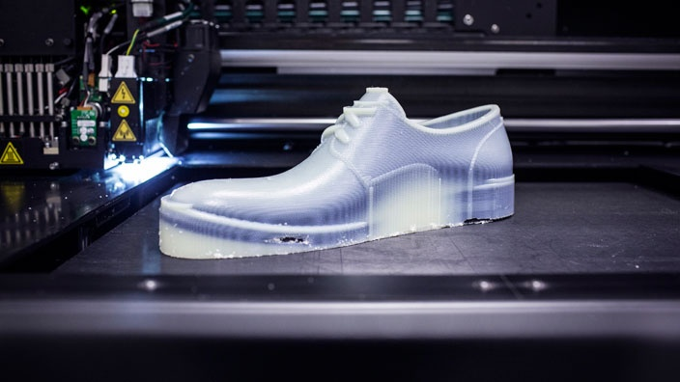
TARGETED MARKETS
Additive manufacturing
Material Extrusion: material is selectively dispensed through a nozzle or orifice.
Material Jetting: droplets of build material are selectively deposited.

Slide 19
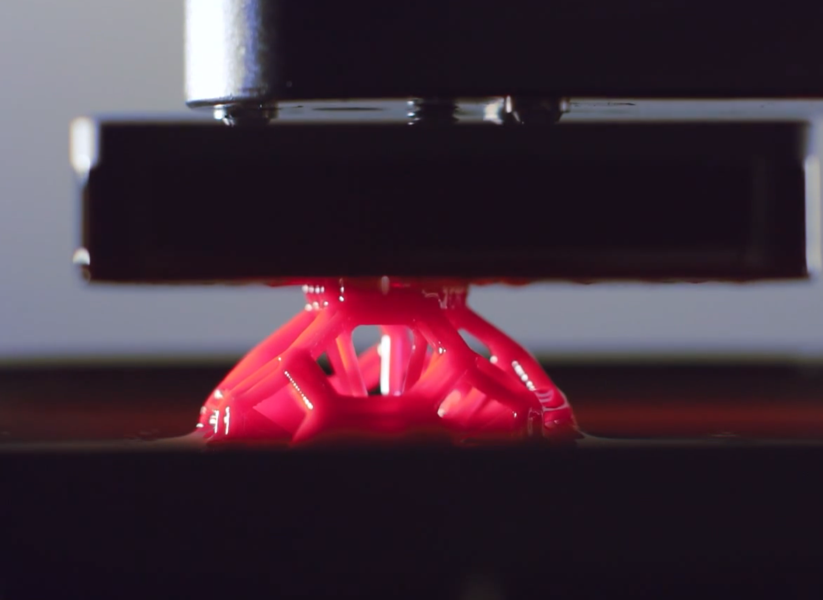
TARGETED MARKETS
Additive manufacturing
Sheet Lamination: sheets of material are bonded to form an object.
Vat Photopolymerization: liquid photopolymer in a vat is selectively cured by light-activated polymerization.

Slide 20
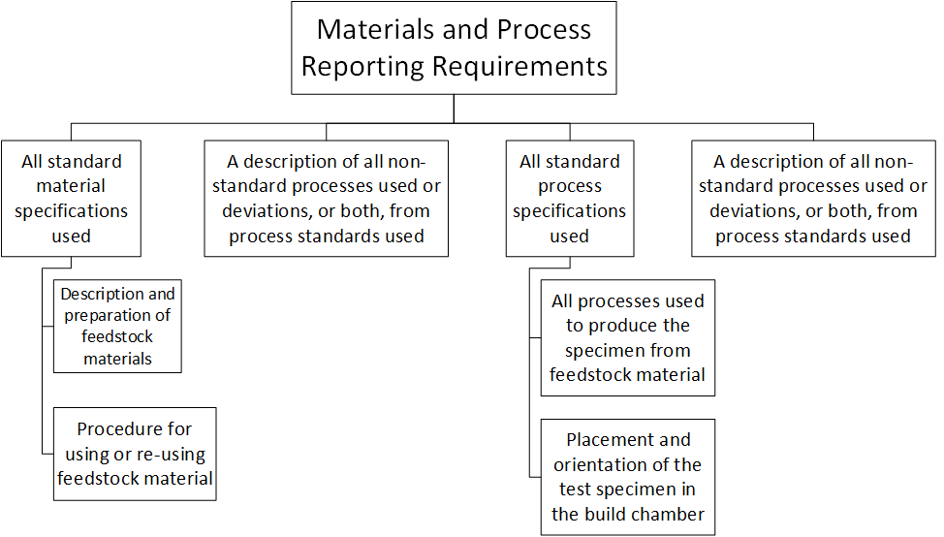
ASTM F2971-13 Prescriptions

Slide 21
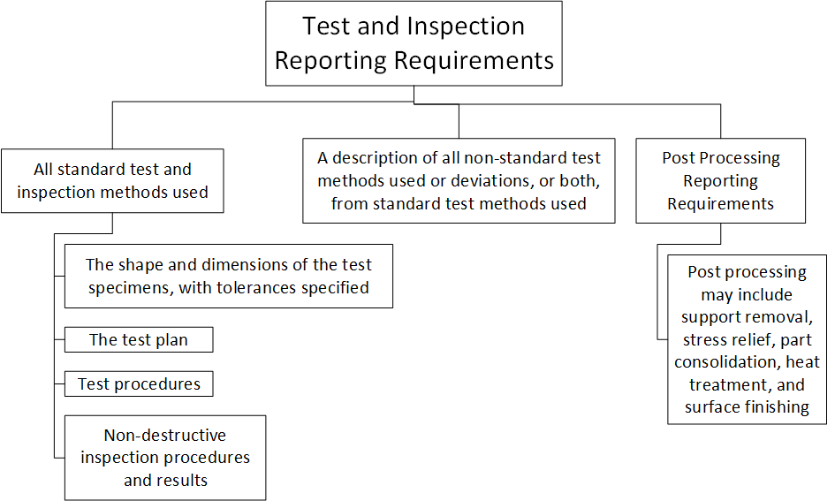
ASTM F2971-13 Prescriptions

Slide 22
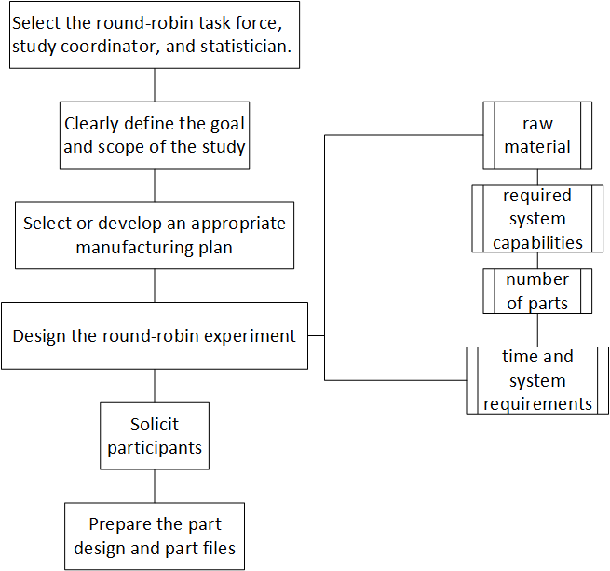
ASTM Jte20150317 Prescriptions

Slide 23
ASTM Jte20150317 Prescriptions

Slide 24
ADDIN AND ASTM JTE20150317, ASTM F2971 − 13
”To improve confidence and encourage proliferation of additive manufacturing (AM) technologies and parts by generating more high-quality data describing the performance of AM processes and parts. “ – ASTM JTE20150317
ADDIN is a new technology focused on improving 3D printing material properties. To gain acceptance reliable material data must be generated

Slide 25
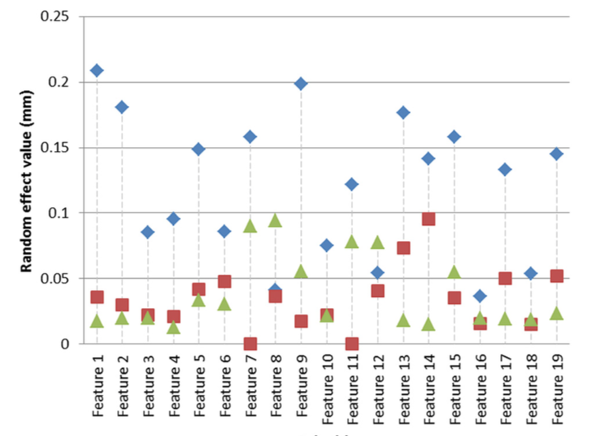
Applying ASTM JTE20150317
Primary Goal: Separate Variability due to
Printer Effects
Build Effects
Measurement Effects
To generate reliable data requires
Different Machines
Different Operators
Manufacturing plan + Process Control Document
Uncontrolled variability will emerge

Slide 26
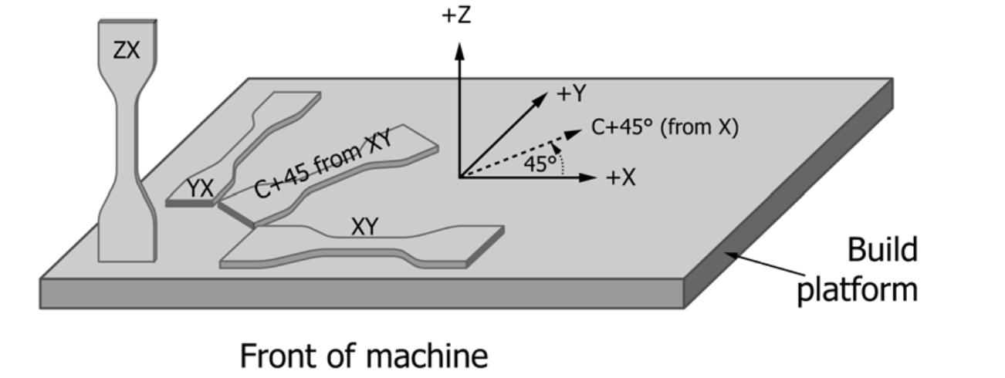
Applying ASTM F2971 − 13
Primary Goal: Develop Effective Reporting Standards
Minimum Required Documents
Material and Handling Specification
Process Specification
Test Plan
Test Process Log
Sample Orientation
Measurement Plan
Measurement Log

Slide 27
ADDIN Material Specs
Material (Print Material + COTS Item)
Supplier
Production Date
Storage Conditions (Temp + Humidity)

Slide 28
ADDIN Process specs
Software Configuration (exportable as .ini file)
ADDIN Hardware Revision
ADDIN Nozzle Configuration (Type, Diameter)

Slide 29
ADDIN Test plan
.stl file for part to be printed
COTS item and installation requirements
Printer setup and initialization (surface leveling, nozzle purge)
Ambient conditions (temp + humidity)

Slide 30
Measurement plan
Make, Model, Calibration of test equipment
Test Fixture and Calibration
Setup instructions
Ambient condition requirements
Time to measurement requirements

Slide 31
THANK YOU! ANY QUESTIONS?

