Slide 1
Standards & Regulations
RoboGraphers
Team G RoboGraphers
Gauri, Tiffany, Rohit, Jimit, Sida
March 23, 2016

Slide 2
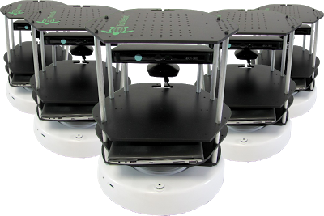
Agenda
RoboGraphers
IEEE 208-1995: IEEE Standard on Video Techniques: Measurement of Resolution of Camera Systems, 1993 Techniques
ISO 13482:2014:
Robots and robotic devices -- Safety requirements for personal care robots

Slide 3
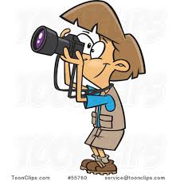
IEEE 208-1995:
Standard on Video Techniques
Measurement of Resolution of Camera System
RoboGraphers

Slide 4
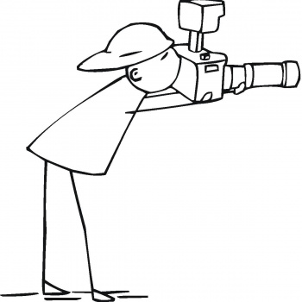
What’s it for: Camera Resolution
RoboGraphers
The methods for measuring the resolution of camera systems are described.

Slide 5
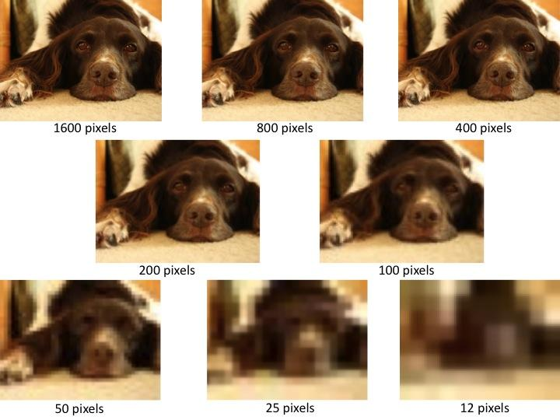
Sad...
RoboGraphers

Slide 6
Applicability
RoboGraphers

Slide 7
Applications
RoboGraphers
For users and manufacturers to quantify the limit where fine detail contained in the original image is no longer reproduced by the camera system.
For laboratory measurements and for proof-of-performance specifications for a camera.

Slide 8
Parameters for Measurement
RoboGraphers
Resolution
Resolution quantifies how close lines can be to each other and still be visibly resolved.

Slide 9
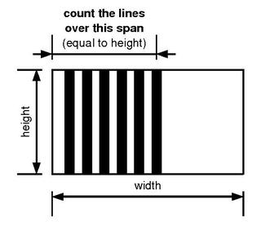
Parameters for Measurement
RoboGraphers
Television Lines
Maximum number of alternating light and dark vertical lines that can be resolved per picture height.

Slide 10
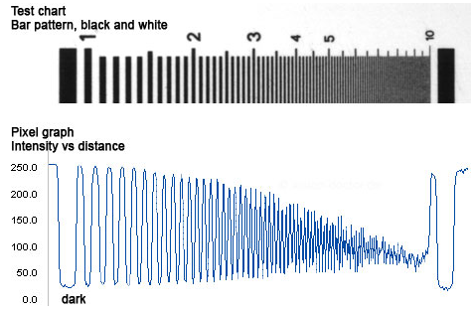
Parameters for Measurement
RoboGraphers
Limiting Resolution
Maximum number of lines per picture height discriminated from a test chart.

Slide 11
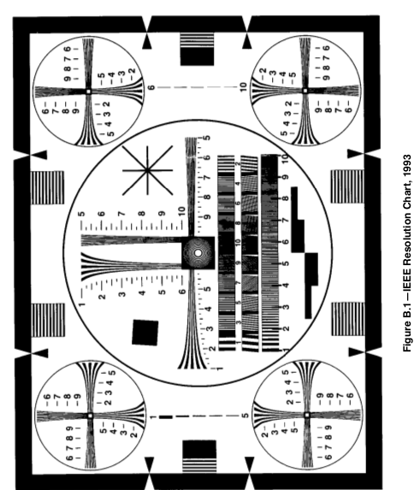
RoboGraphers
Measurement Equipments
Test Chart
IEEE Resolution Chart, 1993
What can be measured: resolution, scanning linearity, aspect ratio, interlacing, shading, streaking, and ringing.

Slide 12
RoboGraphers
Measurement Equipments
Picture Monitor
A monochrome monitor is recommended to measure the resolution of a camera system.

Slide 13
RoboGraphers
Measurement Procedure
Conditions
Scanning and interlace
Shading
Nonlinear video signal processing
Image enhancement
Streaking and ringing
Focus
Light level
Signal component to be measured
Measurement Technique
Measurement of limiting resolution
Measurement of horizontal resolution response of camera systems
Presentation of Data
Quantitative data presentation
Graphical data presentation

Slide 14
Relevance in our system
RoboGraphers

Slide 15
Camera in RoboGraphers!
RoboGraphers
Can’t detect April tag’s exact position
&&
Can’t get person’s face position
&&
Can’t extract person’s facial expression
Upgrading Hardware !

Slide 16
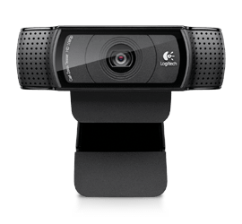
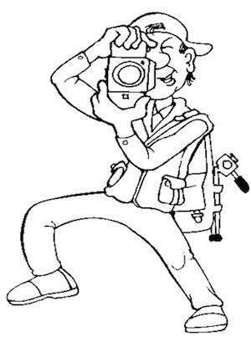
Camera in RoboGraphers!
RoboGraphers
Brand: Logitech C920
Resolution: 1920 x 1080 pixels
Photo Quality: 15MP
Focus Type: 20-step autofocus

Slide 17
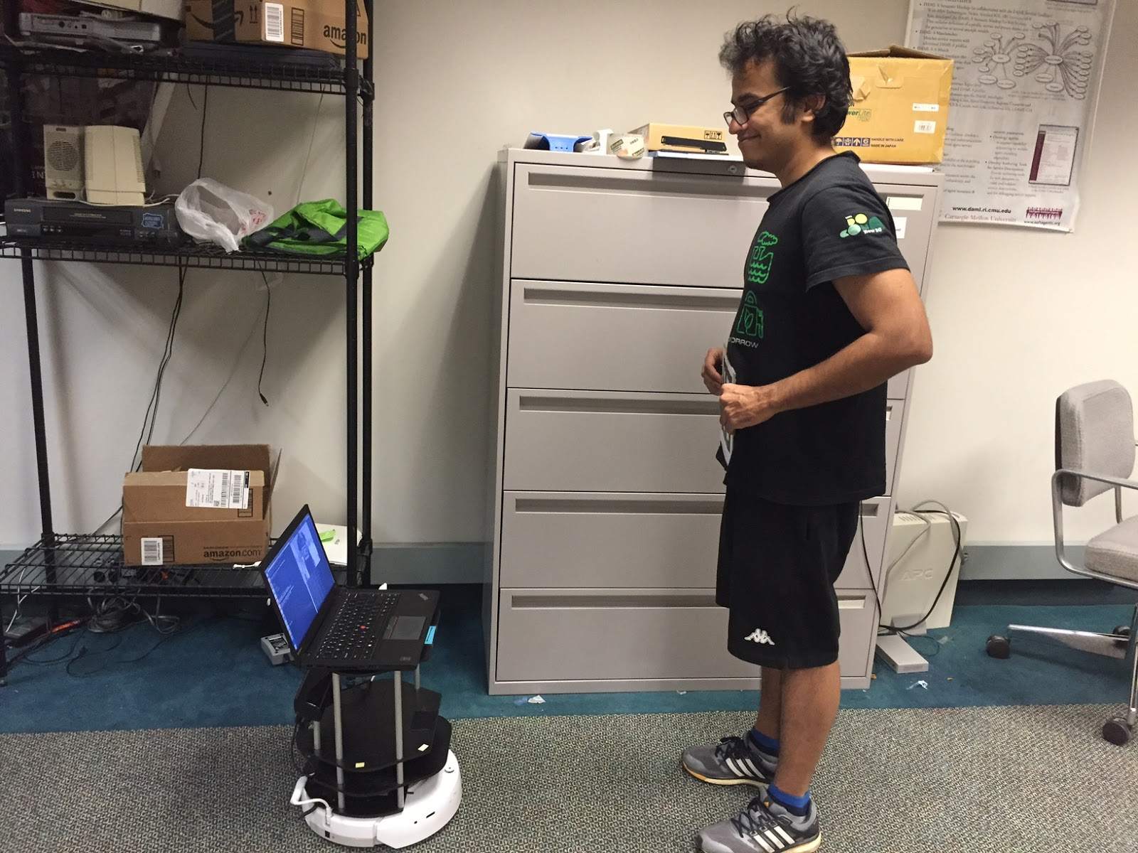
Camera in RoboGraphers!
RoboGraphers

Slide 18
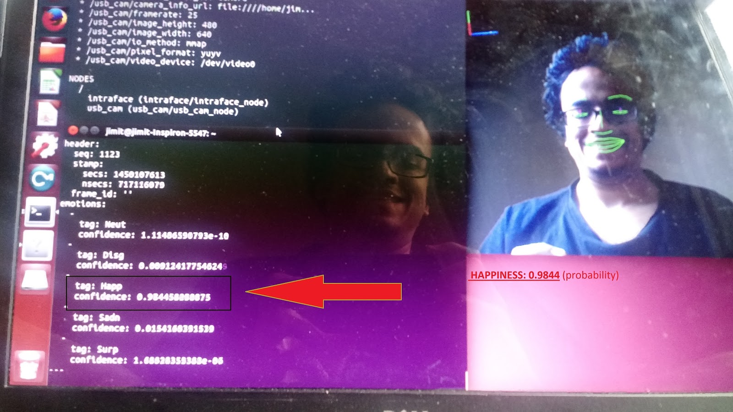
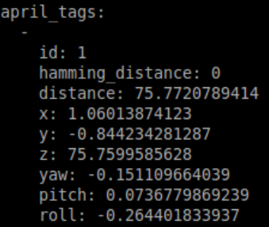
Camera in RoboGraphers!
RoboGraphers

Slide 19
ISO 13482 : 2014:
Robots and robotic devices -- Safety requirements for personal care robots
RoboGraphers

Slide 20
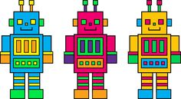
What’s it for: Personal Care Robots
RoboGraphers
ISO 13482:2014 specifies requirements and guidelines for the inherently safe design, protective measures, and information for use of personal care robots.

Slide 21
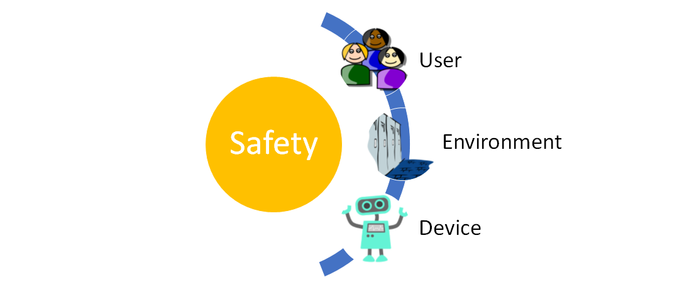
Why do we need this?
RoboGraphers

Slide 22
Applicability
RoboGraphers

Slide 23
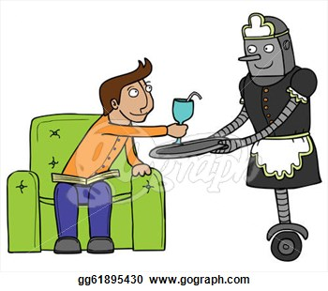
Where is it applicable?
RoboGraphers
The earthbound robots that typically perform tasks to improve the quality of life of intended users, irrespective of age or capability.

Slide 24
Where is it applicable?
RoboGraphers
Mobile servant robot
service robot that performs actions contributing directly towards improvement in the quality of life of humans
Physical assistant robot
personal care robot that is capable of travelling to perform servicing tasks in interaction with humans, such as handling objects or exchanging information
Person carrier robot
personal care robot that physically assists a user to perform required tasks by providing supplementation or augmentation of personal capabilities

Slide 25
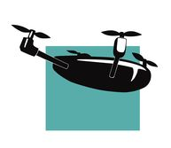
Where is it not?
RoboGraphers
— robots travelling faster than 20 km/h
— robot toys
— water-borne robots and flying robots
— industrial robots
— robots as medical devices
— military or public force application robots

Slide 26
How does our system fit?
RoboGraphers
— Turtlebots travel at speeds less than 20 km/h
— Earth-bound robots
— Mobile photo-clicking service robots for humans
— Physical assistant robots for the photographers
— Performs tasks by exchanging information

Slide 27
Prescriptions
RoboGraphers

Slide 28
Safety Related Parameters for Measurement
RoboGraphers
Safety-related object human, domestic animal, or property to be protected from harm
Safety-related obstacle object, obstacle, or ground condition which can cause harm to robot
Safety-related speed limit upper boundary of speed that a certain point of a personal care robot may reach without creating an unacceptable risk
Safety-related force limit upper boundary of force that a certain point of a personal care robot can exert against a human, or other surrounding objects without creating an unacceptable risk
Safety-related surface condition adverse conditions of travel surface for a mobile personal care robot, eg., slipping, rolling over

Slide 29
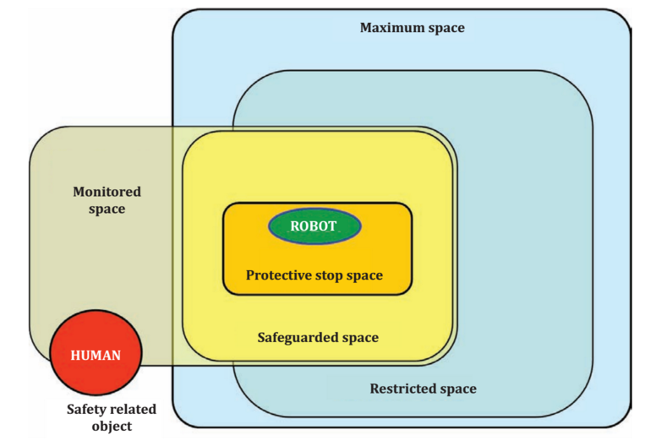
Operational spaces for personal care robots
RoboGraphers

Slide 30
Operational spaces for personal care robots
RoboGraphers
Space in which personal care robot will perform a protective stop if a safety-related object enters it

Slide 31
Operational spaces for personal care robots
RoboGraphers
space in which the personal care robot initiates a safety-related function if a safety-related object is detected within it

Slide 32
Operational spaces for personal care robots
RoboGraphers
space observed by sensors available to the personal care robot in which a safety-related object is detected

Slide 33
Operational spaces for personal care robots
RoboGraphers
volume which can be swept by the moving parts of the robot as defined by the manufacturer, plus the volume which can be swept by manipulators and payloads

Slide 34
Operational spaces for personal care robots
RoboGraphers
portion of the maximum space (3.18.1) confined by limiting devices that establish boundaries which will not be exceeded by the robot

Slide 35
Hazards and Associated Safety Clauses
RoboGraphers
Battery Charging Hazards:
Battery overload
Charging of deeply discharged batteries
Contact with live battery terminals
Battery short-circuit
Safety Clauses:
Charging contacts and plugs shall be designed in a way that accidentally touching live parts is prevented (e.g. caps for plugs and outlets).
Voltage between charging contacts shall conform to appropriate standards.
Battery charging currents shall be chosen to be as low as reasonably practicable.

Slide 36
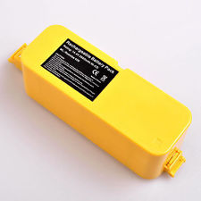
RoboGraphers
Roomba(Create base) batteries follow these standards!

Slide 37
Hazards and Associated Safety Clauses
RoboGraphers
Hazards due to lack of awareness:
Lack of noise/silent operation
Hazardous vibration:
Harmful levels of vibration
Safety Clauses:
Where needed, the personal care robot shall be designed in a way that it has a highly-noticeable appearance, and produces noticeable sound without reaching harmful noise levels.
Minimization of vibration produced by mechanical components in the design of the personal care robot
Selection and use vibration damping materials within the design

Slide 38
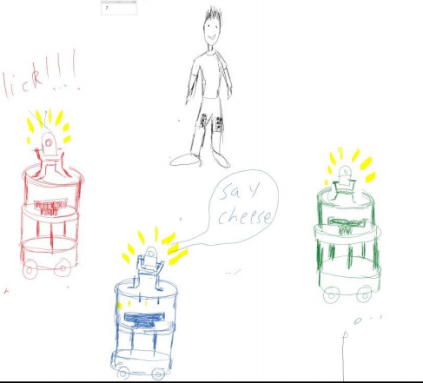
RoboGraphers
We have the voice command feature in our system!

Slide 39
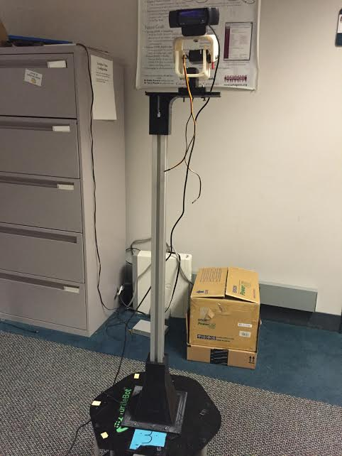
RoboGraphers
The new PTZ unit design in our system takes care of the vibrations!

Slide 40
Hazards and Associated Safety Clauses
RoboGraphers
Collision with safety-related obstacles:
Collision with safety-related objects
Collision with domestic animals
Collision with other robots
Collision with fragile safety related objects
Collision with walls, permanent/ unmovable barriers
Safety Clauses:
Physical limitation of the travel speed of the personal care robot to an inherently safe maximum
Moving parts shall be designed so that acceptable impact energy cannot be exceeded
Use of materials or structures to reduce impact forces to levels that do not cause harm.

Slide 41
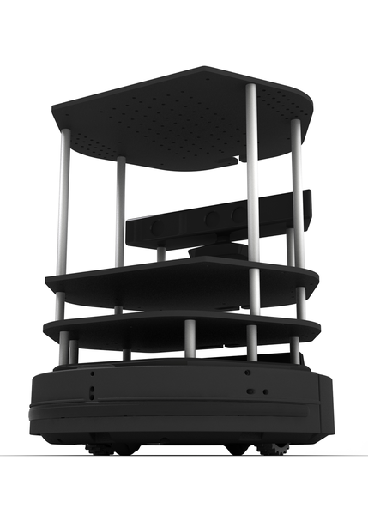
In our system...
RoboGraphers
Maximum speed of robots is 15cm/s
Each turtlebot has an object sensor that stops the robot on collision
Flocking prevents collision of robots
Obstacle Detection and Avoidance is a desirable goal

Slide 42
Thank you!
Questions?
RoboGraphers

