Slide 1
ROBOGRAPHERS
FACIAL EXPRESSION RECOGNITION USING SWARMS
IN-CLASS PRESENTATION #3 Nov, 17 2015
PROJECT STATUS & ACTION
FVE PROGRESS
RISK MITIGATION UPDATES
SPONSORED BY: DR. KATIA SYCARA
TEAM :GAURI GANDHI SIDA WANG TIFFANY MAY JIMIT GANDHI ROHIT DASHRATHI

Slide 2
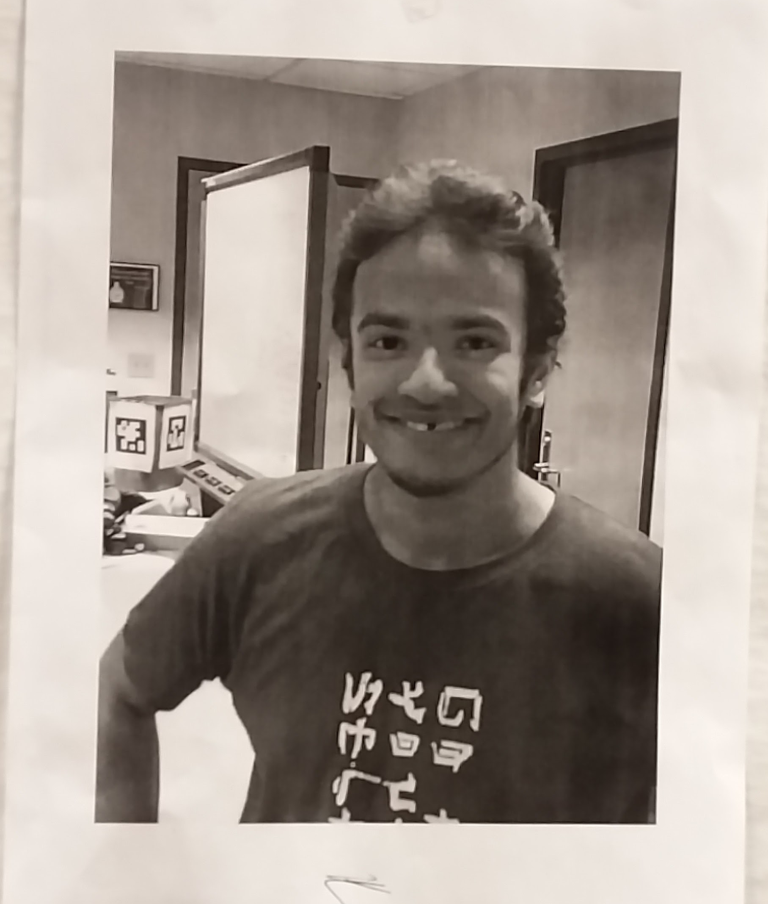

Slide 3
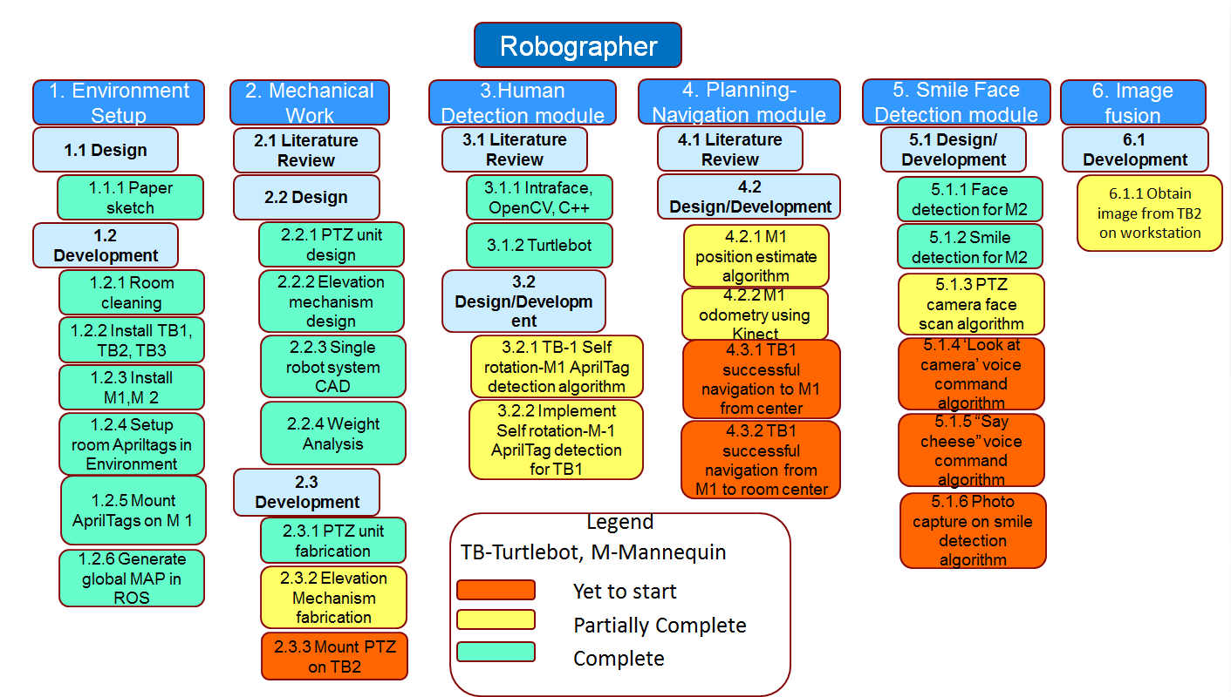
PROJECT STATUS & ACTION

Slide 4
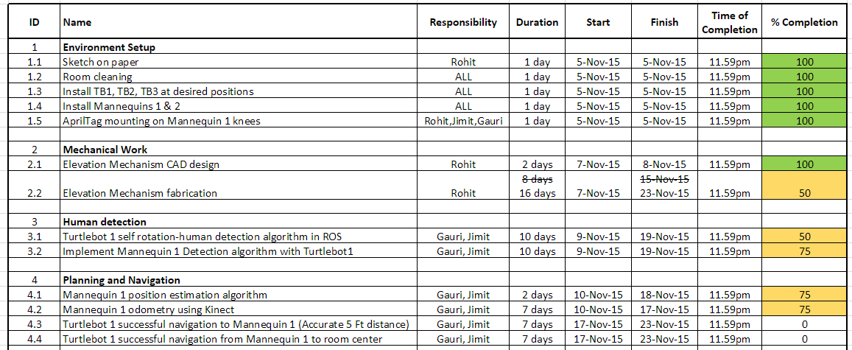
PROJECT STATUS & ACTION

Slide 5
PROJECT STATUS & ACTION

Slide 6
PROJECT STATUS & ACTION
S.No. | Technical Challenges | Proposed Solution | Progress
1. | Communication lag between ROS Master(Netbook) and Workstation(Our Laptop); getting live video stream | Process and Click Image in the master itself; send image to workstation | Working on the code to be run at the master
2. | Issues with the source codes of turtlebot launch files | Using alternate launch files | fixed
3. | April tags not getting detected through Kinect | Use Webcam instead of Kinect | fixed
4. | Issues in using Team Roborn’s repository | Take help from Allard; upgrade version of g++ compiler | fixed

Slide 7
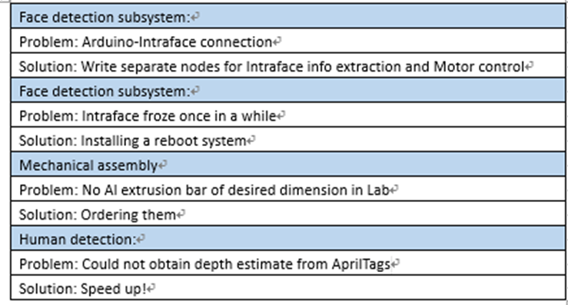
PROJECT STATUS & ACTION
Delays:

Slide 8
FVE Progress
Success-
Detect and track the face which could be used to drive the pan tilt motors in order to position the camera.
Designed a pan tilt unit that can perform pitch and yaw motion according to commands given by the Arduino.
Detected April tags using camera and also obtained the transfer function by which the relative coordinates and relative orientation can be determined.
Able to move turtle bots from location A to location B autonomously.
Determined expression of a person using Intraface on Linux Operating system.
Issues-
Integration of the above tasks into one system.
Face detection works in the beginning but freezes after sometimes.
Unable to form a new tracker once the target is lost
Change of requirements-
Robots in in the system shall:
M.F. 1: Detect Human Figures
M.F.3: Detect Faces At 1s
M.F.4: Detect Facial Features
M.F.9: Detect Obstacles at 10 Cm Minimum Height

Slide 9
Risk Mitigation: Updates
Risk Name | Likelihood | Consequence | Rqt | Mitigation Strategy | Update | Risk Manager | Closing Date
1. Multi Camera reconstruction low robustness. | 4 | 3 | M.F.5 | Install Intraface on each TurtleBot separately and calculate the total probability of the expression | Put forward 2 schemes for multi-camera: 2D and 3D. | Sida | 24 Nov
2. Noisy detection in moving data | 4 | 5 | M.F.3, M.F.4, M.F.3 | Make height adjustment design robust with Base Support | Fixed | Rohit
3. Intraface crash | 4 | 5 | M.F.6 | Get a more stable version of Intraface for the system | Fixed | Sida
4. Calibration during initial setup goes wrong | 4 | 3 | M.F.9 | Recalibrate Turtlebots every 2 weeks Buy new Kobuki Base | a.Fixed b.Processing | Gauri | b. 24. Nov
5. Battery drain of Turtlebots | 5 | 2 | M.N.9 | Request sponsors & new set of batteries | Fixed | Jimit
6. Single robot failure | 3 | 4 | M.F.3, M.F.6, M.F.10 | Make the swarm robust to work without the non-operative robot. b. Ask sponsor & get custody of 2 extra turtlbot | a.Processing b.Fixed | Jimit | a.15th Feb
7. Extra Payload | 2 | 2 | M.F.8 | Improve design | Fixed | Rohit

Slide 10
THANK YOU!

Slide 11
QUESTIONS?

