Slide 1
ROBOGRAPHERS
TEAM G
FACIAL EXPRESSION RECOGNITION USING SWARMS
IN-CLASS PRESENTATION #2
REQUIREMENTS TO BE VERIFIED AT FVE
SIGNIFICANT CHANGES TO ARCHITECTURES
WORK BREAKDOWN STRUCTURE
CRITICAL PATH
TOP RISKS AND MITIGATION STRATEGIES
SPONSORED BY: DR. KATIA SYCARA
TEAM : GAURI GANDHI SIDA WANG TIFFANY MAY JIMIT GANDHI ROHIT DASHRATHI
DATE: OCTOBER 29, 2015

Slide 2
REQUIREMENTS TO BE VERIFIED AT FVE
Detect human figures
Detect facial expression
Avoid obstacles
Localize itself
Localize the human
Drive towards Human
Click photograph

Slide 3
FUNCTIONAL ARCHITECTURE (REVISED)
Map
Coordinates,
Head pose of
Person of Interest
Detect if smiling and click!
Input
Detect a
person of Interest
Move towards
the person
of Interest
Signal
Photograph

Slide 4
Flock as swarm in the room
No
Video frame
# times person been clicked>3?
Yes
Locate person on map
Detect Human
Update location of robots
Plan a collective Strategy of approach
Send signal
Move towards Person of Interest to respective goal points
Video frame
Detect Expression
Smile probability> 0.5
Yes
Click!
Photograph
“Say cheese” if No

Slide 5
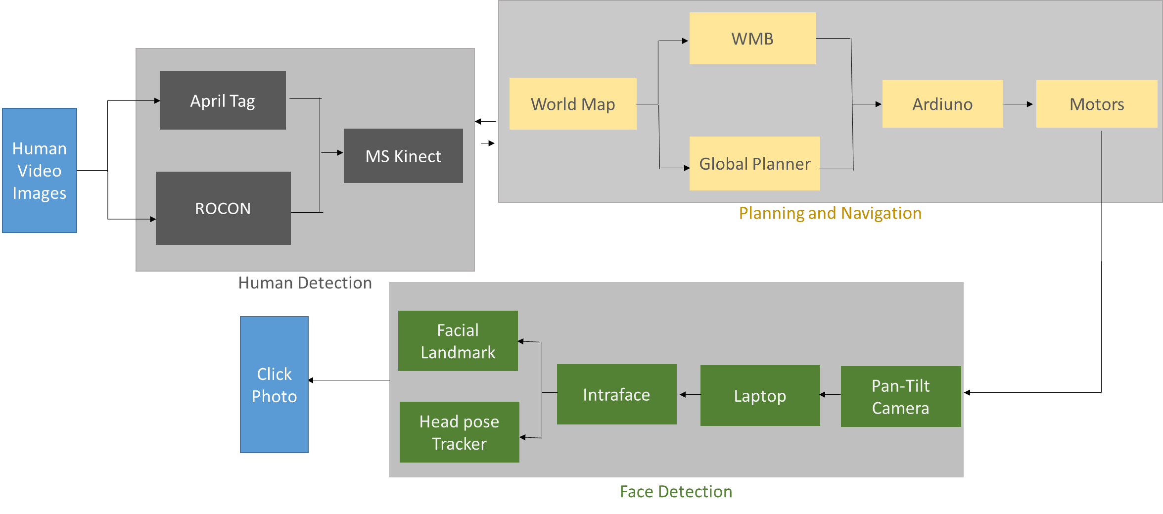
CYBER-PHYSICAL ARCHITECTURE (REVISED)

Slide 6
W0RK BREAKDOWN STRUCTURE
THE ROBOGRAPHER
1
MATERIAL PROCUREMENT
1.1. LITERATURE REVIEW
1.2.2 COLLECTION & COMPILATION
2
MECHANICAL WORK
2.1 LITERATURE REVIEW
2.2.3 ELEVATION ROD DESIGN
3
DETECTION
3.1 LITERATURE REVIEW
3.2.1 TASK SCHEDULE
1.2.3 PARTS LIST VALIDATION
1.2.4 BUDGET PREPARATION
1.3.1 PURCHASE REQUEST
2.2.4 TURTLEBOT CAD DESIGN
2.2.5 SINGLE ROBOT SYSTEM CAD
2.2.6 WEIGHT ANALYSIS
2.3.1 PTZ UNIT FABRICATION
2.3.2 ELEVATION ROD FABRICATION
2.3.3 SINGLE ROBOT ASSEMBLY
3.3.1 INTERFACING CAMERA WITH INTRAFACE
3.3.2 FACE EXPRESSION RECOGNITION USING INTRAFACE AND SINGLE CAMERA
3.3.3 CAPTURE SINGLE SMILING PHOTO
3.3.5 HUMAN DETECTION WITH INTRAFACE
1.2.1 SYS. LEVEL TRADE VALIDATION
1.2 ANALYSIS
1.3 DEVELOPMENT
2.2.1 TASK SCHEDULE
2.2 DESIGN & ANALYSIS
2.3 DEVELOPMENT
3.2 DESIGN AND ANALYSIS
.3.1 .1 INTRAFACE, OPENCV, C++ FAMILIRIZATION
3.2.4 MULTIPLE PHOTO CAPTURE AVOIDANCE ALGORITHM
3.2.3. SINGLE PHOTO CAPTURE ALGORITHM
3.3.4 IMPLEMENT MULTIPLE PHOTO CAPTURE AVOIDANCE
3.3 DEVELOPMENT
1.1.1 MECHANICAL
1.1.2 DETECTION
1.1.3 PLANNING-NAVIGATION
1.1.4 COLLABORATION
2.1.1 PTZ UNIT
2.1.2 TURTLEBOT
4
PLANNING-NAVIGATION
4.1 LITERATURE REVIEW
4.1.1 ROBORN REPOSITORY
4.1.2 ROS FAMILIARIZATION
4.2 DESIGN AND ANALYSIS
4.2.1 TASK SCHEDULE
4.2.3 WORLD MODEL BUILDER ROBORN DESIGN STUDY
4.2.4 GLOBAL PLANNER ROBORN DESIGN STUDY
3.2.2 HUMAN DETECTION WITH INTRAFACE FEASIBILITY
2.2.2 PTZ UNIT DESIGN
4.2.2 LOCALIZATION ROBORN DESIGN STUDY
4.2.5 NAVIGATION ROBORN DESIGN STUDY
4.3 DEVELOPMENT
4.3.1 LOCALIZATION DEVELOPMENT
4.3.2 WORLD MODEL BUILDER DEVELOPMENT
4.3.3 GLOBAL PLANNER DEVELOPMENT
4.3.4 NAVIGATION DEVELOPENT
5 COLLABORATION
5.1 LITERATURE REVIEW
5.2 DESIGN & ANALYSIS
5.2.1 ALGORITHM DESIGN FOR COLLOBORATIVE HEAD POSE FOLLOWING
5.2.2 ALGORITHM DESIGN FOR IMAGE FUSION
5.3.1 FACIAL EXPRESSION RECOGNITION WITH MULTIPLE CAMERAS
5.3 DEVELOPMENT
5.3.2 COLLABORATIVE HEAD POSE TRACKING
5.3.3 OBTAIN FUSED SMILING IMAGE
6
INTEGRATION
6.1 DEVELOPMENT
6.1.1 SINGLE ROBOT MECH ASSEMBLY
6.1.2 SINGLE ROBOT MECH ASSEMBLY + DETECTION INTEGRATION
6.1.3 SINGLE ROBOT MECH ASSEMBLY + DETECTION + PLANNING-NAV INTEGRATION
6.1.4 ALL ROBOT MECH ASSEMBLY + DETECTION INTEGRATION
6.1.5 ALL ROBOT MECH ASSEMBLY + DETECTION + PLANNING NAV. INTEGRATION
6.1.6 ALL ROBOT MECH ASSEMBLY + DETECTION + PLANNING NAV. + COLLABORATION INTEGRATION

Slide 7
CRITICAL PATH
Procure Parts
3D CAD Model of PTZ Unit+Turtlebot Assembly
Design Single PTZ unit
Detect human within a specified range(using apriltag)
Interface webcam with intraface
Begin
Assemble PTZ unit on Turtlebot
Design 4 more PTZ units
Assemble PTZ units on all turtlebots
Detect and recognize facial expressions using intraface
Combine inputs from multiple cameras
Estimate smile percentage collaboratively
Detect head pose
Caliberate Wheel/IMU odometry
Absolute April Tag localization on single robot
Design World Model Builder
Exploration by single robot and swarm system
Move towards person of interest
Follow head pose collaboratively
Set-up ROCON
Implement flocking algorithm
Integrate
Click Photo
End
MECHANICAL ASSEMBLY
DETECTION
PLANNING AND NAVIGATION
COLLABORATION

Slide 8
RISK MITIGATION
1. Problem: ROS deployment and familiarization in a limited time
Reason: no one in our team used ROS before. And Turtlebots requires ROS Hydro with Ubuntu 12.04 to make it work.
Solution: work and learn at the same time start from now! Start to use Ubuntu
12.04 with ROS Hydro.
2. Problem: Precise Algorithms for Facial Expression Recognition by Multi-­Camera.
Reason: There is limited paper related to this field
Solution: Fernando has published several paper in this field, and we will ask their
students in his laboratory for help.
3. Problem: Robustness of multi­robot system: if one robot crashes, we hope to guarantee other robots can still work.
Reason: Robots are connected with each other, and it will be hard if any one fails
Solution: Build robust system of multi­robots.

Slide 9
QUESTIONS?

Slide 10
THANK YOU!

