Slide 1
Auto-Park for Social Robots
By Team Daedalus

Slide 2
Requirements for FVE
Functional
Performance
Receive commands from user via smartphone app
Share data with other cars
Sense the environment (static obstacles)
Navigate through parking lot
Establish communication with other vehicles within 30 seconds
Be able to handle collaboration between 2-3 vehicles
Detect obstacles within 20 cm of vehicle
Obstacles are 1-50 cm high and 2-120 cm wide
Return to exit within 90 seconds of receiving ‘Return’ command when no obstacles are encountered
Non-Functional
Communicate reliably between local vehicles
Network of cars is scalable
Make minimal changes to infrastructure
Be within $4000 budget

Slide 3
Functional Architecture

Slide 4
Park
Preloaded Map
“Park”
Command
from User
Navigate to Entry Queue
Car Localizes Itself
Query Other Cars
For Lot Status
Select Best Spot
Plan Path to Best Spot
“Return”
Command
from User
Navigate to Spot
Return
Obstacle Detected?
Yes
Navigate to Exit
Plan Route to Exit
Park in Spot
No
No
Obstacle Detected?
Exit Queue
Reached?
Reached Spot?
Yes
No
Yes
No
Yes
SENSE
PLAN COLLABORATIVELY
“Car Returned” Notification to User
ACT

Slide 5
Cyber-Physical Architecture – Original
Updated
Sensing/Control Subsystem
Single Board Computer
Actuator Control Board
Sensor Control Board
Sensors
Control Subsystem
Single Board Computer
Actuator Control Board
Communications Subsystem
Bluetooth Link
Car Radio
Switch
Communications Subsystem
Bluetooth Link
DigiMesh Adapter
MOBILE PLATFORM
MOBILE PLATFORM
Software Subsystem
Localization
Path Planning
Software Subsystem
Localization
Path Planning
System State Estimation
Power Subsystem
Power Source
Voltage Regulators
Sensing Subsystem
Cameras (KINECT)
SHARP IR Sensor

Slide 6
Mobile Platform 1
LIDAR
Smart Phone
Bluetooth Module
Single Board Computer
Sensor Control Board
Proximity
Sensor
Camera
Switch
Comm. Radio
Actuator Control Board
VOLTAGE REGULATOR
POWER SOURCE
Actuators
Mobile Platform 2
Mobile Platform 3

Slide 7
MOBILE PLATFORM 1
SMART PHONE
Bluetooth 4.0
BLUETOOTH MODULE
ODROID XU4
(SBC)
KINECT
DigiMesh ADAPTER
ARDUINO MEGA
SHARP IR
12V
5V
MOTOR DRIVERS
VOLTAGE REGULATOR
POWER DISTRIBUTION BOARD
VOLTAGE REGULATOR
LI-PO Battery
ENCODER
FEEDBACK
MOTORS
Communication
Communication
Control
Control
MOBILE PLATFORM 2
MOBILE PLATFORM 3
Sensing
Data
Actuation
Power
User Interface

Slide 8
Work Breakdown Structure
APfSR
P2P Com.
App
Sensing and Perception
Literature Study
Subsystem Integration
Bluetooth
Algorithm
GUI
Phone ↔ Laptop
Phone ↔ ROS
Mobile Platforms
Literature Study
Hardware
Hardware
Network
Acquire
Set-Up
Test
Design
Functions
Test
Test
Literature Study
MP & S+P
Test
Select
Implement
Acquire
Set-Up
Test
Test
Acquire
Set-Up
Test
MP & P2P
Set-Up
ROS Integration
Test
MP & App
Validate
Validate
Validate
Validate
Validate

Slide 9
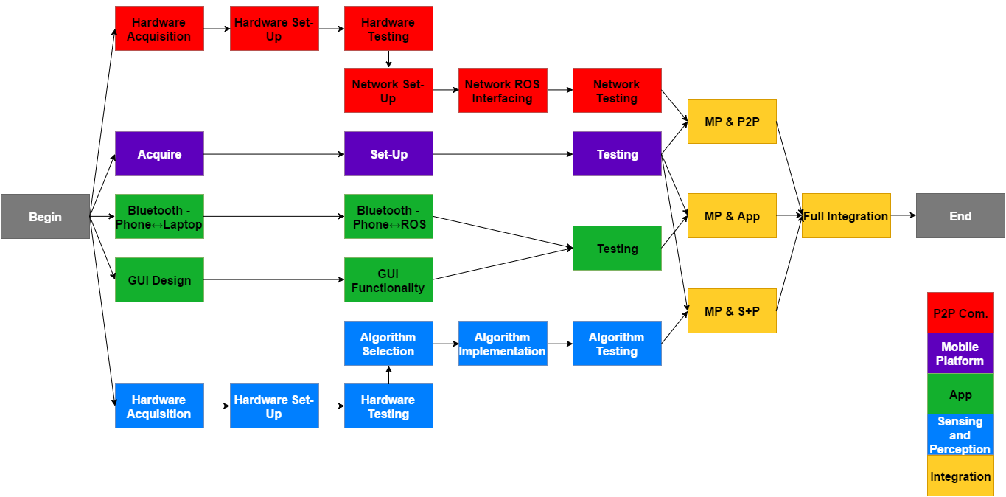
Critical Path

Slide 10
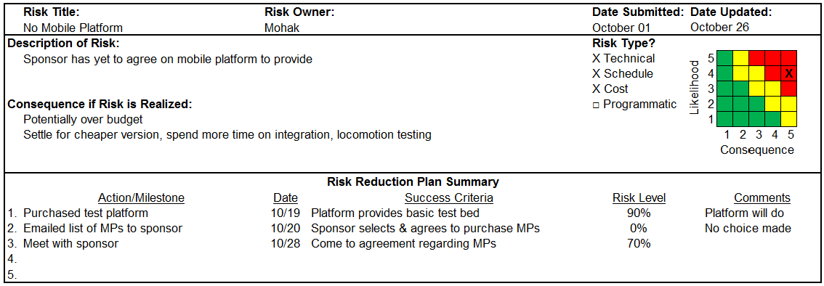
Risks

Slide 11
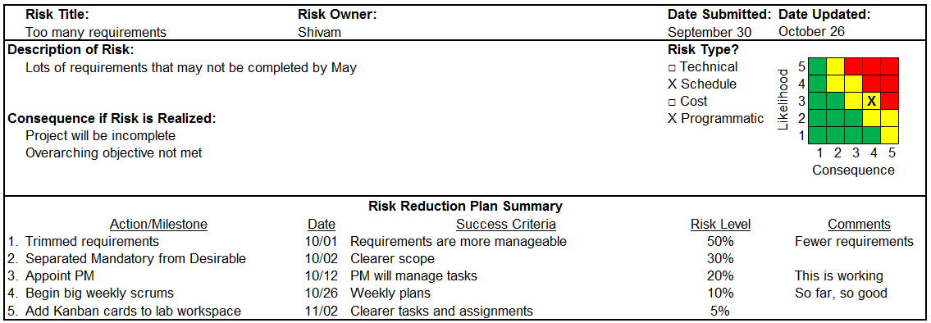
Risks

Slide 12
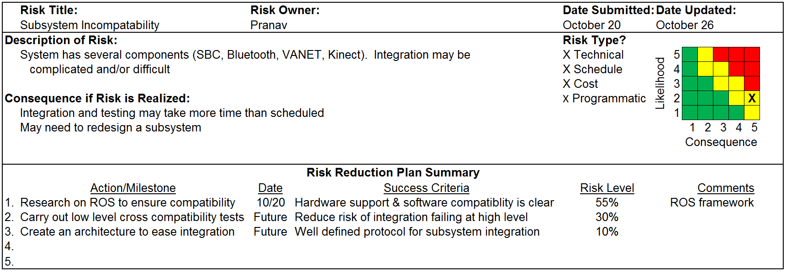
Risks

Slide 13
Thank you!
Questions?

