Slide 1
Auto-Park for Social Robots
By Team Daedalus

Slide 2
Outline
Work Breakdown Structure
Status
Schedule
Unforeseen Challenges
FVE Progress
Risk Management

Slide 3
Work Breakdown Structure
APfSR
P2P Com.
App
Sensing and Perception
Literature Study
Subsystem Integration
Bluetooth
Algorithm
GUI
Phone ↔ Laptop
Phone ↔ ROS
Mobile Platforms
Literature Study
Hardware
Hardware
Network
Acquire
Assemble and Mount
Power and Actuation
Design
Functions
Test
Test
Literature Study
SBC & Arduino Mega
Test
Acquire
Test
Test
Acquire
Send Serial Commands
Test
SBC and Comm.
Define Serial Protocol
Configure XBees
Test
MP & Subsystems
Validate
Interface Arduino w/Sensors
Odroid XU4 w/Kinect
Emergency Node
Kinect Obstacle Detection
Project Management
Test 1D Locomotion
Test
Validate
Validate
Validate
Validate

Slide 4
Current System Status
Auto Park for Social Robots
Mobile Platform
Navigation and Control
Sensing and Perception
Android App
Development
Communication
System

Slide 5
ROS Framework
Mobile App Node
Collaboration Node (Send/Receive Data between SBCs)
Data Analysis Node (Parsing Received Occupancy Map)
Decision Unit
Obstacle Detection Node (Kinect)
Emergency Node (IR-Arduino Nano)
Locomotion Node (Control Oculus Prime)

Slide 6
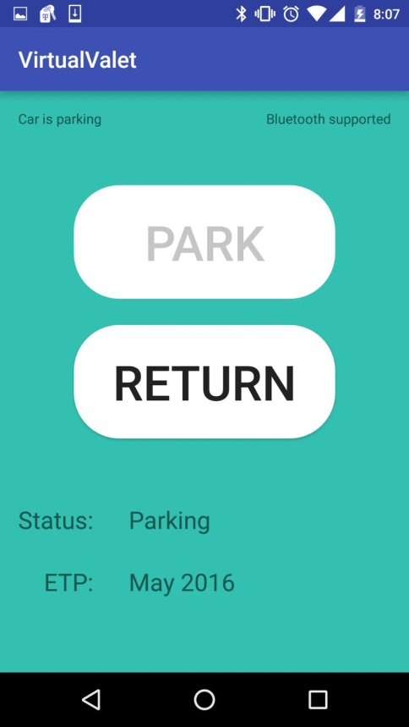
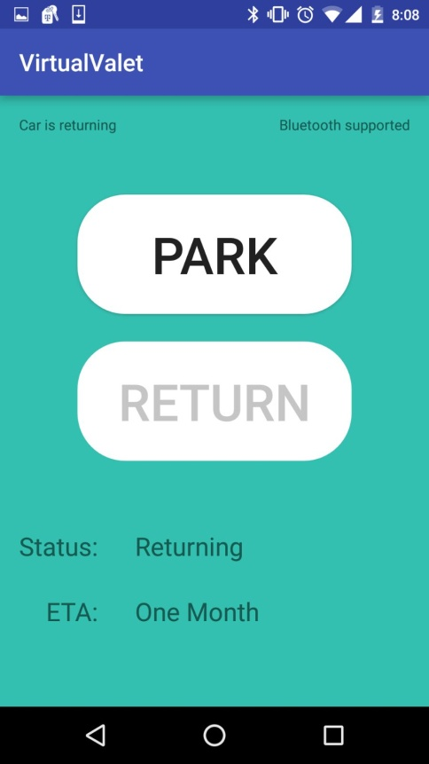
Android App Development
Application GUI
Send Serial Messages
Android Application GUI

Slide 7
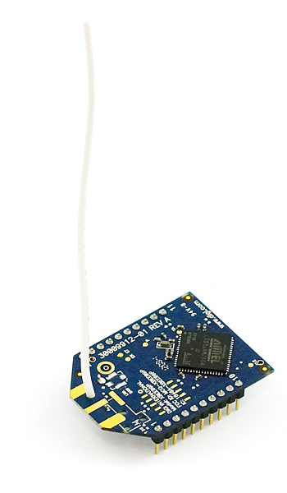
Communication System
Literature Survey
Hardware Procurement
Preliminary Testing
Create ROS Collaboration Node

Slide 8
Communication Architecture
ODroid XU4
Antenna Transmit Power 50mW
XBee Pro 900
Bluetooth 4.0
Freq : 902 - 928 Mhz
Indoor Range: 450 ft
Data Rate: 156.25 kbps Topology : Mesh
Smartphone
ODroid XU4
XBee Pro 900
XBee Pro 900
ODroid XU4

Slide 9
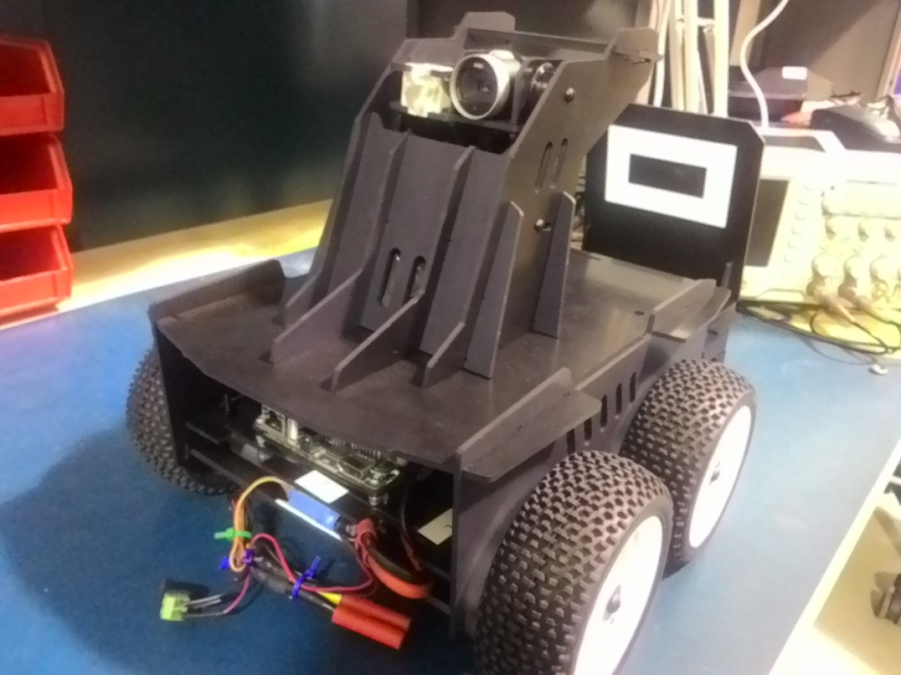
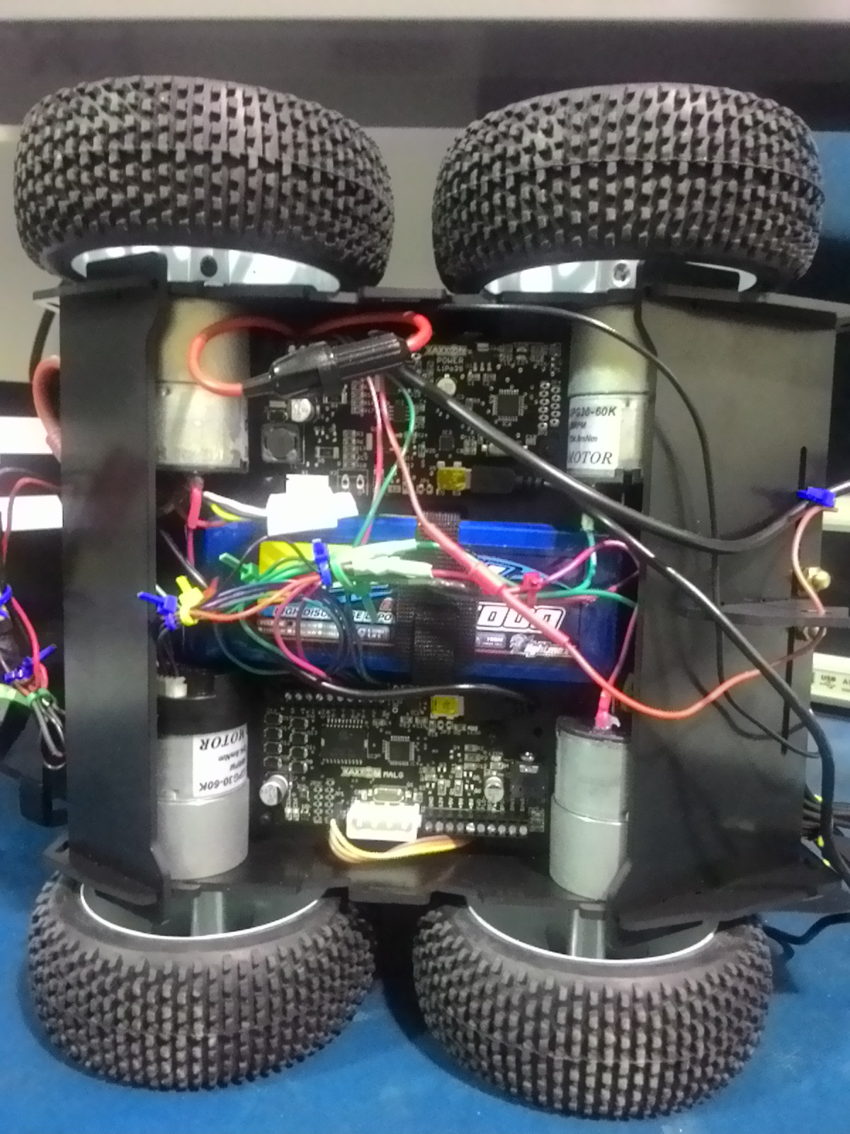
Mobile Platform
Literature Survey
Assembled Mobile Platform

Slide 10
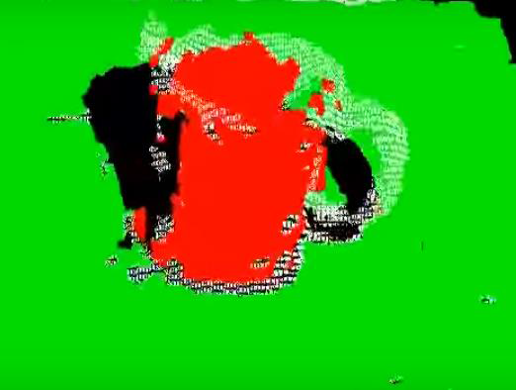
Sensing and Perception
Literature Survey
Kinect Libraries Installation
Obstacle Definition
IR Close Range Obstacle Detection
Kinect Obstacle Detection

Slide 11
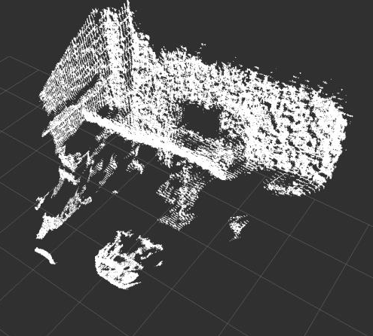
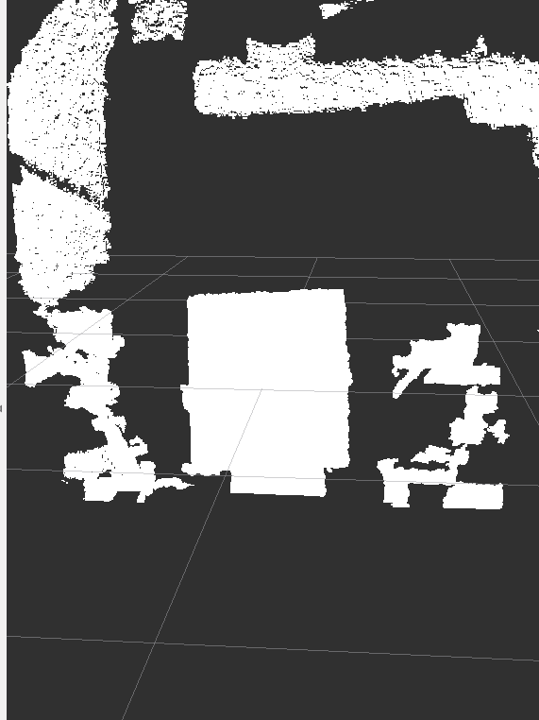
Dense Point Cloud Data of a Board
Unfiltered and Dense Point Cloud Data
Point Cloud of a Person Holding Cup
Down-Sampled Point Cloud of a Board

Slide 12
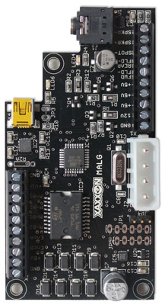
Navigation and Control
Literature Survey
MALG-PCB Software Familiarization
Locomotion Arduino Node
MALG PCB

Slide 13
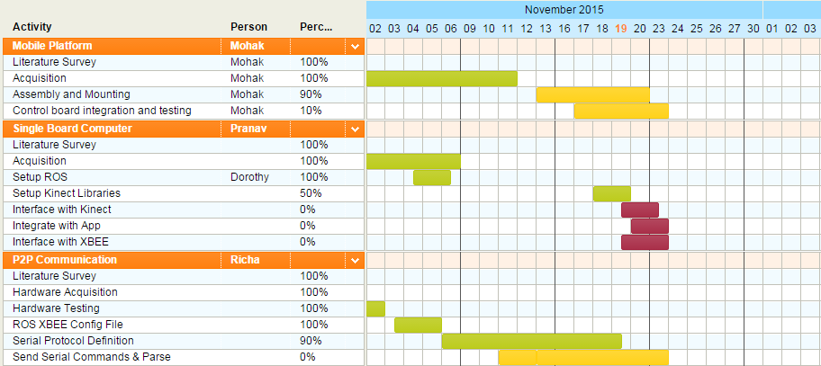
Schedule

Slide 14
Schedule

Slide 15
Unforeseen Challenges
Bumps | Technical Challenge | Delay | Lack of Progress
32-64 bit package compatibility | √ | √
SBC Setup |  | √
Setting up Kinect | √ |  | √
Mobile Platform Shipment |  | √
PCB – PDB vs. IR |  | √ | √

Slide 16
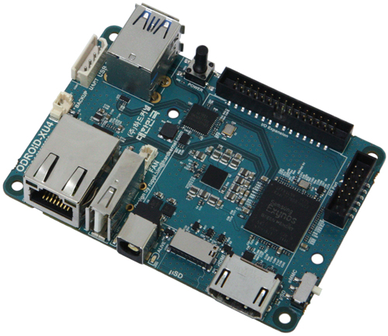
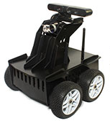
It’s not you, it’s me.

Slide 17
Fall Demo 1
LED Control
Android Application
Bluetooth
SBC
Serial
Arduino
Park/ Unpark
Status
ETP/ ETA
Start/Stop
Motion Control
Position Feedback
Motor Control + Encoder Feedback

Slide 18
Fall Demo 1
Task | Success Criteria | Requirements Validated | Progress
“Park” command sent to the mobile platform using the Android app | LED blinks to indicate command received | MF.1 | Command sent to laptop via Bluetooth
Vehicle begins locomotion upon receiving the command | Vehicle moves forward and turns as required to reach destination | MF.10 | Command received and interpreted
“Return” command sent to the mobile platform via the Android app | Vehicle moves forward, backward, and turns to reach destination | MF.1, MF.10 | Command sent to laptop via Bluetooth

Slide 19
Fall Demo 2
SBC
LED Control
Sends Request
Direction
Android Application
Bluetooth
SBC
Serial
Arduino
Park/ Unpark
Status
ETP/ ETA
Start/Stop
Motion Control
Position Feedback
IR - Arduino Nano
Kinect
Motor Control + Encoder Feedback
Obstacle Detection

Slide 20
Fall Demo 2
Task | Success Criteria | Requirements Validated | Progress
“Park” command sent to the mobile platform using the Android app | LED blinks to indicate command received | MF.1 | Command sent to laptop via Bluetooth
Navigation direction set from second SBC | Platform receives destination | MF.2, MN.2, DN.1, MN.5 | XBees share data between laptops XBees can join and drop No changes to infrastructure
Platform begins locomotion upon receiving the command | Vehicle moves forward and turns as required to reach destination | MF.10 | Serial Protocol defined
While navigating to the spot, the vehicle will detect an obstacle and stop within a safe distance of the obstacle | Vehicle does not collide with obstacle | MF.8, MN.6 | IR works Working on Kinect

Slide 21
Risk Management
ID | Description | Owner | Area of Impact | Mitigation Plan | Status
1 | No Mobile Platform | Mohak | Technical Schedule Cost | Purchase test platform Email list of MPs to sponsor Meet with Sponsor | Resolved
2 | Inadequate Mobile Platform | Shivam | Technical | Review platform needs Only select adequate platform | In Progress
3 | Unsuitable Smartphone Interface | Dorothy | Technical Programmatic | Frequent and extensive testing | Open
4 | Subsystem Incompatibility | Pranav | Technical Schedule Cost Programmatic | Research on ROS to ensure compatibility Software architecture to ease integration Carry out low level cross compatibility tests | In Progress

Slide 22
Risk Management
ID | Description | Owner | Area of Impact | Mitigation Plan | Status
5 | Too Many Requirements | Shivam | Schedule Programmatic | Trimmed requirements Separated mandatory from desirable Appointed PM Begin big weekly scrums Created Kanban cards | Resolved
6 | Inaccurate Parking Lot and Obstacles | Richa | Programmatic | Analyze parking lots IRL Scale to match mobile platform | Open
7 | ROS Framework | Pranav | Technical | Arduino/ROS testing Android/ROS testing ROS-ROS serial communication | In Progress
8 | SBC and Platform Incompatibility | Mohak | Technical Schedule Cost Programmatic | Test SBCs from inventory Contact manufacturer Order new, compatible SBCs Work-around with 32-bit SBCs | In Progress

Slide 23
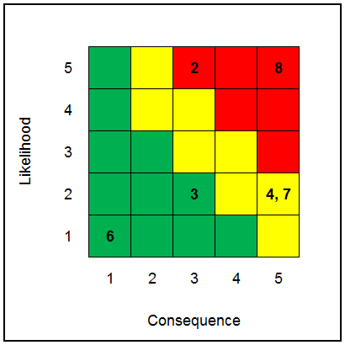
Risk Management

Slide 24
Thank you!
Questions?

