Slide 1
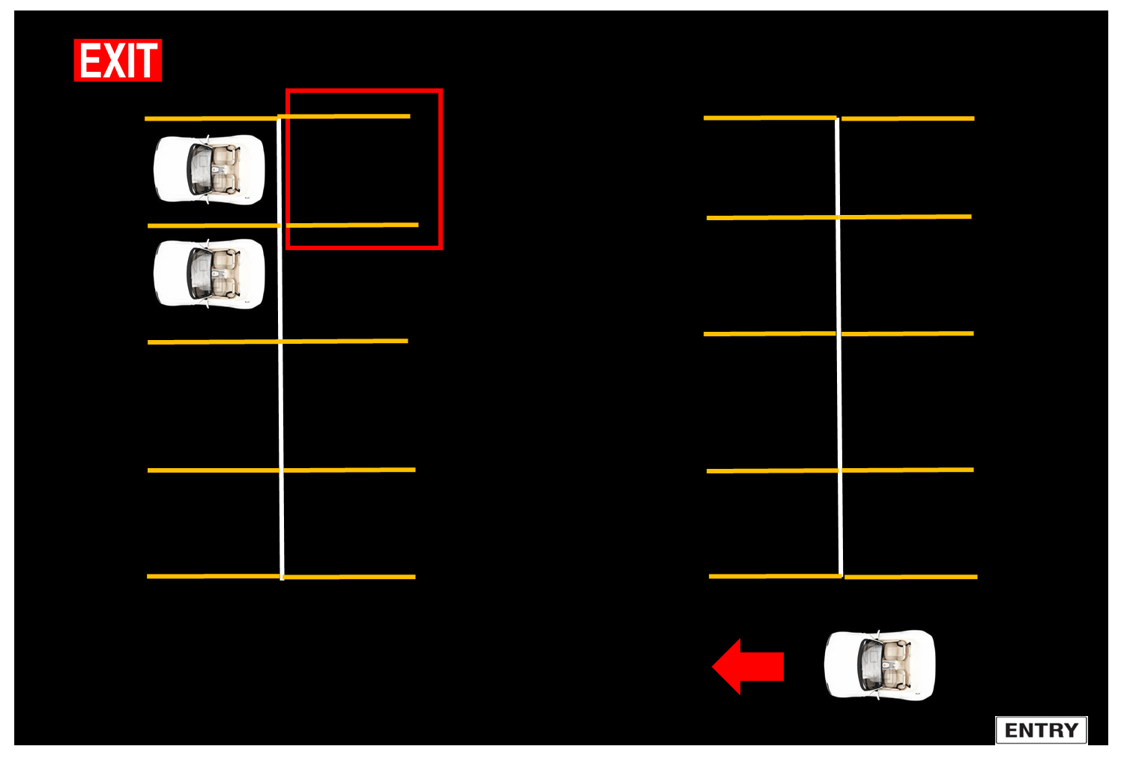
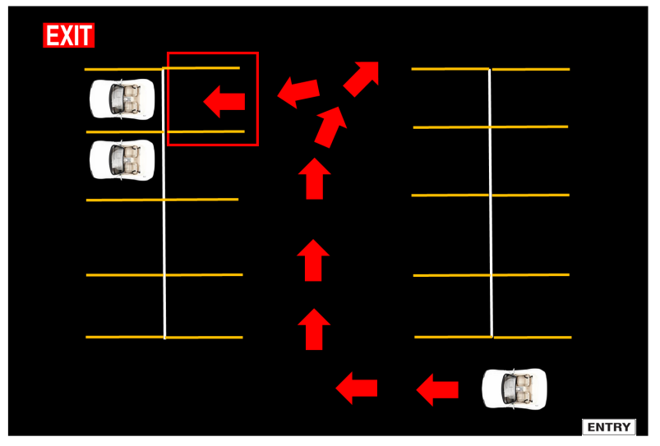
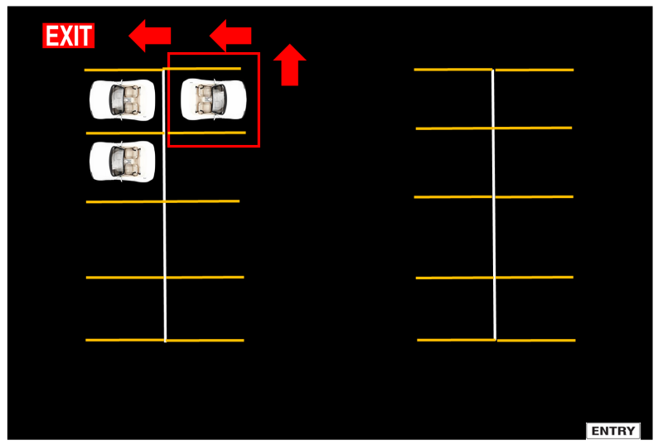
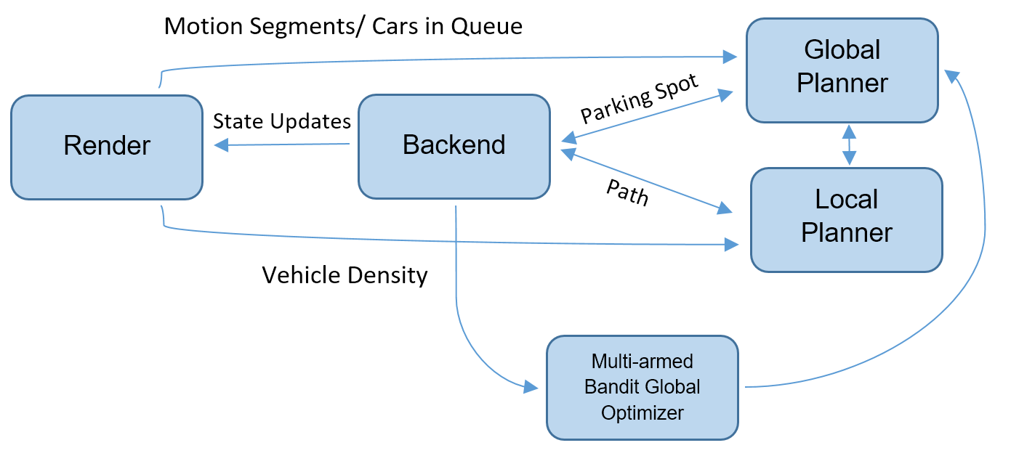
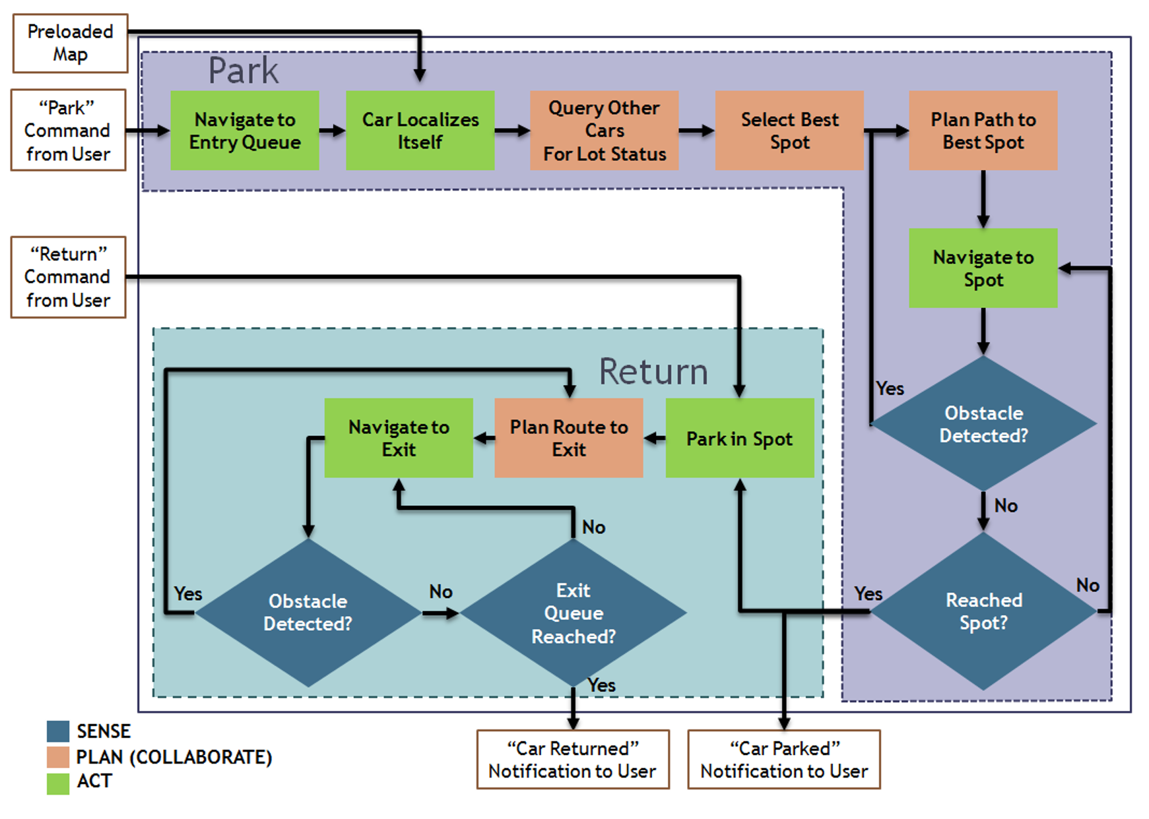
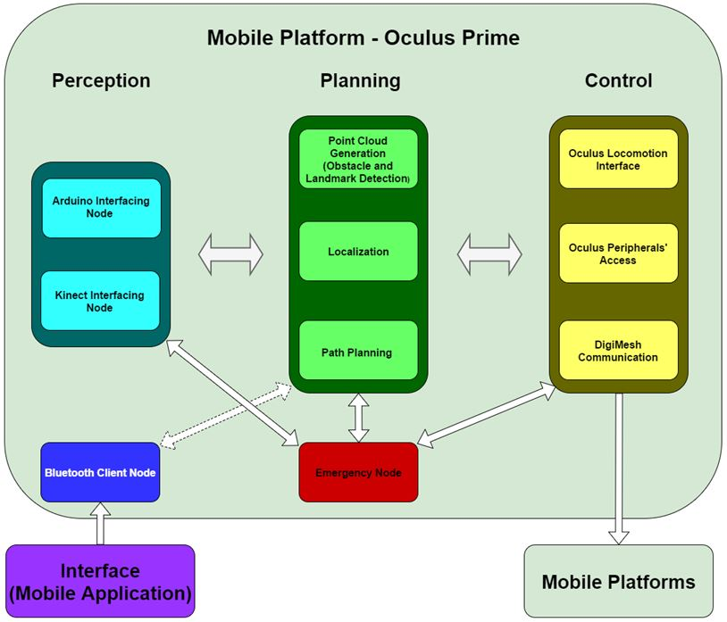
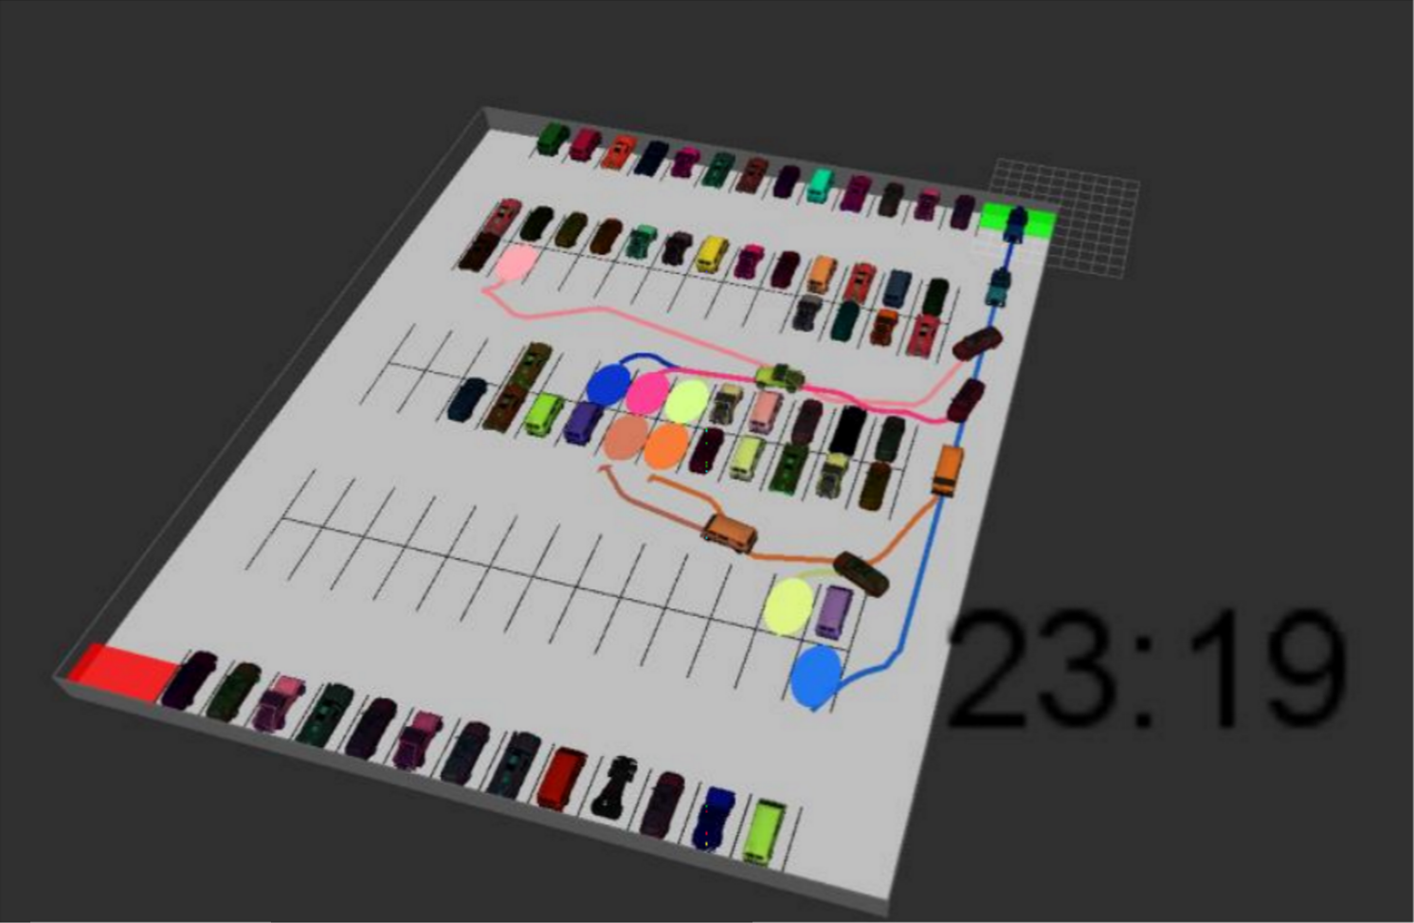
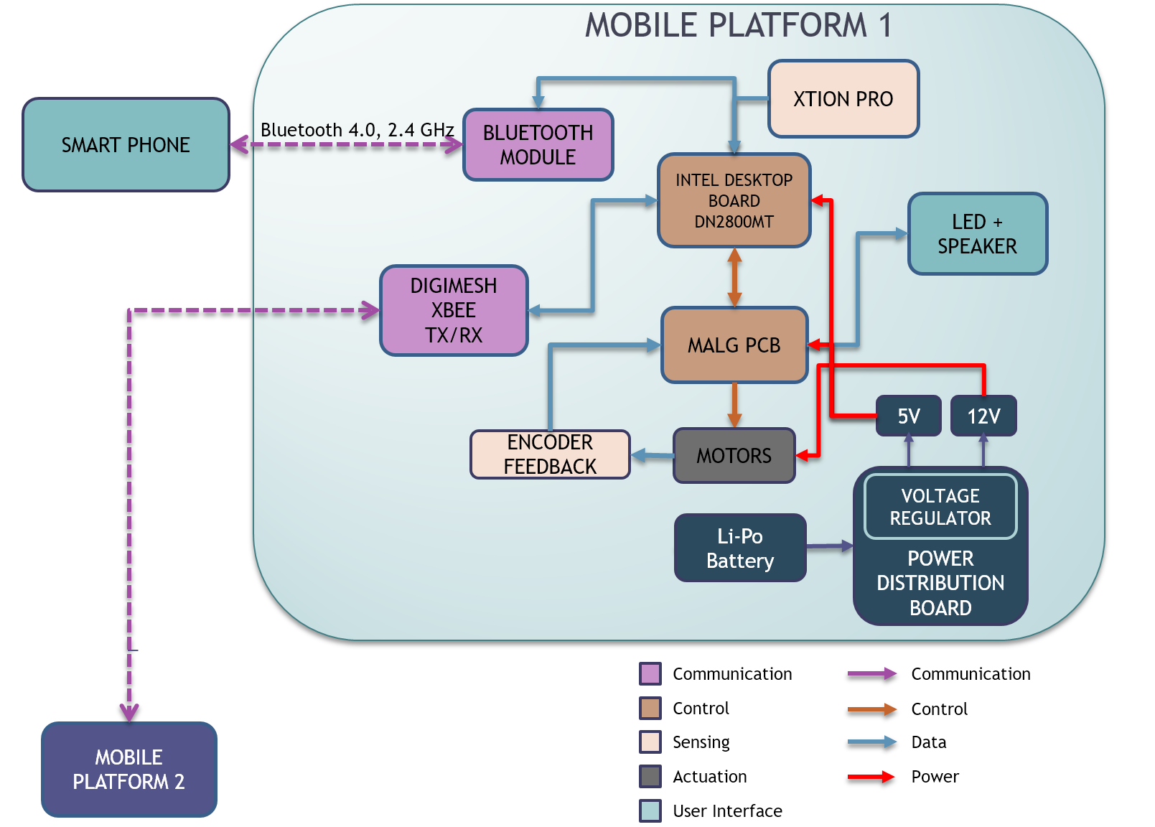
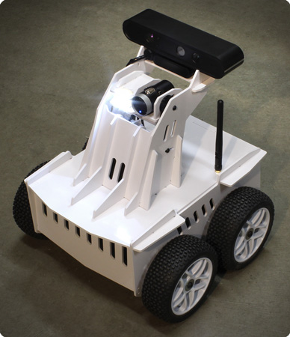
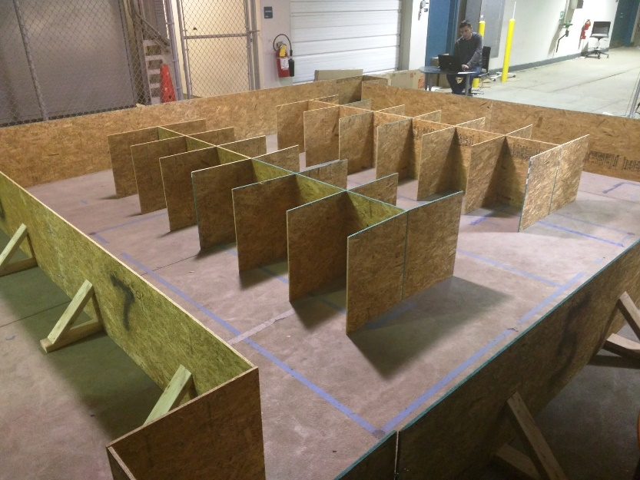
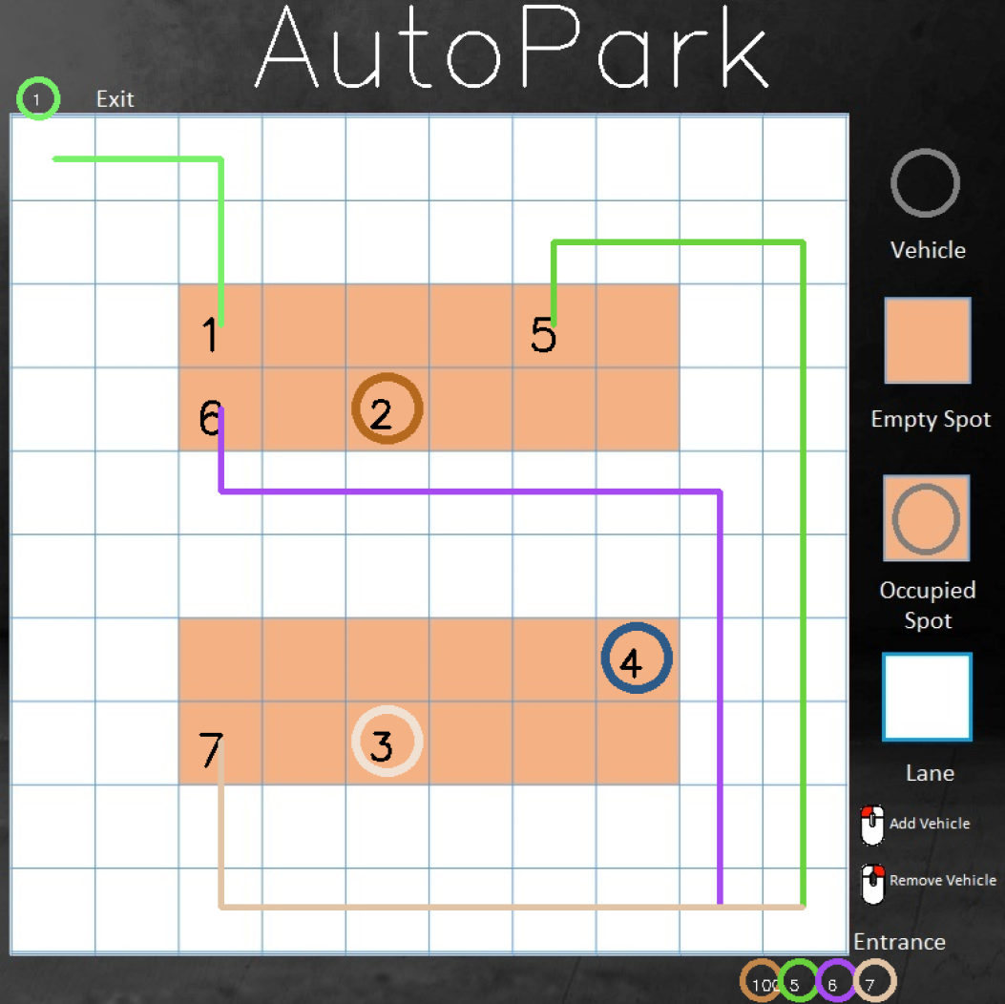
AutoPark – Collaborative Parking For Autonomous Robots
Mohak Bhardwaj, Shivam Gautam, Dorothy Kirlew, Pranav Maheshwari, Richa Varma
2015-2016 MRSD Team I
Project Description
With the ever increasing presence of autonomous cars in our world, vehicles no longer need to operate as disjoint systems. Vehicle to vehicle communication enables a vehicle to communicate and collaborate, leading to more optimized performance and higher safety. AutoPark showcases these capabilities in the context of a parking lot, by enabling cars to autonomously park in a lot and exit the lot as efficiently as possible with no human interference.
Enter and Select Spot
Plan Route to Spot
Plan Route to Exit
Physical System
Simulation System
Problem Statement
System Architecture
Optimization
Create a system that allows multiple autonomous vehicles to cooperatively and efficiently park in a parking lot by sharing information. Interface with drivers to drop-off and recall vehicles through a mobile device.
Functional Architecture
Software Architecture
Global Optimization:
Multi-armed bandit based
exploration vs. exploitation
approach in search of
Global Maxima
Heuristic Driven Local Optimization:
Track and guide system towards a state of less entropy
Event Triggered Reward Maximization:
Alter state of Vehicles via Numerical Optimization in a tradeoff between cost minimization and reward maximization
Multi-layered Optimization
Implementation
Performance
Implementation
Greedy Approach
Average Parking Time | Average Pause Time | Average Return Time
33.52 seconds | 23.57 seconds | 28.64 seconds
Results
Success Criteria | Performance
The entire routine is followed in a predictable manner and the vehicles park themselves in the most optimal spot
Time taken by the system with collaboration is less than that by the platform without collaboration
Vehicles do not collide with any obstacles and stay clear of the infrastructure | Some collisions occurred between vehicle and infrastructure leading to manual intervention
User Interface accurately shows the state of the parking lot
The app accurately shows the state of its vehicle
AutoPark Approach
Average Parking Time | Average Pause Time | Average Return Time
12.5 seconds | 15.37 seconds | 15.6 seconds
Cyber-Physical Architecture
Conclusion
Acknowledgements
Systems that facilitate collaboration between vehicles hold great potential and will be a direct demand of the new age autonomous systems which will be much more aware of their surroundings than present manned systems. Continued work should focus on optimization strategies in varied use cases and encryption of shared data.
Prof. John Dolan
Prof. Dimi Apostolopoulos
Siddhartha Srivastava (UTRC)
Alessandro Pinto (UTRC)
Julie Goldstein, Keyla Cook
Platform Environment User-Interface

