Slide 1
Standards and Regulations
Team Daedalus

Slide 2
Standards and Regulations
FCC – Part 15
Advanced Encryption Standard
Description
Prescriptions and Standards
Application to Project

Slide 3
FCC Part 15 – What is it?
Federal Communications Commission (FCC) has rules to limit the interference to licensed transmitters by low-power, non-licensed transmitters.
These non-licensed transmitters must comply with the regulations of Part 15 of the FCC rules.

Slide 4
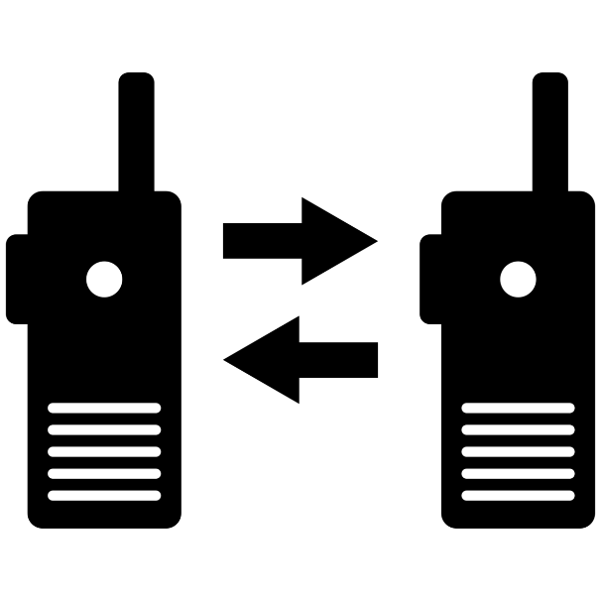
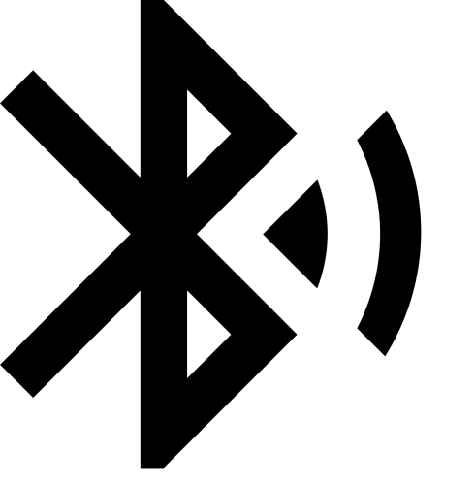
Applicable Product and Market

Slide 5
Unlicensed Operation
Certain bands within the RF spectrum are available for “unlicensed” operation (ISM)
The manufacturer of a product designed for “unlicensed” operation is not exempt from testing and/or certification
Both the transmitter and receiver must be tested by a qualified testing laboratory
Once the necessary approvals are received, the end user can then operate the product without further obligation or licensing

Slide 6
902-928 MHz band
XBee modules come under Part 15.247 for spread spectrum radios - Frequency Hopping (FHSS)
Only restrictions on output power, harmonic levels and bandwidth
No restrictions on application, transmission duration, or how often a radio transmits
Popular for data, video and audio

Slide 7
902-928 MHz band - Advantages
Very little restrictions on the type or duration of analog or digital data transferred
Higher output power allows the potential for much longer transmission distances
Higher frequencies mean shorter wavelength
This allows a ¼ wave antenna at 900MHz to be less than 3.25” in length compared to 6.5” at 433Mhz
Some antennas in this band are < 0.5” in length w/o sacrificing gain

Slide 8
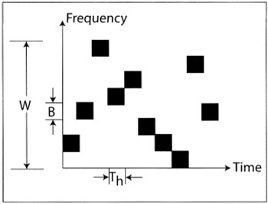
Frequency Hopping
Rather than transmitting at a certain fixed frequency or channel, a technique of hopping between different channels is utilized to facilitate multiple access. This also helps in decreasing interference.
T_{h} = Hop Duration
B = Bandwidth large enough to include most of the power in a signal pulse
W = Bandwidth of hopping band
Reference: http://www.globalspec.com/reference/74106/203279/chapter-3-frequency-hopping-systems

Slide 9
Prescription and Standards
Operational Requirement
§ 15.247 Section a(1)(i) For frequency hopping systems operating in the 902–928 MHz band:
If the 20 dB bandwidth of the hopping channel is less than 250 kHz, the system shall use at least 50 hopping frequencies and the average time of occupancy on any frequency shall not be greater than 0.4 seconds within a 20 second period
If the 20 dB bandwidth of the hopping channel is 250 kHz or greater, the system shall use at least 25 hopping frequencies and the average time of occupancy on any frequency shall not be greater than 0.4 seconds within a 10 second period.

Slide 10
Prescription and Standards
Operational Requirement
§ 15.247 Section b(2) For frequency hopping systems operating in the 902–928 MHz band :
1 watt for systems employing at least 50 hopping channels
0.25 watts for systems employing less than 50 hopping channels, but at least 25 hopping channels

Slide 11
FCC – Part 15
Prescriptions and standards
Antenna Requirement
Changing the antenna on a transmitter can significantly increase, or decrease, the strength of the signal that is ultimately transmitted
Each Part 15 transmitter must be designed to ensure that no type of antenna can be used with it other than the one used to demonstrate compliance with the technical standards

Slide 12
FCC – Part 15
Prescriptions and standards
Conducted emission limits
Part 15 transmitters that obtain power from the electrical power lines are subject to conducted emission standards that limit the amount of radio frequency energy they can conduct back onto these lines in the band 450 kHz - 30 MHz. This limit is 250 microvolts.

Slide 13
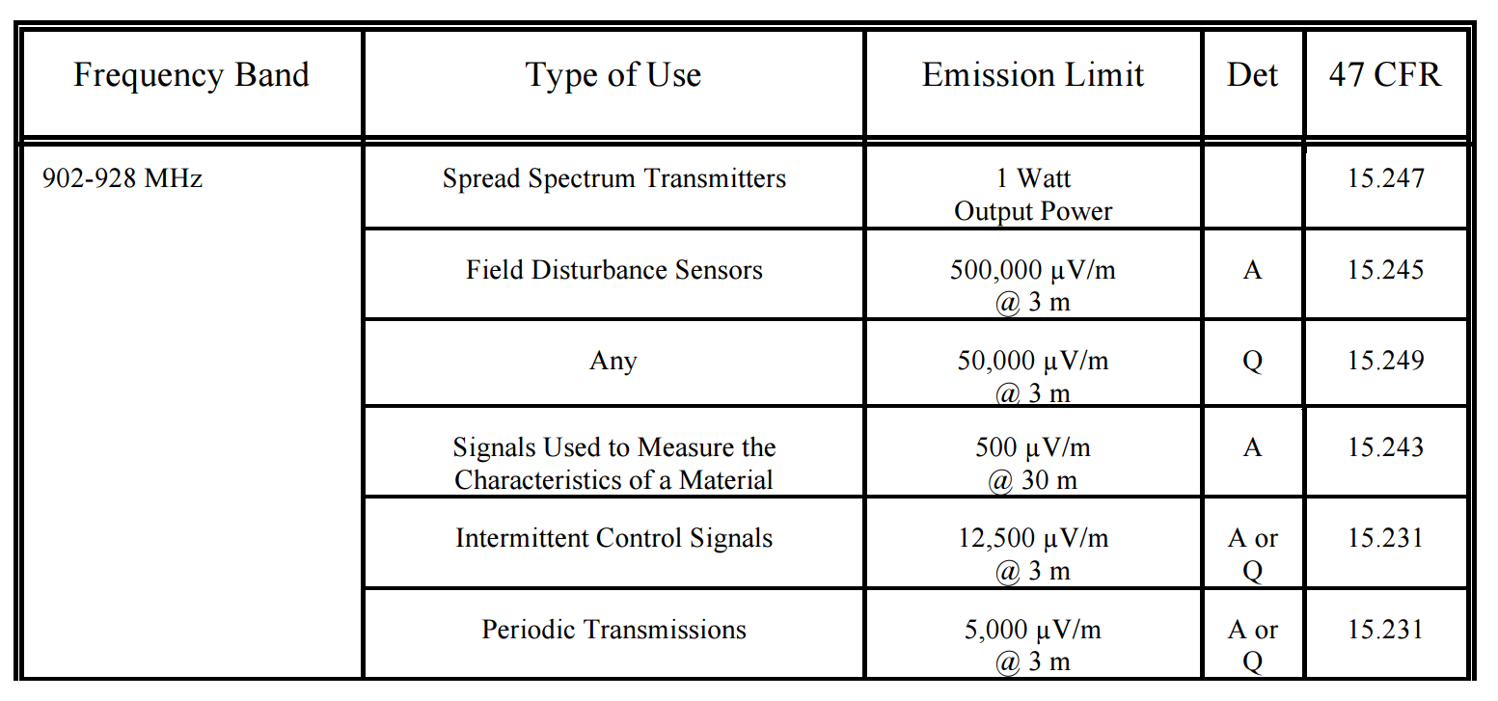
FCC – Part 15
Prescriptions and standards
Radiated Emission Limits
Type of detector used to measure emissions:
average with a peak limit, "A"
quasi-peak, "Q"
Notes:
When a transmitter power limit is specified instead of an emission limit, no emission detector is specified.
Quasi-peak detection is a form of detection where a signal level is weighted based on the repetition frequency of the spectral components making up the signal. That is to say; the result of a quasi-peak measurement depends on the repetition rate of the signal.

Slide 14
International regulations
Canada and Brazil are almost the same as the United States
433.92 MHz is legal in most countries
Japan, China and India are notable exceptions
900 MHz band is not the same in many countries
Illegal in Europe, need to go to 862-870 MHz
Brazil, Australia and NZ have restricted gaps within this band
2.4 GHz band is globally accepted

Slide 15
FCC – Part 15 : Application to our project
XBee from Digi allow designers to move across both the 2.4 GHz and 900 MHz bands using the 802.15.4 protocol, with the 900 MHz versions for longer range or environments that need more immunity to interference.
These embedded RF modules have a common footprint shared by multiple platforms, including multipoint and ZigBee/Mesh topologies with both 2.4 GHz and 900 MHz solutions.
Interference is a key reason for using modules -
Provide protection against EMI interference through shielding
Optimized antenna path designs to reduce the interference from the rest of the electronics and external sources

Slide 16
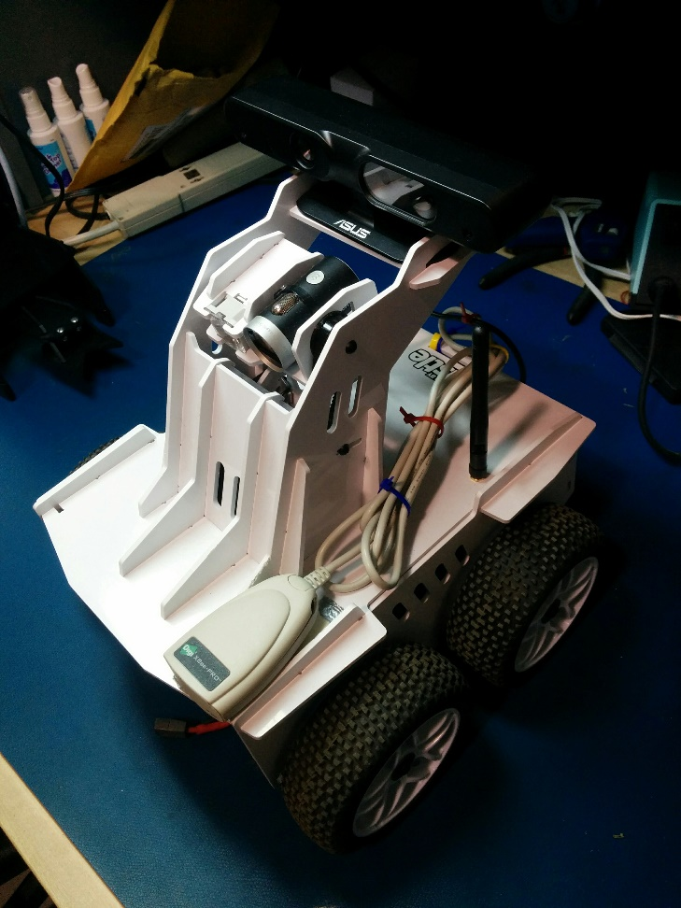
FCC – Part 15 : Application to our project
XBee 900 modules use FHSS
Cyclic redundancy checking (CRC) is used to maintain the integrity of the data
128-bit Advanced Encryption Standard
CRC check implemented in the message datagram
Oculus Prime equipped with XBee 900 module for V2V communication

Slide 17
Advanced Encryption Standard (AES)

Slide 18
AES
What is it?
Computer Security Standard approved by Federal Information Processing Standards (FIPS) that can be used to protect electronic data.
The AES algorithm is capable of using cryptographic keys of 128, 192, and 256 bits to encrypt and decrypt data in blocks of 128 bits.
It is also included in the ISO/IEC 18033-3 standard which specifies block ciphers for the purpose of data confidentiality.

Slide 19
AES
What is it?
AES is based on the Rijndael algorithm, which is a symmetric iterated block cipher. The block length is 128 bits and key lengths can be 128, 192, or 256 bits.
Data
128
128
128
AES
Ciphered Data
Key

Slide 20
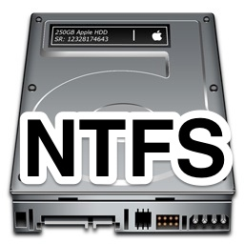
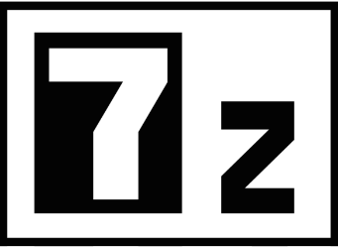
AES
Applicable product or market
The algorithm specified in this standard may be implemented in software, firmware, hardware, or any combination thereof.
Used by Federal departments for information that requires cryptographic protection.
Successful use by the U.S. government led to widespread use in the private sector, leading AES to become the most popular algorithm used in symmetric key cryptography

Slide 21
AES
Main prescriptions and standards
Variations of Rijndael that can operate on block sizes larger than 128 bits are not included in the actual standard.
Certain cryptographic devices and technical data regarding them are subject to Federal export controls.
Exports of cryptographic modules implementing this standard and technical data regarding them must comply with Federal regulations and be licensed by the Bureau of Export Administration of the U.S. Department of Commerce.

Slide 22
AES
Application to our project
XBee Digimesh Pro 900 adapter supports 128-bit AES encryption
Setting an identical 16 byte key network security key value on all devices allows exchange of encrypted data through the network
These features are accessed via AT Commands (Hayes Command Set)

Slide 23
References
https://transition.fcc.gov/Bureaus/Engineering_Technology/Documents/bulletins/oet63/oet63rev.pdf
https://apps.fcc.gov/kdb/GetAttachment.html?id=QRSnt%2BM%2Fe%2BNFOLVllOMypQ%3D%3D
http://csrc.nist.gov/publications/fips/fips197/fips-197.pdf
https://www.youtube.com/watch?v=MK0SrxBC1xs

Slide 24
Thank you!
Questions?

