Slide 1
PROGRESS REVIEW 1
Team Aware
Amit Agarwal, Harry Golash, Yihao qian,
menghan zhang, Theo zhang

Slide 2
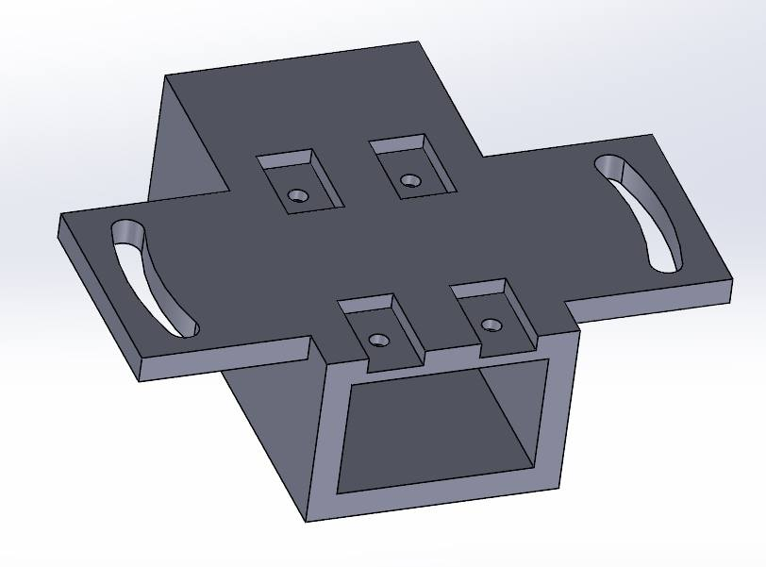
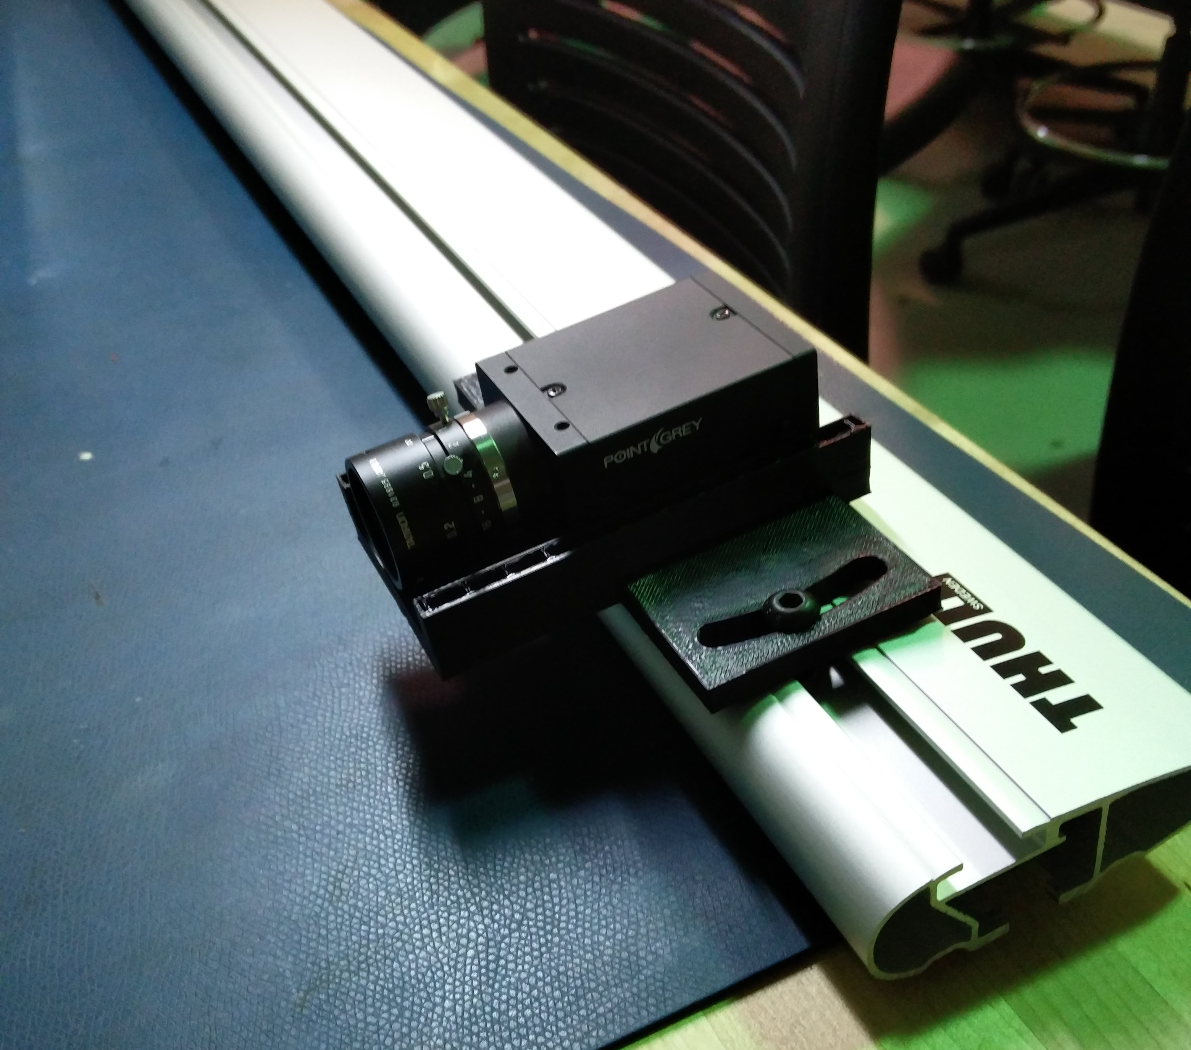
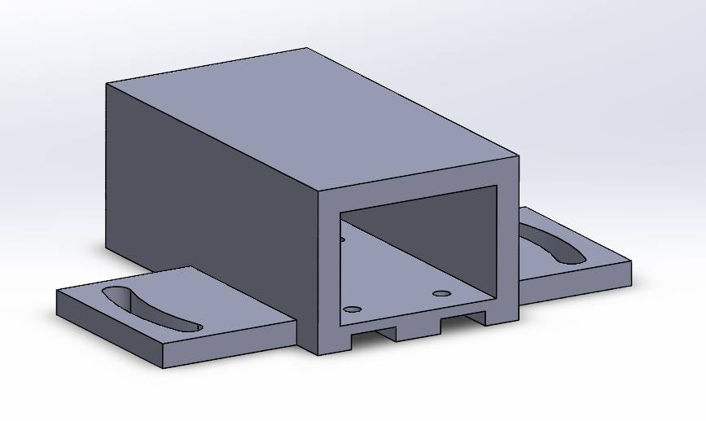
Progress
Designed and fabricated camera housing
Tested the prototype by attaching it to the mounting rack

Slide 3
Progress
Tested functionality of both cameras
(Receiving images, recording images, etc.)
Literature review on radar

Slide 4
Challenge
Lack of information/ hardware for Delphi ESR radar
No reply from sponsor yet
Currently finding solutions through literature (next page…)

Slide 5
“The Delphi ESR directly provides the information of detected point targets, which is different from that used in the research mentioned above [11,16,17] where generally original data from the radar is used.”
http://ieeexplore.ieee.org/document/1334537/
“Since the ESR is designed to be integrated into a vehicle, accessing the data it produces requires hardware that can interface between the CAN bus standard it uses and the common interfaces used by modern computers.”
“Since the radar sensor used for this project is manufactured by Delphi, their Private CAN Serial Communication Specification is used to decode all data obtained by the data collection stations (Farsi, 1999). “
Notes:
https://www.amazon.com/RioRand-Converter-Adapter-Dual-channel-Interface/dp/B00MURLEJC/ref=pd_day0_147_2?_encoding=UTF8&psc=1&refRID=7GZYX9JENCYMCSVEBTVV
https://www.amazon.com/ViewTool-Interface-Raspberry-Connector-isolation/dp/B00ZW8N930/ref=sr_1_1?s=pc&ie=UTF8&qid=1476934519&sr=1-1&keywords=usb+can+linux

Slide 6
Future work
System:
Work Breakdown Structure (WBS) and schedule
Choose appropriate platform for data processing (ROS ?)
Build power distribution system
Camera:
Finish prototype of the weather-proof camera housing
Install FlyCapture2 Full SDK and explore the features
Next step: Synchronization
Radar:
Set up radar properly so that data can be received and displayed
Check object detection capability

