Slide 1
Team A – Perception System using Stereo Vision and Radar
Amit Agarwal
Harry Golash
Yihao Qian
Menghan Zhang
Zihao (Theo) Zhang

Slide 2
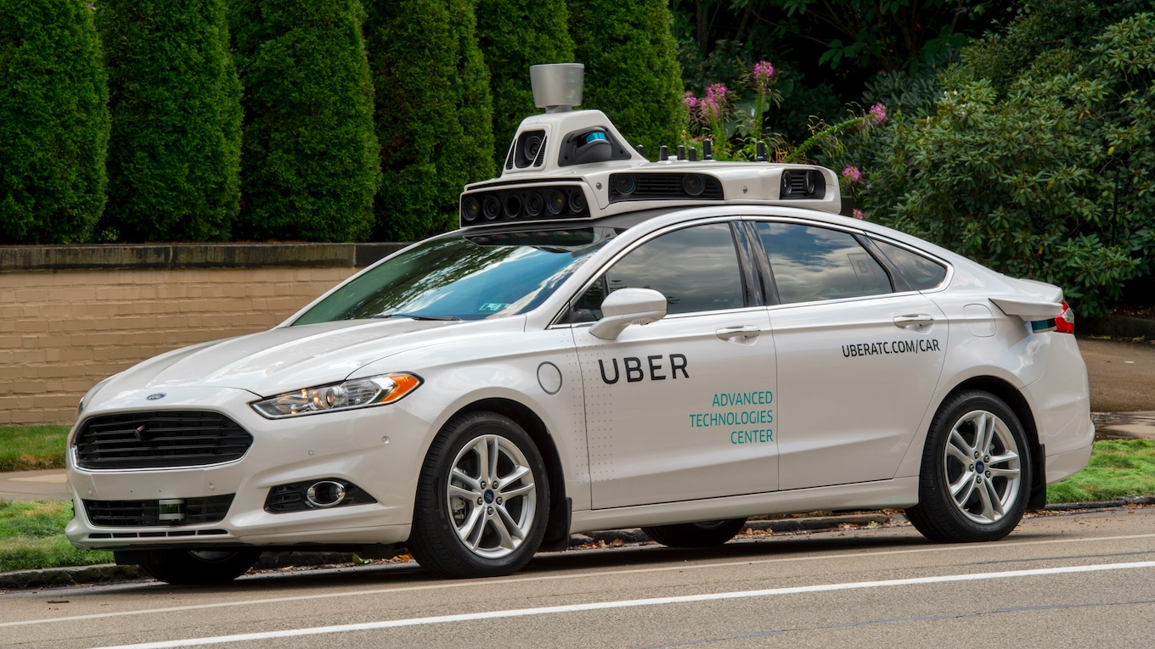
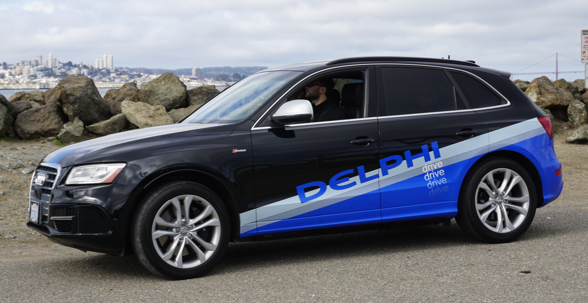
Project Objective
Develop a standalone system to initially assist current autonomous vehicle sensor systems, and eventually replace existing systems.

Slide 3
Perception System for Autonomous Vehicles
Standalone
Inexpensive
Object Detection and Classification
Full-Range
Reliable

Slide 4
Draft Functional Requirements
Conduct full-range perception
Perceive in real-time
Use multiple sensors
Detect and identify objects
Classify objects
Estimate vehicle motion
Be self-contained

Slide 5
Draft Performance Requirements
Detect objects up to 150 m
Unify sensor data up to 50 m
Acquire sensor data at up to 20 Hz
Detect object size with an accuracy of up to 80%
Detect object distance with an accuracy of up to 95%
Detect object velocity with an accuracy of up to 80%
Classify objects with an accuracy of up to 70%
Estimate vehicle motion with an accuracy of up to 90%

Slide 6
Draft Non-functional Requirements
Costs less
Is weather-proof
Functions in all lighting conditions
Is concealable within the vehicle
Works in real-time
Is compatible with vehicle display systems

Slide 7
Draft Functional Architecture
Input
Data processing
Perception
Output
RGB Image Data 1
Detect
Object velocity and position
Collect Data
Classify
Labels of vehicles and pedestrians
RGB Image Data 2
Synchronize Data
Log
Track
Object size and location
Calibrate Data
Radar Data
Velocity and yaw rate
Estimate

Slide 8
Draft Cyber-physical Architecture
Hardware
Algorithms
Environment Algorithm
Virtual Environment with Fused Classification and Motion Data
POWER
Camera 1
CPU + GPU
Synchronization Algorithm
Object Detection Algorithm
Camera 2
Object Classification Algorithm
Classified Object
RADAR
Vehicle & Object Egomotion Algorithm
Vehicle & Object Egomotion
Result
Sensors
Buffer Data
Training Data
Memory

Slide 9
Questions?

