Slide 1
Team G-Excalibr
Progress Review
Yiqing Cai
Man-ning Chen
Huan-Yang Chang
Siddharth Raina
Sambuddha Sarkar

Slide 2
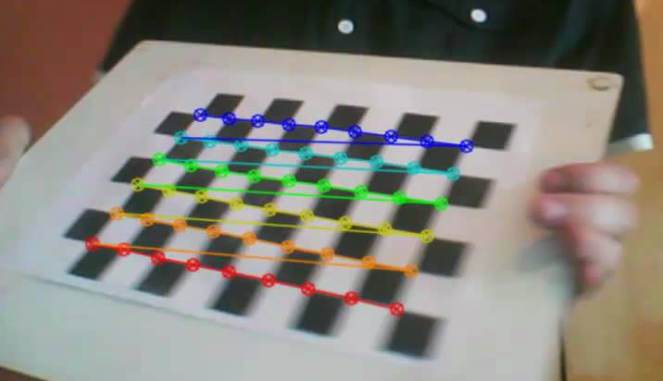
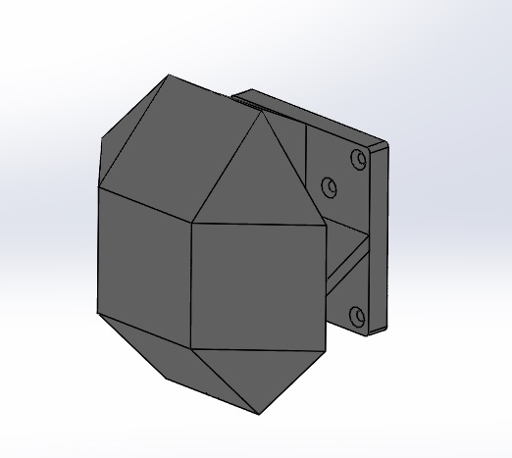
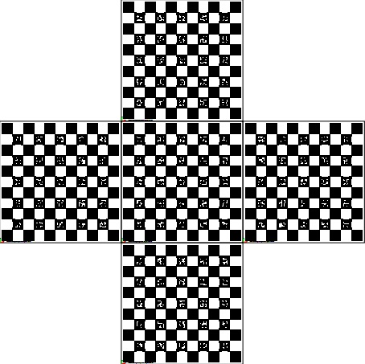
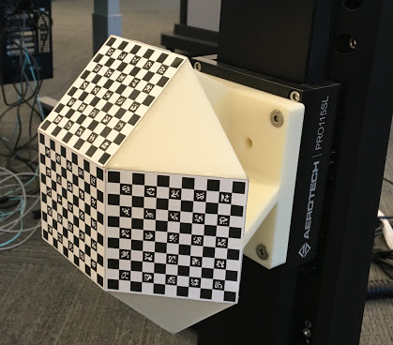
Robot Arm Setup
Peter & Sam
Calibration Target
20cm
+
=
Why 3D?
Why use this shape (Rhombicuboctahedron) rather cubic shape?
Why use such a big target (20cm) rather than a small target?

Slide 3
AEROTECH Operation
Setup the Robot (AEROTECH - 3 Prismatic Joint)
Hooked up the A3200 series controllers to different axes and tested for faults and bugs.
PSO (Position Synchronized Output) setup and configuration: used to send trigger pulses to camera
Move the robotic arm in a certain predefined pattern. (basic motion planning)
Movement along different axis generates unique pulses at predefined set-points to trigger camera to capture images. (using PSO)

Slide 4
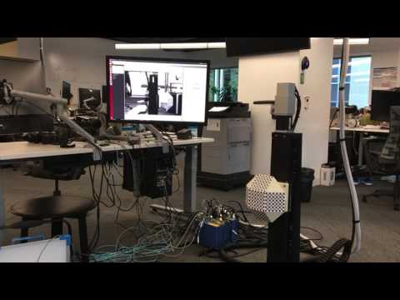
Demonstration

Slide 5
Camera Setup
Cece, Mandy and Sid
Before geometry, photometric and lightfield calibrations, sensor calibration is required.
Noise:
• Random noise
• Fixed pattern noise (FPN):
• DSNU - Dark Signal Non-Uniformity
  • DSNU is seen as an offset between pixels in dark DSNU is seen as an offset between pixels in dark
  • Corrected by subtracting a dark frame
  • Measured in the absence of light
• PRNU - Pixel Response Non-Uniformity
  • PRNU is seen as a responsivity variation between pixels under illumination
  • Corrected by offset and gain for each pixel (which is mostly done off-chip)
y = ax +b

Slide 6
Usual method
Uniform light source
Focal length = 1.2m
Lambertian surface

Slide 7
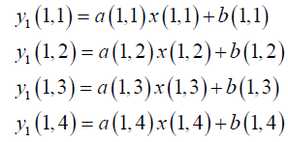
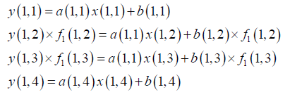
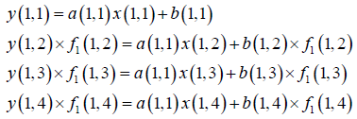
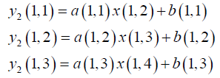

Frame 1
unified
Frame 2
Frame 3

Slide 8
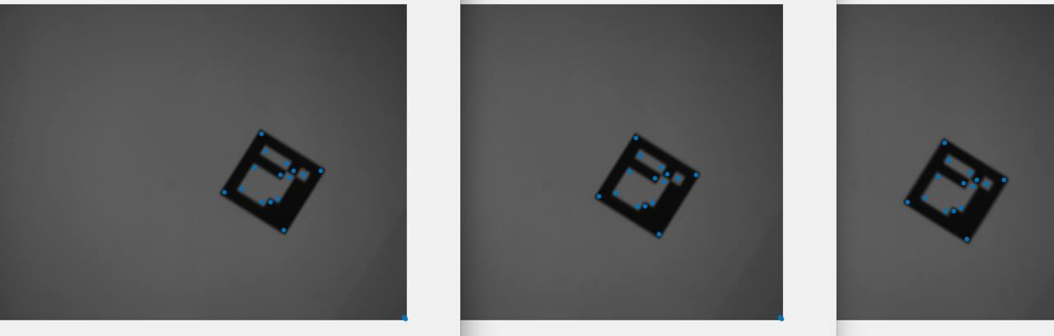
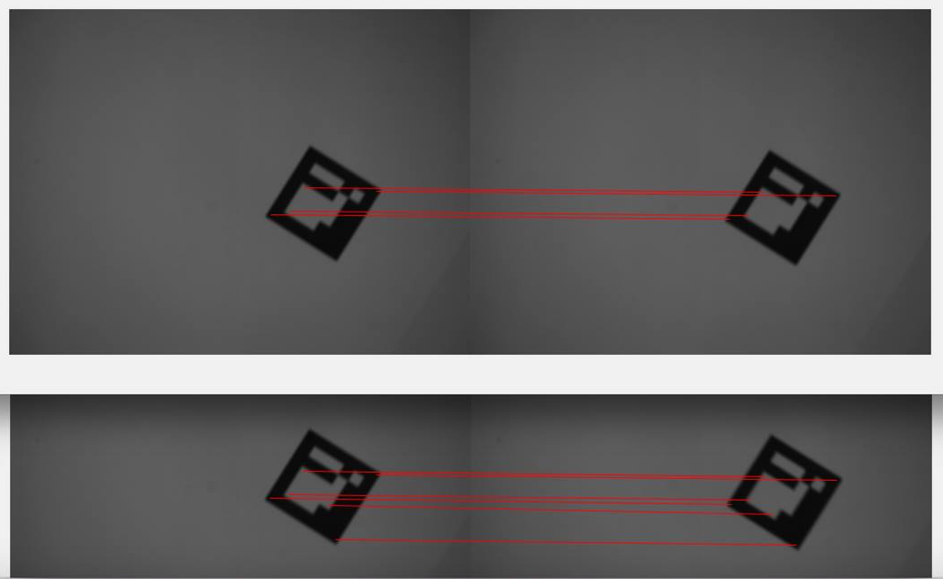

Slide 9
Reference
Mohammadnejad, Shahram, Sobhan Roshani, and Saeed Roshani. "A Novel Fixed Pattern Noise Reduction Technique in Image Sensors for Satellite Applications." Electrical and Electronic Engineering 2.5 (2012): 271-276.
https://www.eecs.tu-berlin.de/fileadmin/fg144/Courses/10WS/pdci/talks/noise_sensors.pdf
https://www.youtube.com/watch?v=ViPN810E0SU

