Slide 1




Robotic Calibration of
Multi-Sensor Capture System
EXCALIBR
Team G

Slide 2
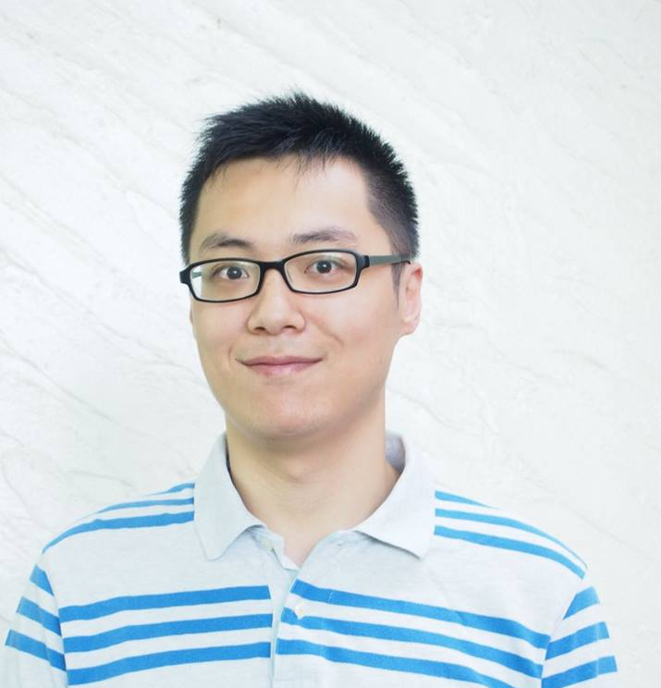
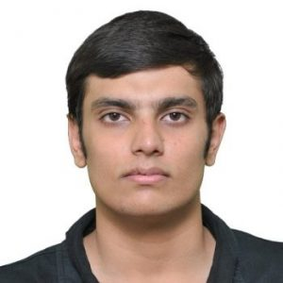
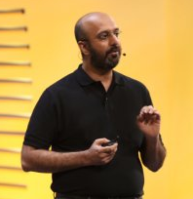

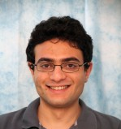
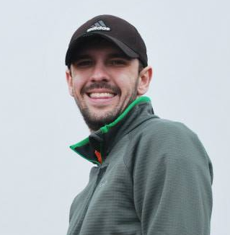
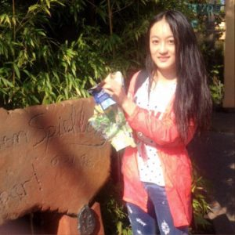


MEET THE TEAM
MRSD Team
Sponsor
Mechanical Engineer
Mechanical Engineer
PETER
SID
Perception Engineer
YASER SHEIKH
Electrical Engineer
Creative Director
MANDY
HATEM ALISMAIL
Software Engineer
Electrical Engineer
TIM
GODISART
YIQING
SAM

Slide 3
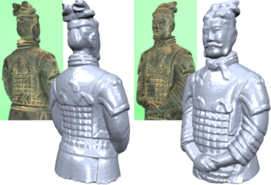
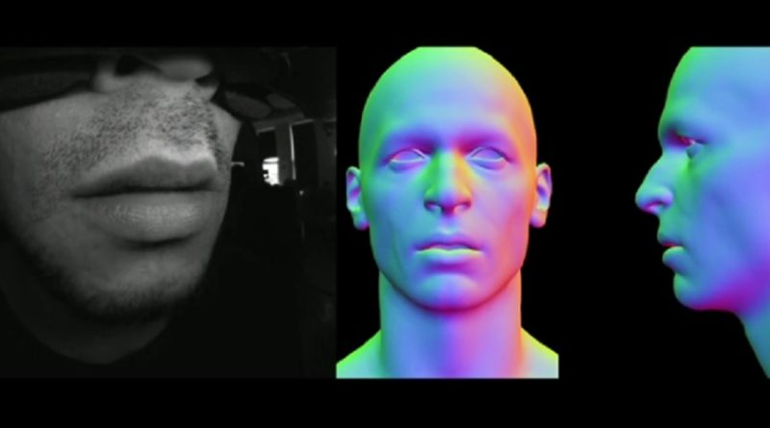
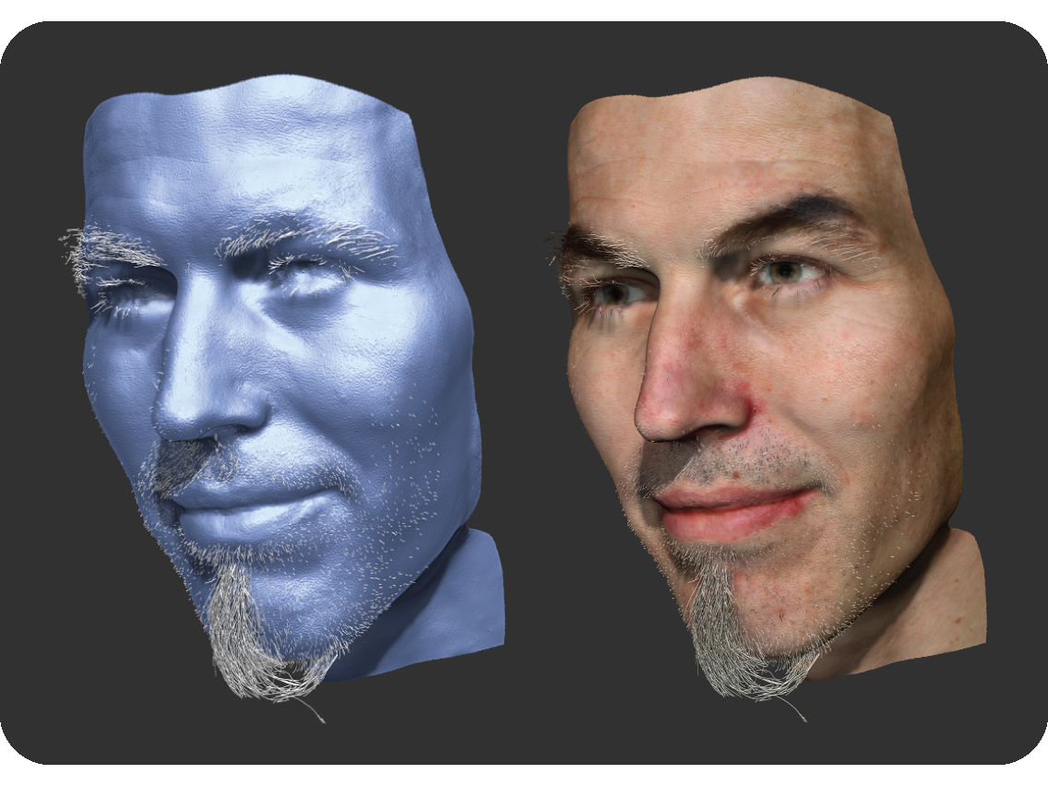
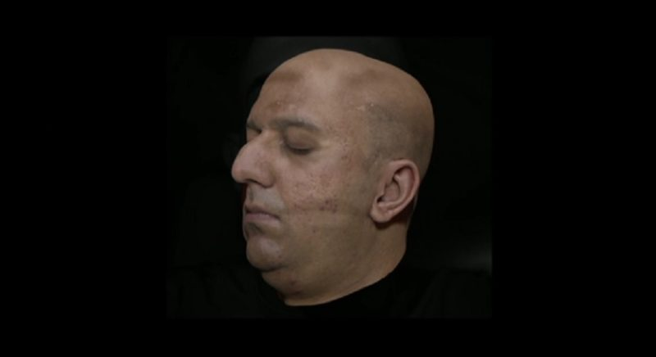
PROBLEM DESCRITPION
What 3D reconstruction can currently do...
What is possible in a shorter duration after our calibration technique....
But we want to capture more detail with a better resolution in a shorter time span to create a more realistic reconstruction

Slide 4
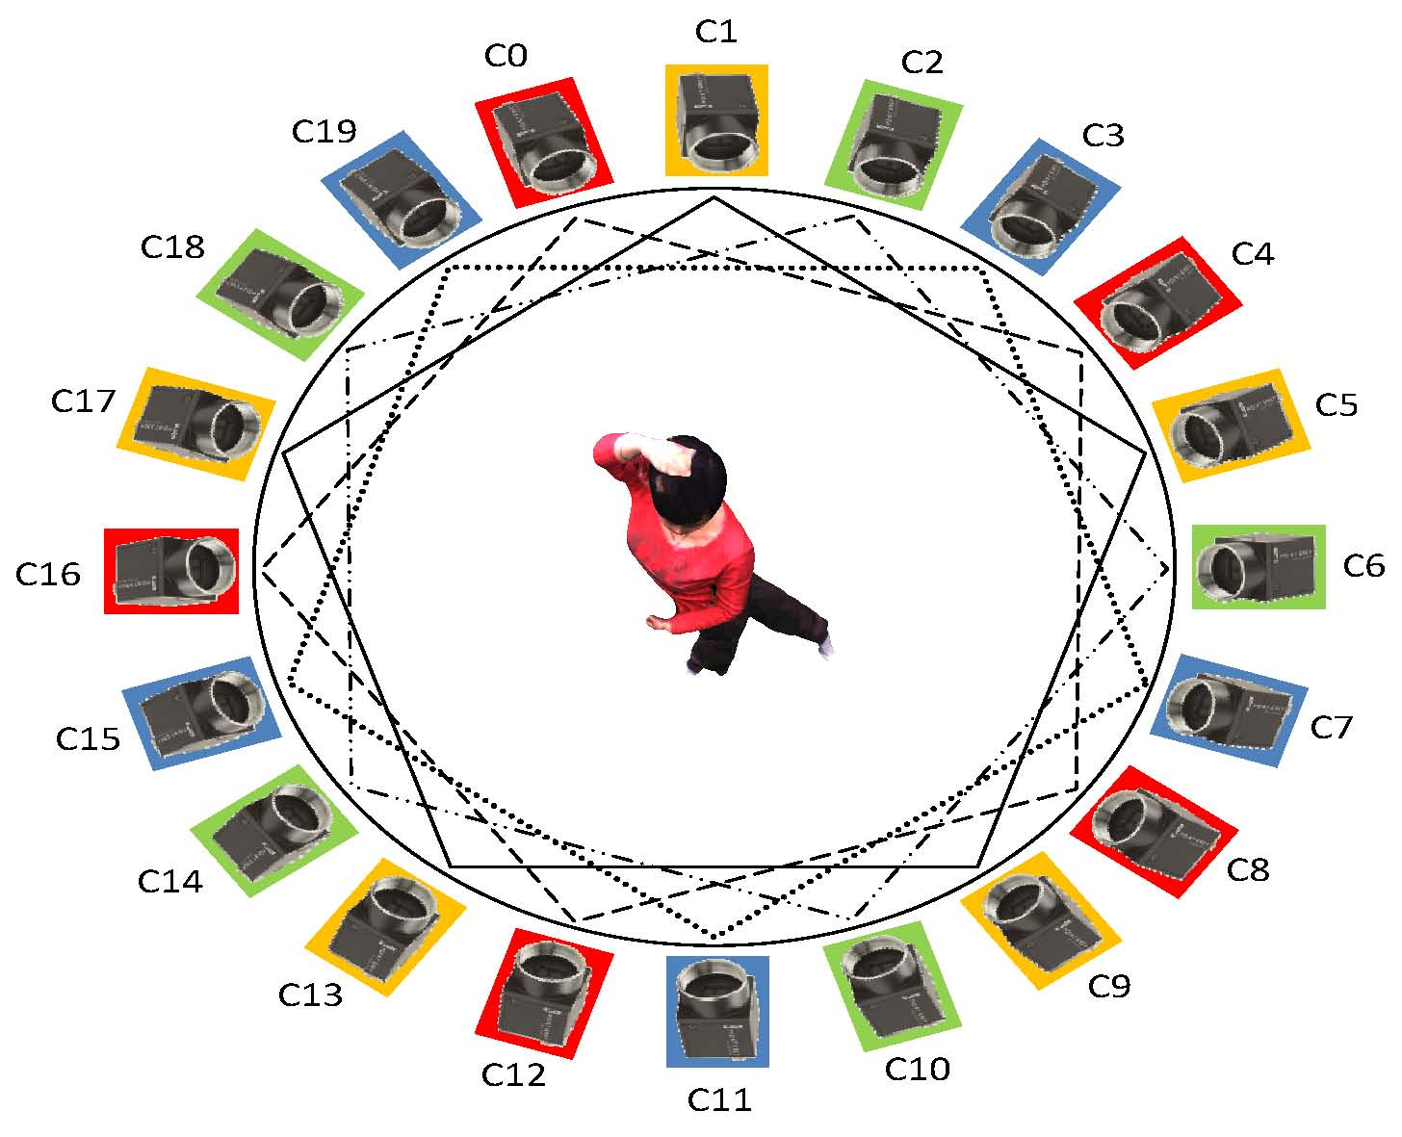
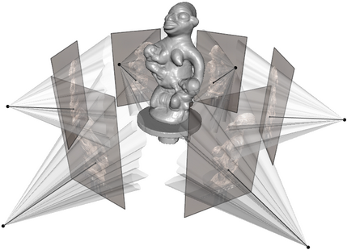
PROBLEM DESCRIPTION
One way to achieve desirable results is to use more sensors

Slide 5


PROBLEM DESCRIPTION
But wait,
even a minute deviation in the sensor orientation or error in the calibration can lead to disastrous result....
And,
using multiple sensors to obtain better resolution and quality of data, the system will have to be calibrated multiple times which is not feasible to do manually.
TIRED ENGINEER

Slide 6
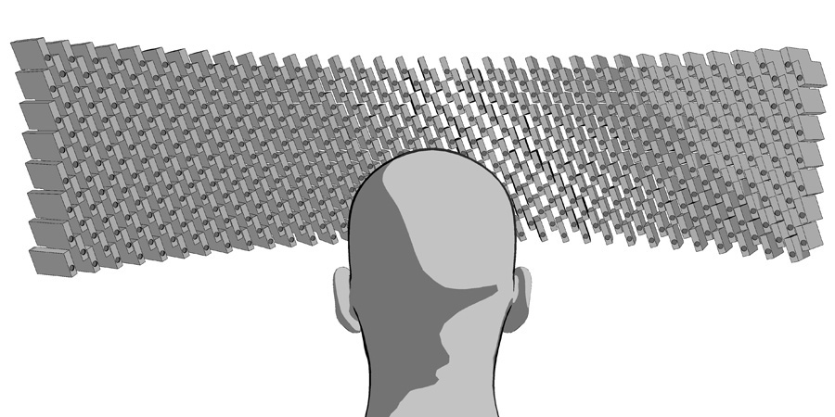

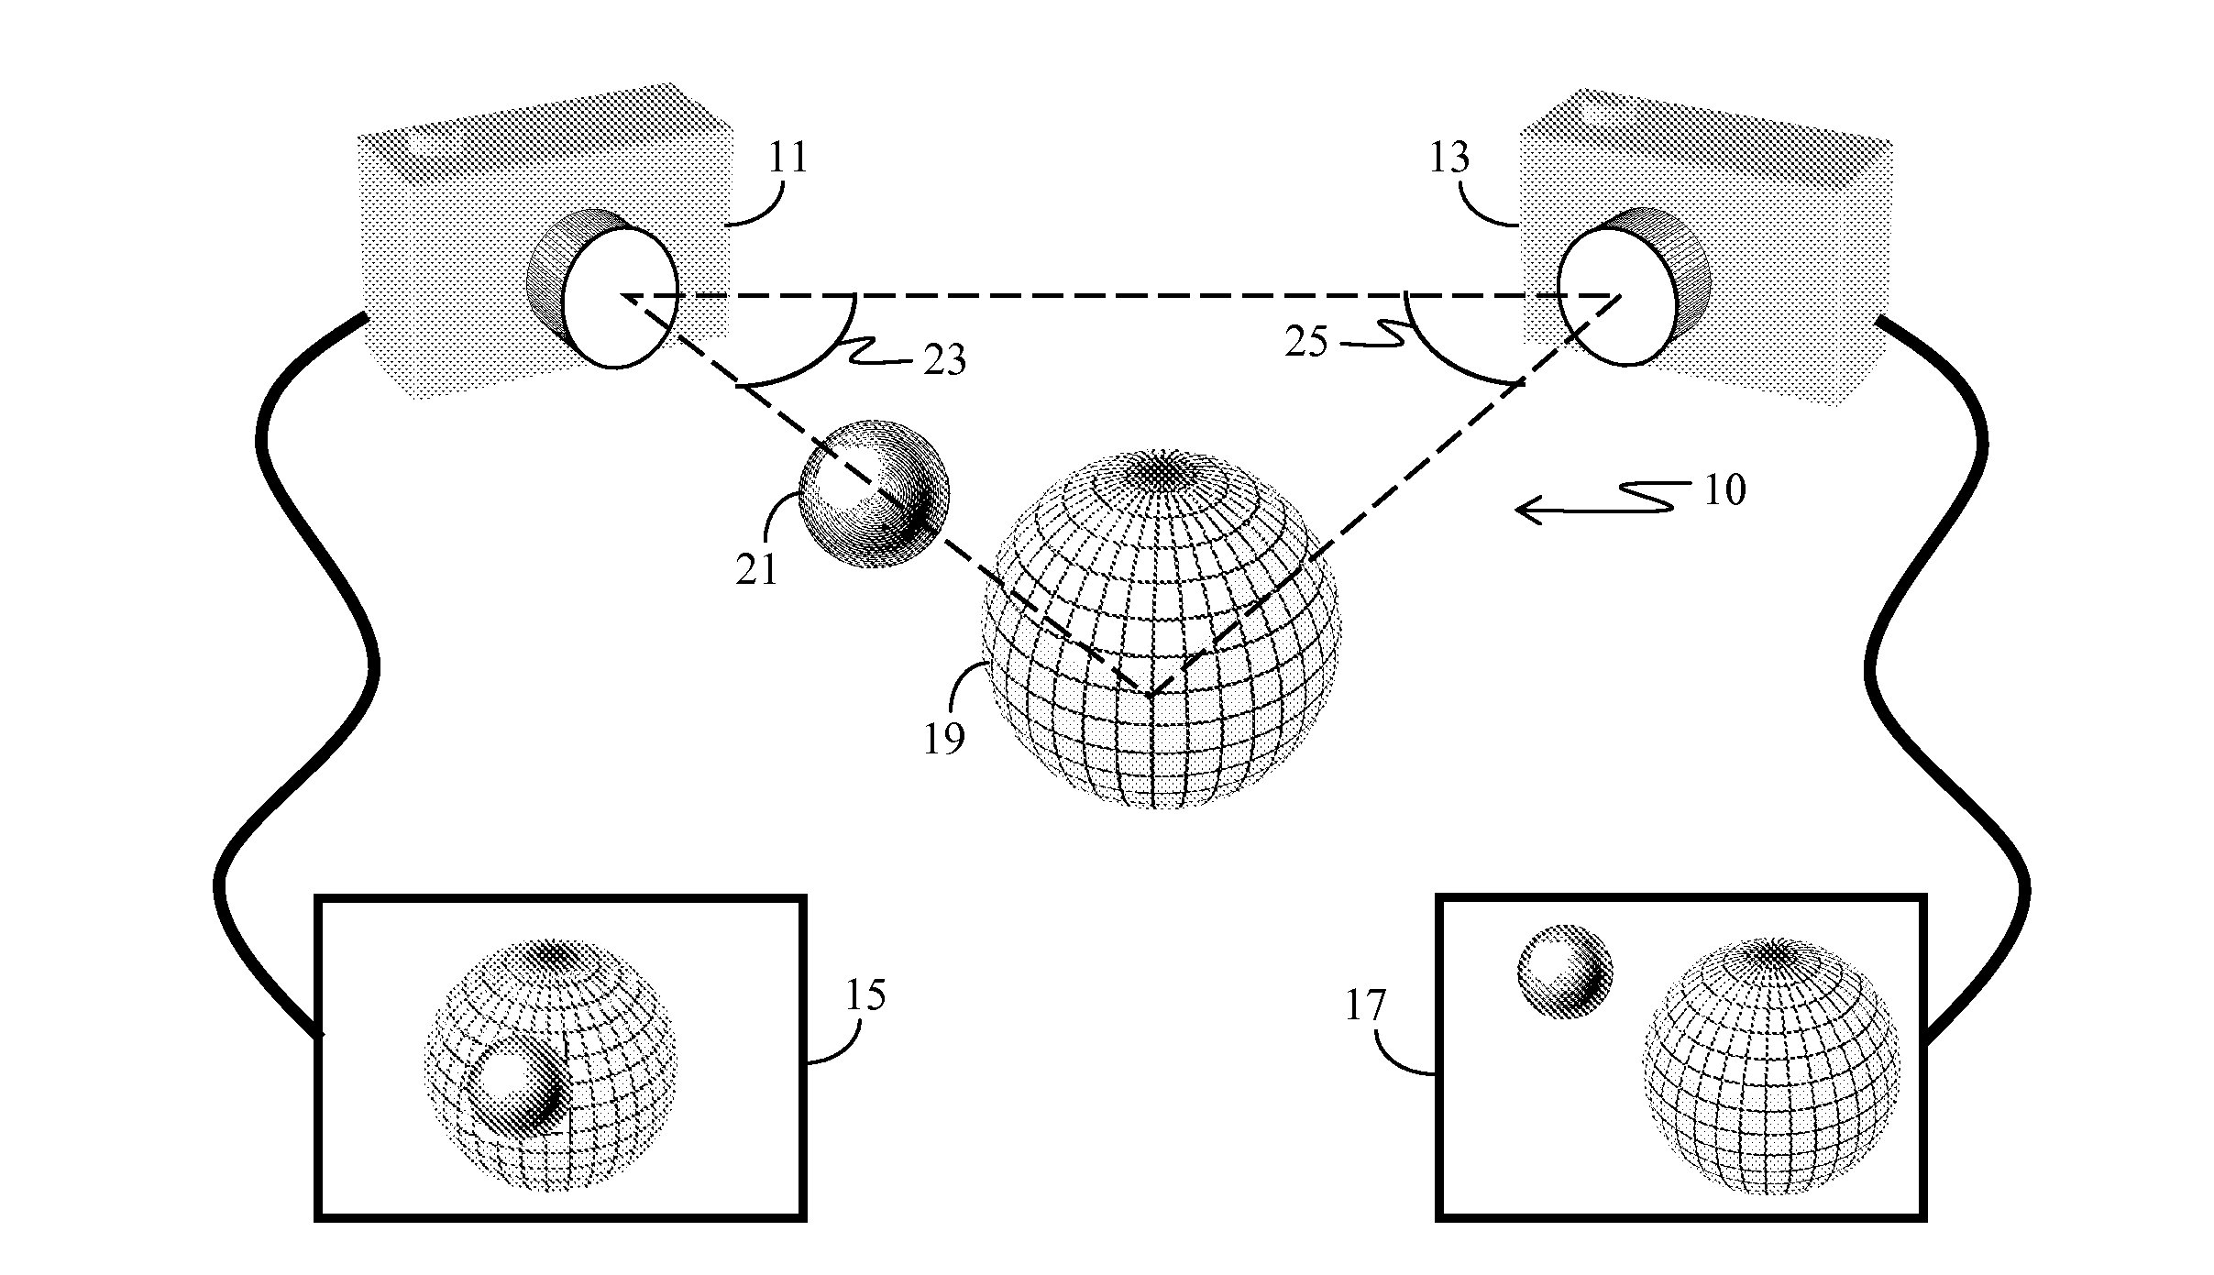
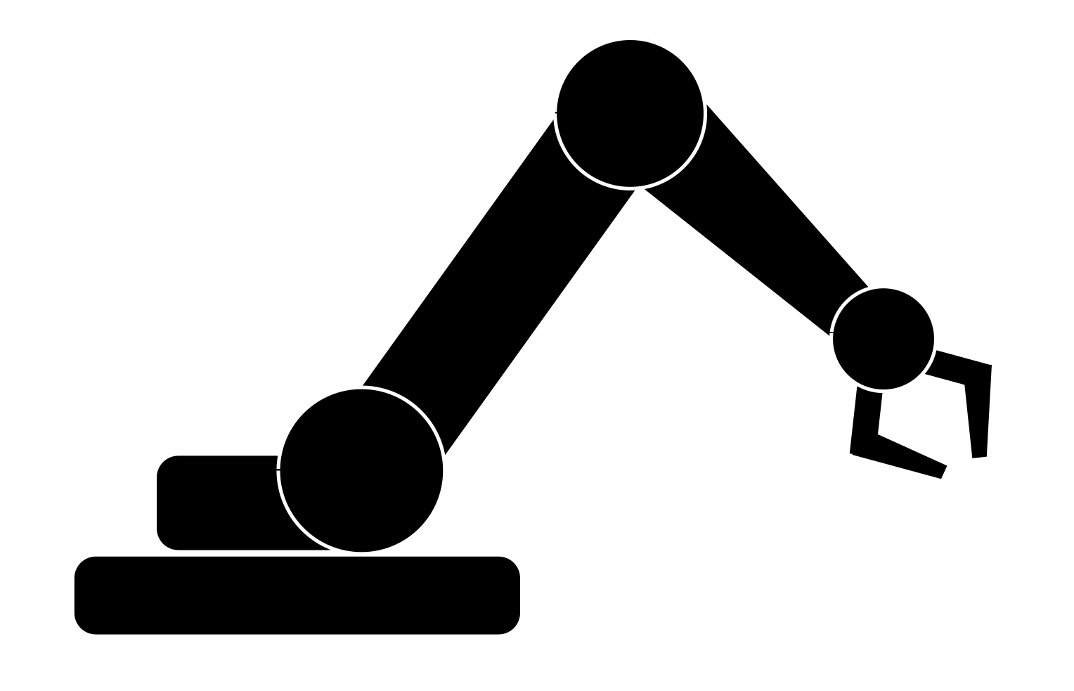

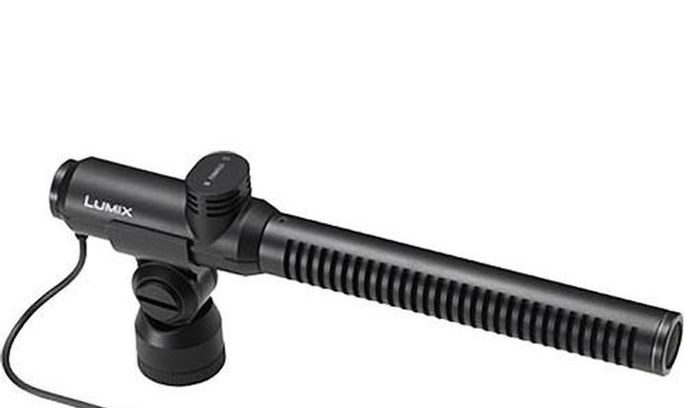
OUR SOLUTION
In order to overcome such problems we introduce calibration along four parameters:
LIGHT-FIELD
GEOMETRIC
PHOTO-METRIC
ACOUSTIC
Light-field
OBOTIC
Geometric
Photo-metric
AUTOMATION
Acoustic
Multiple times leads to

Slide 7
OBJECTIVES
A robot-based calibration system for multi-sensor system (cameras and microphones)
Calibration of:
    Light-field
    Geometric
    Photometric
    Acoustic
Positional Accuracy & Precision
Rotational Accuracy & Precision
Repeatable & Scalable
Audiovisual 3D reconstructions with unprecedented precision.
Ease of Use.

Slide 8
OBJECTIVE TREE
Robotic Calibration of Multi-Sensor Capture System
Photometric Calibration
Geometric Calibration
Light-field Calibration
User friendly
Is Accurate &
Precise
Is efficient
Is Scalable
Move Micro-phone
Detect the frequency
Localize Source
Capture Image of Target
Capture Multiple Images of Target
Move Calibration Target
Execute Calibration
Fix Light Source
Move Calibration Target
Warn people when calibrating the system.
Don’t hit anything(sensor, equipment, etc)
Positional accuracy & precision
Calibrate multi-sensor
Complete in one night
Replicate on multiple setups sensors
Move calibration Target
Execute Calibration
Execute Calibration
Rotational accuracy & precision
Acoustic accuracy & precision
One action operation
Microphone Calibration
Execute Calibration
    Core Objectives Secondary Objectives

Slide 9
FUNCTIONAL REQUIREMENTS
Move the calibration target ( Photometric, Geometric & Light-field).
Produce sound with a frequency sweep.
Apply calibration algorithms to meet standards.
Fix light source.
Complete in one night.
Take high resolution, stable and clear picture of target.
Check accuracy.
Maintain user safety.

Slide 10
Performance REQUIREMENTS
Move the robot arm: at most 8 hours per single motion
Produce a consistent sound with frequency sweep: (82~1200 Hz & 60~100dB)
Apply calibration: around 100 microphones and 140 cameras at the same time
Fix light source: correct it with a suitable offset ~ 100 microns.
Take the picture: at least 3000 images at a time.
Warn people when calibrating: sound alarm if human in close proximity of the system.
Don’t hit anything: keep a distance 1m away from the dome extremities and sensors.
Check accuracy: Positional 10-100 microns; Rotational: an arc second (1/3600°)
Complete in one night: around 12 hours

Slide 11
NON-FUNCTIONAL REQUIREMENTS
Completely autonomous operation.
Create a easy to use GUI & physical buttons for managing operations.
Restrict budget to $5000

Slide 12
FUNCTIONAL ARCHITECTURE

Slide 13
CYBERPHYSICAL ARCHITECTURE

Slide 14
Q & A
Got any queries?

