Slide 1
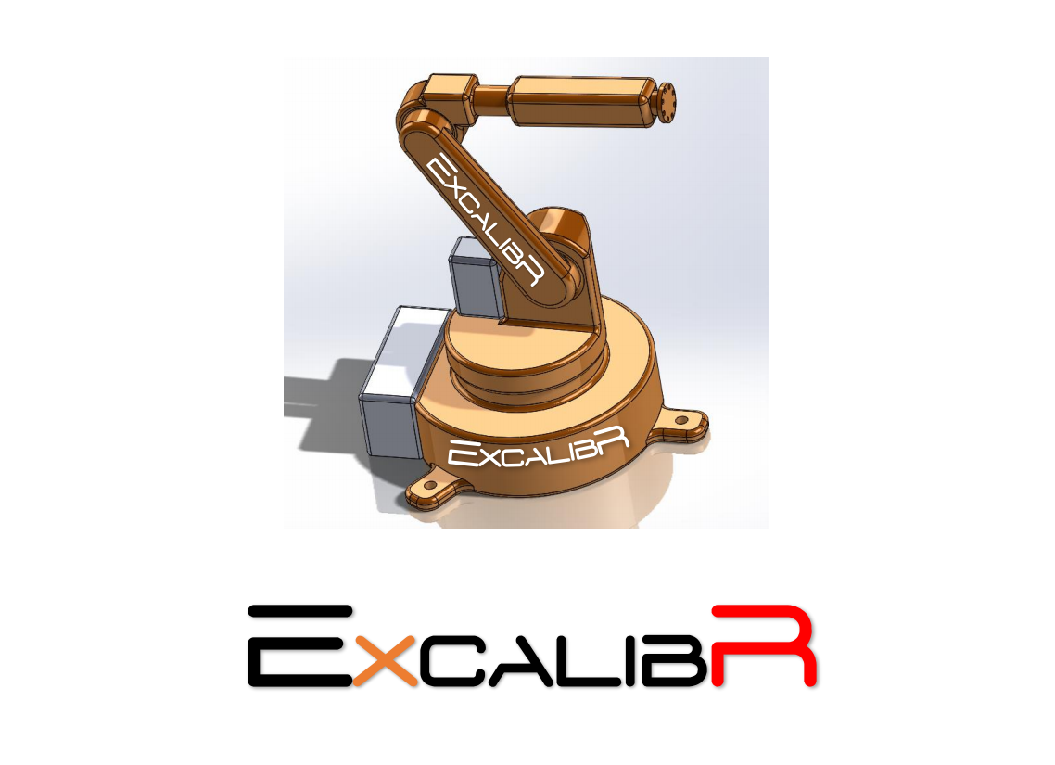
Preliminary Design Review
Team G

Slide 2
Meet The Team

Slide 3
Project Description
Oculus Research, Pittsburgh is building a multi-sensor capture system consisting of a large number of sensors to perform very accurate motion tracking and 3D reconstruction.
The scope of the project involves calibrating sensors accurately using a robotic arm and a calibration target, which would be attached to the end effector of the robotic arm. The target would move around in the capture system. Cameras would be located on the circumference of the capture space, which would collect images of the target in multiple positions and this data would be used to calibrate the system.
The calibration process would involve four methods, namely: geometric calibration of the cameras, estimation of the illumination: light field calibration, photometric calibration of the cameras and acoustic calibration of the microphones.

Slide 4
Use Case

Slide 5
The "room" is a unique capture space equipped with a multitude of audiovisual sensors: cameras and microphones for 3D reconstruction.
It provides an immersive telepresence experience for a variety of applications ranging from board meetings to social interactions, but accurate calibration of such a multitude of sensors is very challenging.
Excalibr Co. has come up with a solution for this problem by using a 6 DOF robotic arm to achieve accurate calibration of the system.
The Excalibr system focuses on achieving unprecedented accuracy for all four aspects of calibration: geometric, photometric, lightfield and acoustic.
The accuracy of calibration achieved by Excalibr, enables it to be used for super immersive virtual reality, with features which are hard to distinguish from the real thing.

Slide 6
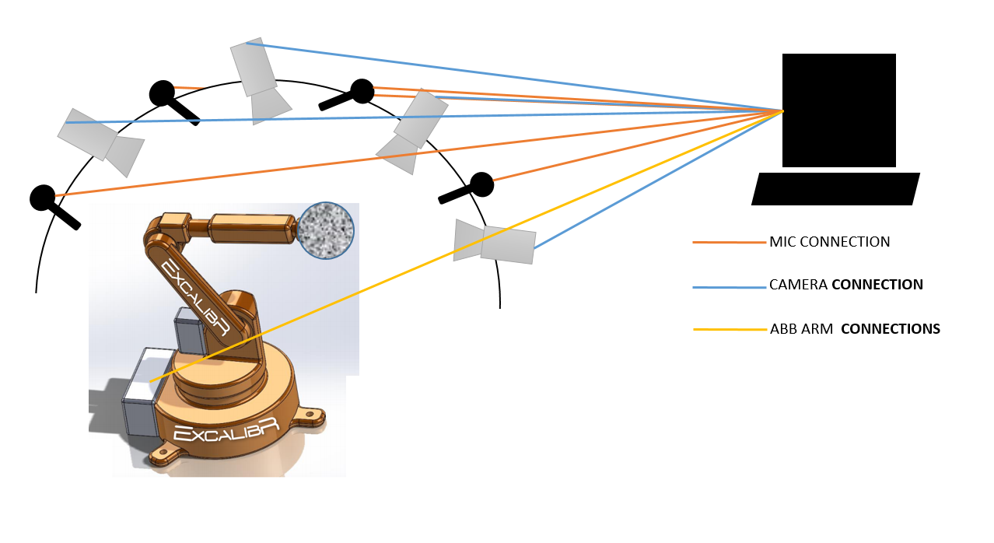

Slide 7
System Level Requirements

Slide 8
System Level Requirements
MANDATORY SYSTEM LEVEL REQUIREMENTS | DESIRABLE SYSTEM LEVEL REQUIREMENTS
Functional Requirements: Fabricate calibration target M.F.1: Operate Autonomously M.F.2: Control and Manipulate the calibration target M.F.3: Emit sound with a frequency sweep M.F.4: Take high-resolution, stable and clear pictures of calibration target M.F.5: Implement camera calibration algorithms on cameras mounted on the dome M.F.6: Calibrate the camera on end-effector for light-field calibration M.F.7: Develop audio calibration method | Functional Requirements: D.F.1: Achieve accuracy standard D.F.2: Operate safely around human D.F.3: Complete all calibration tasks efficiently

Slide 9
System Level Requirements
MANDATORY SYSTEM LEVEL REQUIREMENTS | DESIRABLE SYSTEM LEVEL REQUIREMENTS
Performance requirements: M.P.1: Fabricate the target with 50 micrometers tolerance M.P.2: Manipulate the robot with 100 micrometers accuracy M.P.3: Take pictures with camera more than 5MP at 50fps M.P.4: Complete one stage calibration in at most 8 hours M.P.5: Emit sounds sweeping the frequency between 82~1200 Hz and intensity between 60~100dB M.P.7: Avoid collisions - keep a distance 0.3m away from the dome extremities and sensors M.P.8: Complete the whole calibration process in one night - around 24 hours | Performance requirements: D.P.2: Warn people when calibrating: sound alarm if human in close proximity of the system D.P.3 Calibrate the cameras on the dome to 500 micrometers and 10 arc second D.P.4 Calibrate the camera for light-field on end-effector to 100 micrometer accuracy D.P.5: Develop an audio calibration system with 10 millimeter accuracy D.P.6 Validate before Dec 1

Slide 10
System Level Requirements
MANDATORY SYSTEM LEVEL REQUIREMENTS | DESIRABLE SYSTEM LEVEL REQUIREMENTS
Operate autonomously | Non-functional requirements: D.N.1: Create a user-friendly GUI or physical button

Slide 11
Functional and Cyberphysical Architecture

Slide 12
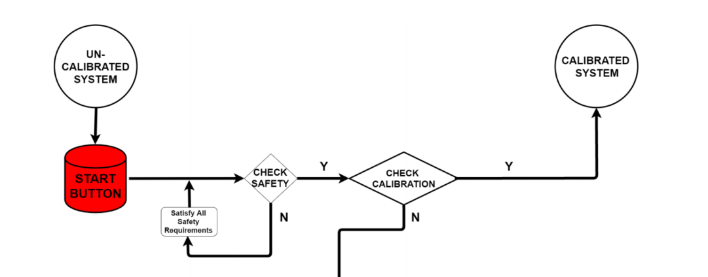
Functional Architecture
To DECISION BLOCK

Slide 13
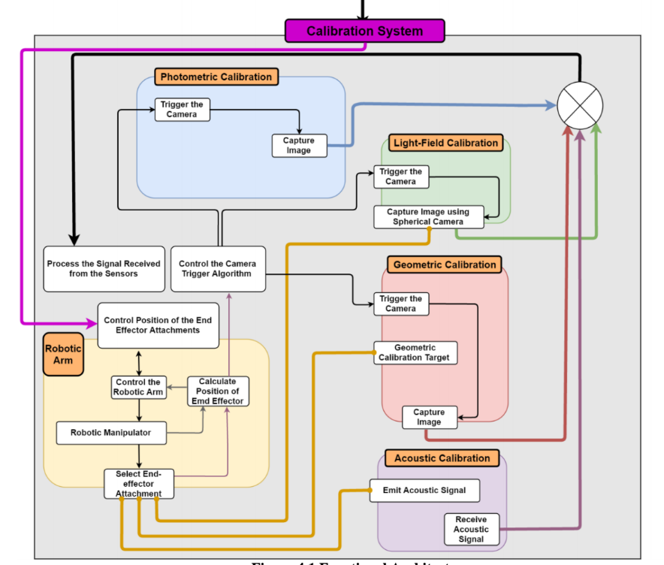
Functional Architecture
DECISION BLOCK

Slide 14
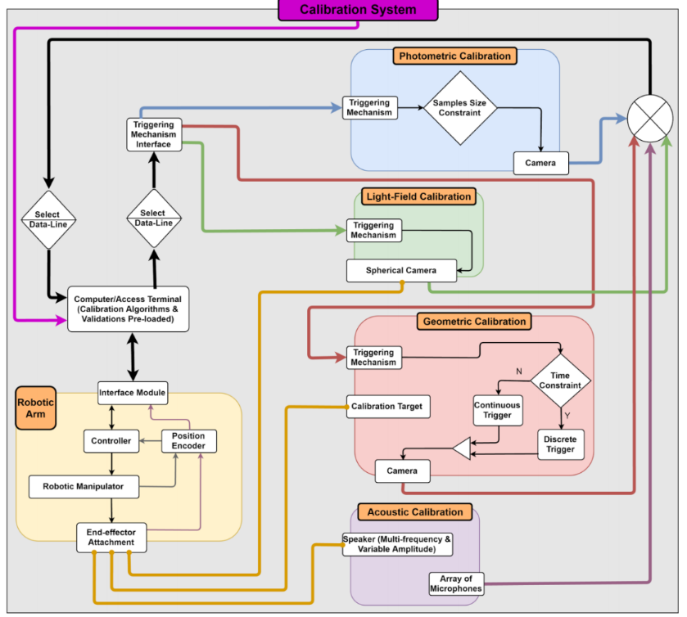
Cyberphysical Architecture

Slide 15
Subsystem and
Current System Description

Slide 16
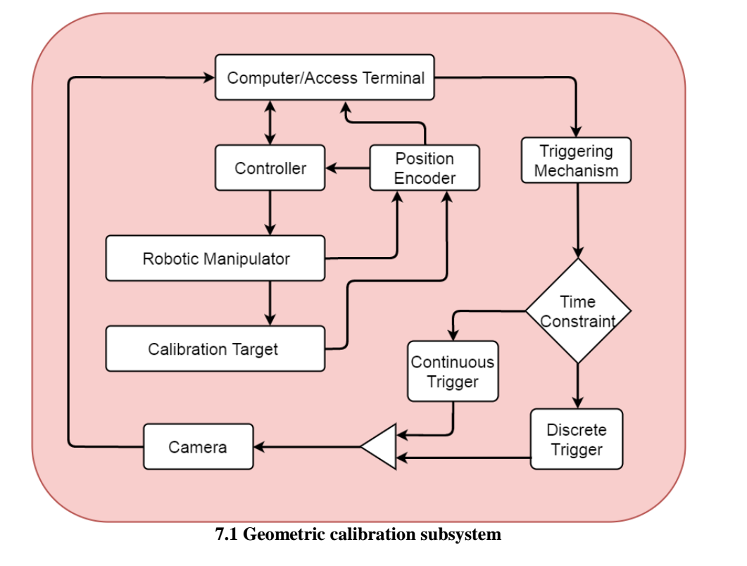
Geometric Calibration

Slide 17
Calibration Target
3D shape (Rhombicuboctahedron)
Size:20x20x20cm( ~human face)
11x11 checkerboard with Apri tags

Slide 18
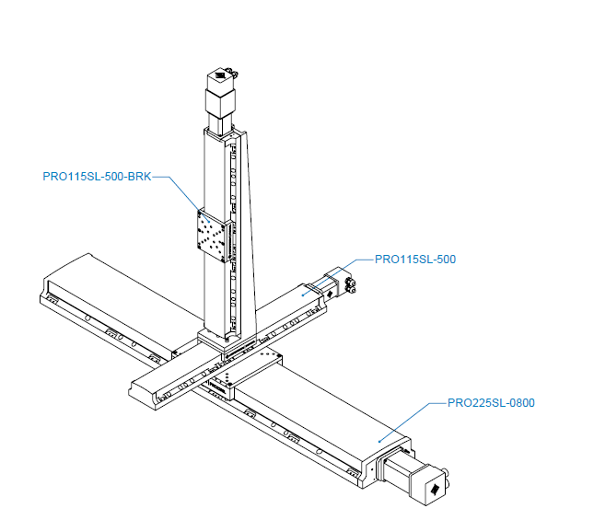
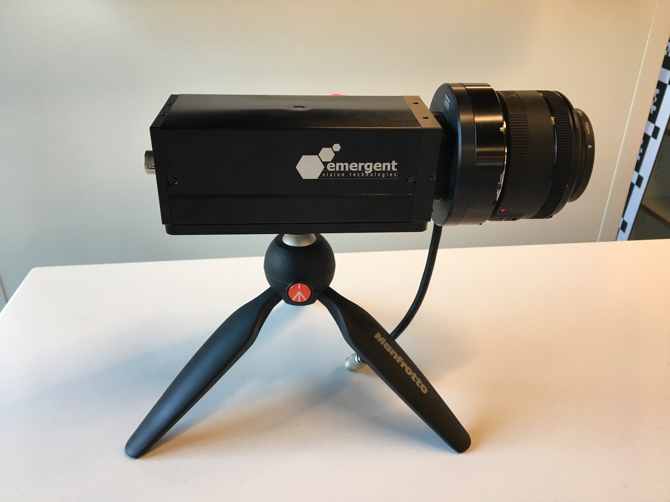
Robotic Arm and Camera
Robot arm
Type: PRO225SL + PRO165SL*2
Controller: A3200 Hpe
Travel: X :800mm, Y: 500mm, Z: 500mm
Accuracy: 17um for 800mm travel for X axis
14um for 500mm travel for Y, Z axis
Camera
Type: HR-12000
Resolution: 12 MP
Capture Speed: 84 FPS

Slide 19
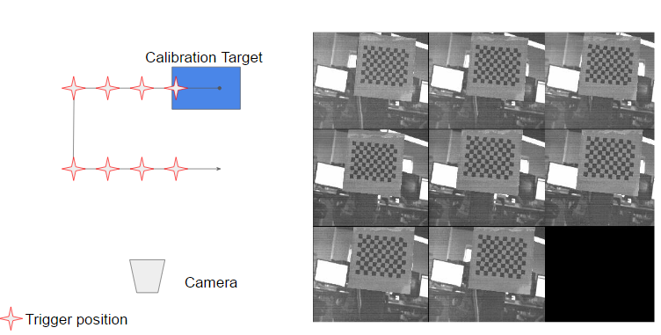
Geometric Calibration
Data collection
--Position Matrix and Corresponding images
Image processing
--Remove FPN
--Conduct photometric calibration

Slide 20
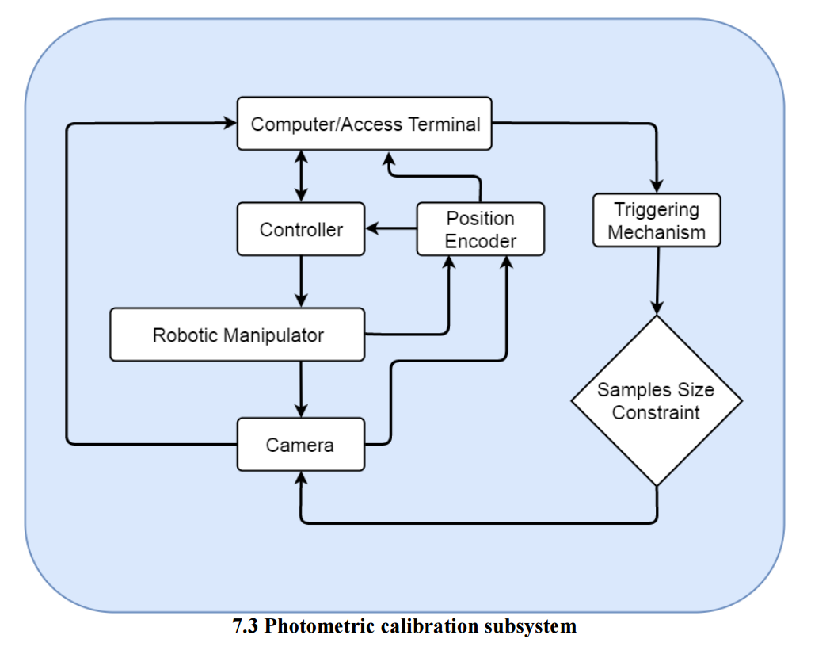
Photometric Calibration

Slide 21
Fixed Pattern Noise
Raw image
Calibrated image
While applying our algorithm on regular scenes, the calibrated image looks smoother. Stripes and vignetting should be eliminated.

Slide 22
Fixed Pattern Noise
NOISY IMAGE
CORRECTED IMAGE
variance = 147.1256
variance = 4.8328

Slide 23
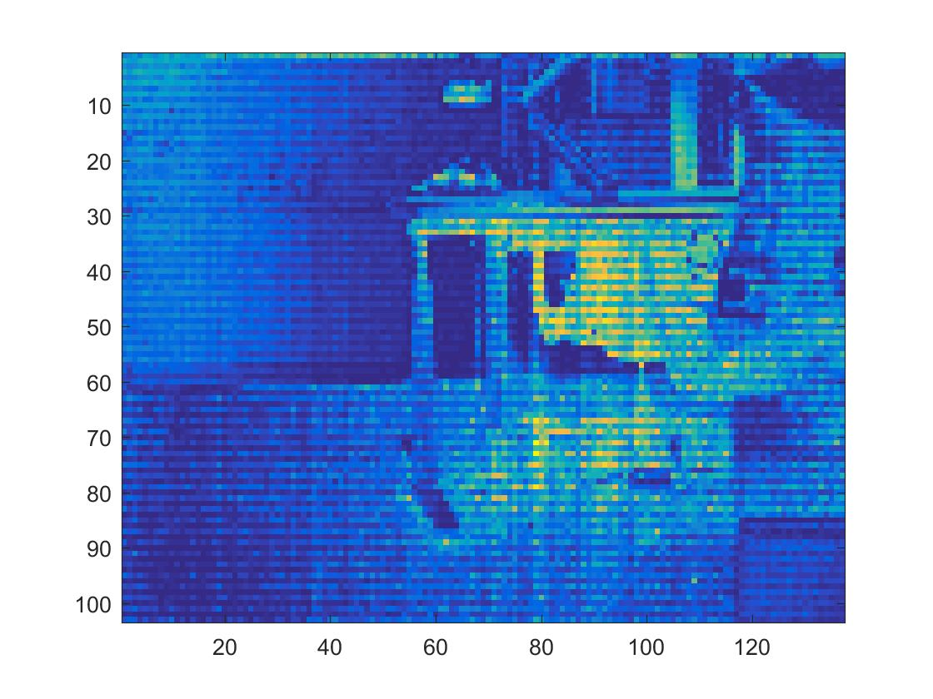
Photometric Calibration
Data collection
-- image too dark. For now, increase gain value; finally, enlarge aperture of the camera.
Data processing
-- memory, downsampling the images
-- rank deficiency, get more image data
Notes:
Because of the aperture problem of the camera, we can not get bright images of regular scenes (other than white surfaces).
For now, increase Gain value for testing.
“Rank deficiency” problem when calculating the camera response function, but too big matrix will exceed the memory limits.
Get more images from larger exposure time ranges, and downsample the images during calculation.

Slide 24
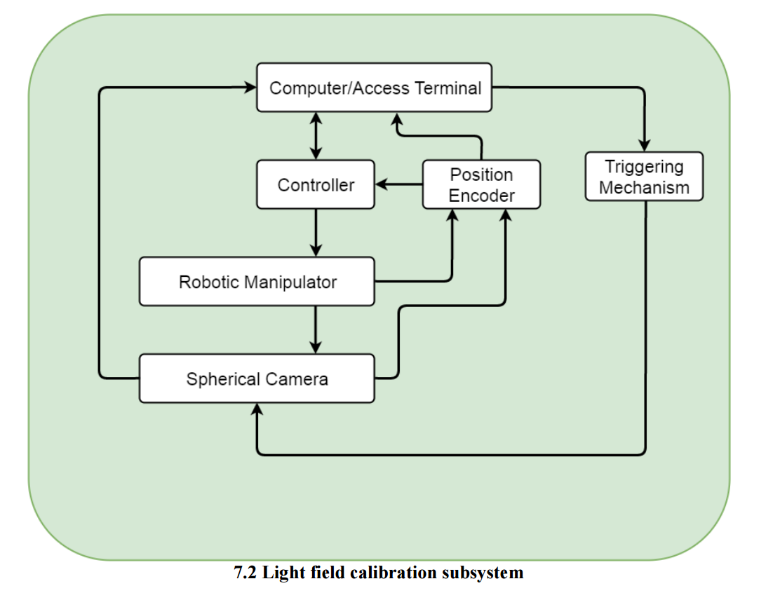
Lightfield Calibration (Spring)

Slide 25
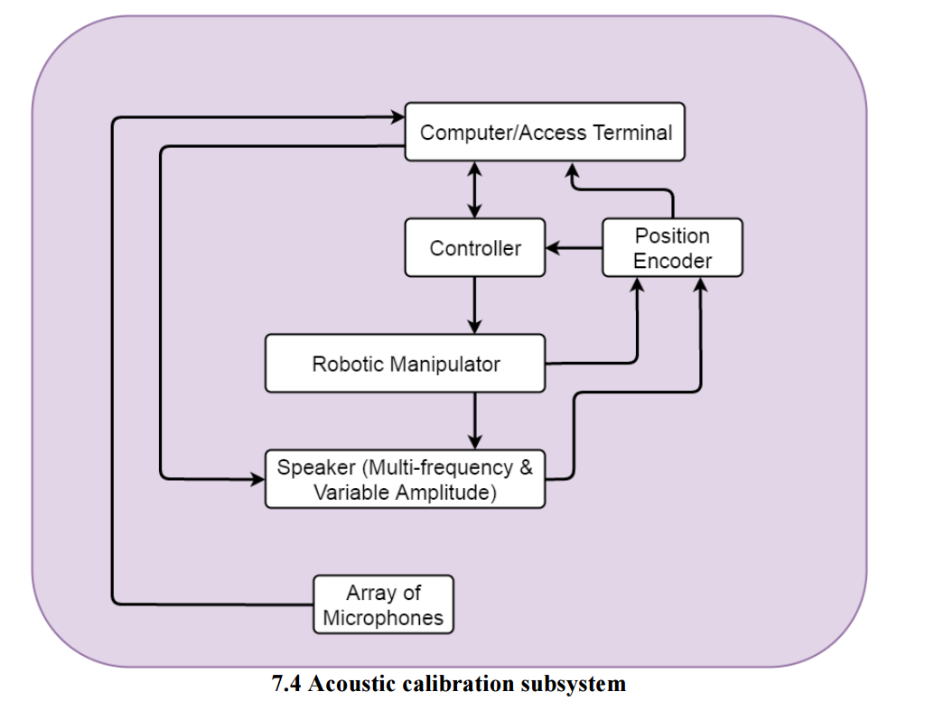
Acoustic Calibration (Spring)

Slide 26
Current System Description

Slide 27
Project Management

Slide 28
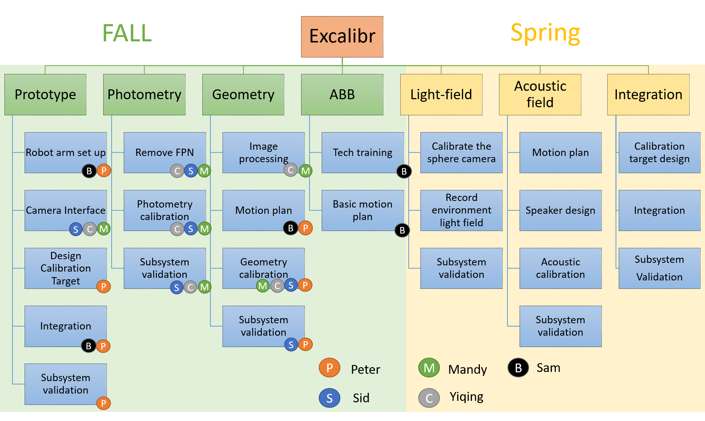
Work Breakdown Structure

Slide 29
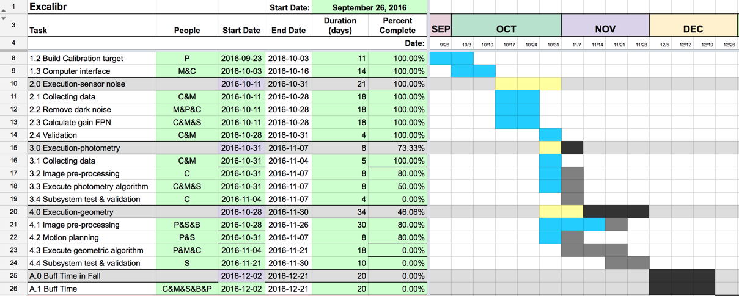
Schedule - Fall

Slide 30
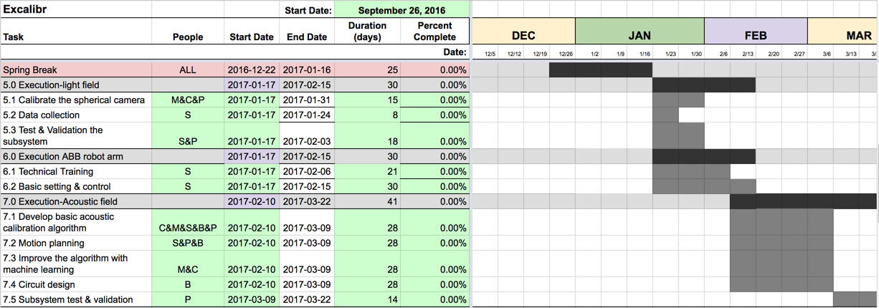
Schedule - Spring

Slide 31
Schedule - Spring

Slide 32
Test Plan
Progress review #3
Date | 10/11/2016 | Test Method
Deliverables | Geometry Calibration algorithm | Use prepared data to conduct a complete geometric calibration process and obtain extrinsic and intrinsic parameters of cameras
 | Photometric Calibration algorithm | Use prepared data to conduct photometric calibration and get the corrected curve
Progress review #4
Date | 22/11/2016 | Test Method
Deliverables | Geometric calibration and photometric calibration subsystem Integration | Move robot arm in certain patterns and trigger cameras, conduct photometric calibration and geometric calibration.

Slide 33
System
Validation

Slide 34
Fall
Validation

Slide 35
Location: Oculus research, Pittsburgh | Testing Equipment: •Aerotech Robotic Arm •Camera •Computer •Calibration target
Test Process: Move calibration target in a certain pattern Trigger the camera to collect corresponding image Apply sensor noise calibration algorithm Apply Photometric calibration algorithm Image Corner detection Apply geometry calibration algorithm | Output: Variance differences Plot the inverse camera response function Image after calibration
Mandatory goal: M.F.1: Fabricate calibration target M.F.3: Control and manipulate the calibration target M.F.5: Take high-resolution, stable and clear pictures of calibration target M.F.10: Validate results M.P.4: Complete one stage calibration in at most 8 hours | Desired goal: D.P.3 geometry Calibrate the cameras on the dome to 1000 micrometers and 100 arc seconds

Slide 36
Spring
Validation

Slide 37
Location: Oculus research, Pittsburgh | Testing Equipment: • ABB•Camera •Computer •Calibration target•Microphone
Test Process: Collect the lightfield density using spherical camera Collect images from the camera and perform the photometric, and geometric calibrations based on the data from lightfield calibration Successfully Control the ABB Robotic arm. Perform Acoustic Calibration of the sensors Perform all given tasks simultaneously with successful system integration. | Output: Lightfield estimation Plot the inverse camera response function Image after calibration ABB arm motion planning
Mandatory goal: M.F.1: Fabricate calibration target with the multi-frequency speaker M.F.3: Control and manipulate the ABB Robotic Arm M.F.5: Complete Motion Planning for the ABB Robotic Arm M.F.10: Validate results M.P.4: Complete the entire calibration process in at most 24 hours | Desired goal: D.P.3 geometry Calibrate the cameras on the dome to 500 micrometers and 10 arc seconds

Slide 38
Budget List
MRSD Total Budget: (USD)5000
Notes:
This table is our budget list
MRSD budget is $5000
We have a Aerotech robot,3 cameras, 2 desktops, 12 cable carriers.
The big ticket item Aerotech $53000

Slide 39
Risk
Management

Slide 40
Risk Management
 |  | 1 | 2 | 3 | 4 | 5
 | 5
 | 4 |  |  |  | R1.3
 | 3 |  |  |  | R1.2
 | 2 |  |  |  | R1.4 | R1.1
 | 1
Consequence
Likelihood
Notes:
We classify our risks by likelihood and consequence.

Slide 41
Risk ID | Risk Title |  | People |  | Date Submit |  | Date updated
R 1.1 | Robot arm malfunction |  | Sam/Peter |  | 20/10/2016 |  | 31/10/2016
Possible Consequences |  |  | Risk Type |  | Likelihood & Consequence
Unable to move calibration target Unable to collect image data |  |  | Technical Schedule
Risk Reduction Plan
Risk Reduction Plan |  | Date |  | Expected outcome |  | Comment
1. Follow User manual |  | 10/20/2016 |  | Get a standard operation process
2. Contact manufacturer for proper motor use method |  | 11/10/2026 |  | Motor speed and usage recommendation
 | Consequence
Likelihood
Notes:
The first risk is robot arm malfunction.
Since the robot arm is the big ticket item comprise the majority of our budget.
If it happen, the consequence would be severe, not only will this impede the data collection and delay our progress, but also will it cost a lot of money.
To prevent this problem, we should follow the manual carefully and consult with the manufacturer for better usage of motors.

Slide 42
Risk ID | Risk Title |  | People |  | Date Submit |  | Date updated
R 1.2 | Camera malfunction |  | Mandy/Cece/Sid |  | 20/10/2016 |  | 31/10/2016
Possible Consequences |  |  | Risk Type |  | Likelihood & Consequence
Unable to take pictures |  |  | Technical Schedule
Risk Reduction Plan
Risk Reduction Plan |  | Date |  | Expected outcome |  | Comment
1. Contact the sponsor to prepare the spare camera |  | 20/10/2016 |  | Get a standard operation process
 | Consequence
Likelihood

Slide 43
Risk ID | Risk Title |  | People |  | Date Submit | Date updated
R 1.3 | Integration failure |  | All members |  | 23/10/2016 | 31/10/2016
Possible Consequences |  |  | Risk Type |  | Likelihood & Consequence
1. Delay schedule 2. May affect the accuracy |  |  | Technical Schedule Cost Programmatic
Risk Reduction Plan
Risk Reduction Plan |  | Date |  | Expected outcome |  |  | Comment
1. Split the integration into smaller steps |  | 25/11/2016 |  | Integrate geometric and photometric calibration first in the end of the semester
2. Verify each steps before move on to the next step |  | 30/11/2016 |  | Validate the result of geometric and photometric calibration in Fall semester and then continue other calibrations
 | Consequence
Likelihood

Slide 44
Risk ID | Risk Title |  | People |  | Date Submit |  | Date updated
R 1.4 | PSO trigger Problem |  | Sam/Peter |  | 20/10/2016 |  | 31/10/2016
Possible Consequences |  |  | Risk Type |  | Likelihood & Consequence
Unable to Trigger camera to collect data when X or Y or Z axis moves |  |  | Technical Schedule Cost Programmatic
Risk Reduction Plan
Risk Reduction Plan |  | Date |  | Expected outcome |  | Comment
1. Use Sample code using X Y Z to create a trigger signal |  | 20/10/2016 |  | Can use X Y Z axis to trigger camera
2. When move to specific position, give a mandatory trigger the camera |  | 30/10/2016 |  | Add Complexity in motion planning |  | Not costing too much time, because the motion pattern is still easy.
3. Contact manufacturer for help |  | 10/11/2026 |  | Problem analyzing and trouble shooting
 | Consequence
Likelihood
Notes:
To mitigate the risk, we prepared a backup plan.
Since we can control the robot to move desired trajectories,
If the camera can’t be triggered automatically, we can still make the robot go to specific position and send out trigger commands manually.

Slide 45
Risk ID | Risk Title |  | People |  | Date Submit |  | Date updated
R 1.5 | Memory Deficiency Problem |  | Cece/Mandy/Peter/Sid |  | 23/10/2016 |  | 31/10/2016
Possible Consequences |  |  | Risk Type |  | Likelihood & Consequence
Incapable of processing input data Currently, we encounter this problem in photometric calibration. This problem might appear in geometric calibration as well. |  |  | Technical Schedule Cost Programmatic
Risk Reduction Plan
Risk Reduction Plan |  | Date |  | Expected outcome |  | Comment
1. Report to sponsor |  | 27/10/2016 |  | Downsample images |  | Acceptable at current stage
2. Discuss with sponsor |  | 15/11/2016 |  | Use hardware with larger memory
 | Consequence
Likelihood

Slide 46
Questions?

