Slide 1
FlySense
Augmented Reality FPV assisted navigation
(applied to a helicopter)
Team C
October 2017
Shivang Bhaveja
Harikrishnan Suresh
Nick Crispie
Joao Fonseca
Sai Nihar Tadichetty

Slide 2
Flash update
Updated
Feature | Achievements this week | Target for next week
UI/UX | Interface with Jetson drafted Epson BT-300 tested vs Hololens Lighter and easier to wear Better under strong direct lightning Images are stationary Sound in Android 2D sound library identified 2 mics noise cancellation identified Offline speech recognition library identified Confirmed that 3D sound does not work with beep sounds (only polyphonic signals) | Testing Android sound libraries Initial mock-ups of HUD With artificial horizon based on head pose and dummy input from onboard computer)
Sensing | Range extended (from 5 to 20 meters) Ghost image removed for slowing moving objects 3D artefacts removed from the floor | Convert Octomap to Gridmap (ethz-asl/grid_map) Convert from PointCloud to Gridmap (Air Lab Code) Apply Edge detection filter to Grid map
System Int. & Testing | Jetson ATK setup with Octomap and Rviz Octomaps generated for the 16 channel Velodyne tested in the lab | Validation of the interface AR - Jetson Octomaps generated for the 64 channel Velodyne data from NEA
Procurement and project management | Procurement of Epson BT-300 finalised | Design Fall Validation Experiment in detail

Slide 3
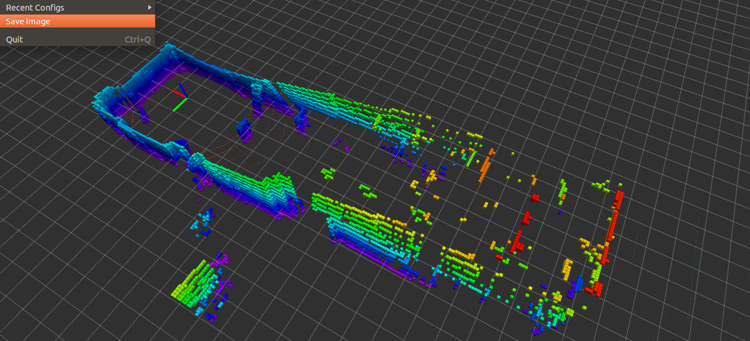
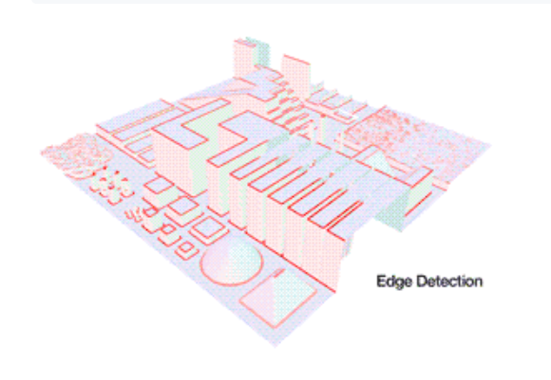
Second attempt at 3D mapping for slowly moving obstacles was successful
VELODYNE TESTING
Achievements
Next steps
Objective of test:
  Test octomaping algorithm for moving obstacles
Achievements
  Range extended (from 5 to 20 meters)
  Ghost image removed for slowing moving objects
  3D artefacts removed from the floor

Slide 4
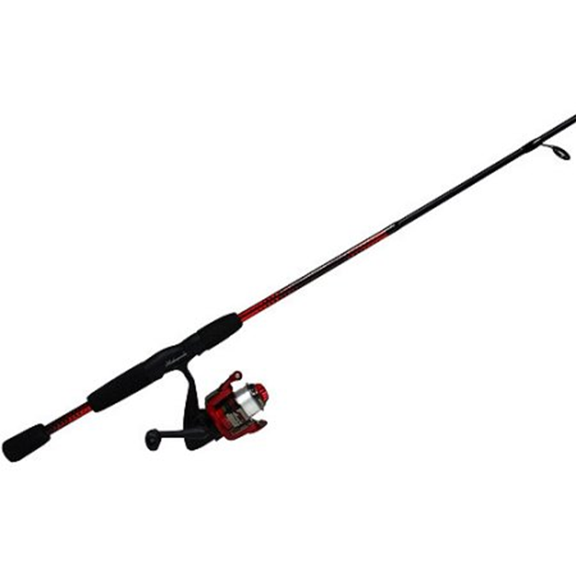
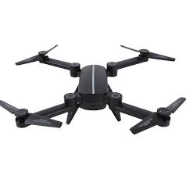
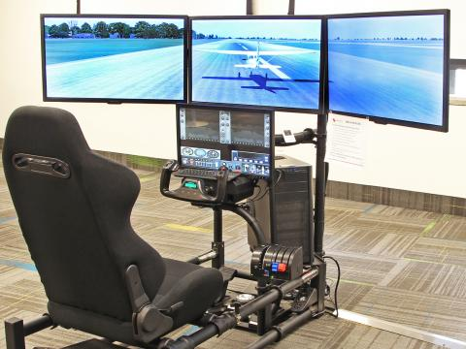
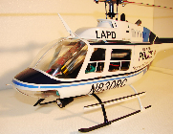
In parallel with the simplification of our requirements, we have reorganized the workflow in order to minimize rework
Least resistance path
Initial Approach
A
B
C
D
?
FlySense
Sensors in a box
Quadcopter
Simulation (online)
Helicopter
Current Approach
FVE
A
B
C
D
?
FlySense
Simulation (offline flight dataset)
Sensors in a box
Quadcopter
Helicopter

Slide 5
Under the new approach, we are currently on schedule (detail in backup)
Draft schedule (subsystem/system level)
Tracks | PR 1 20 Oct 2017 | PR 2 27 Oct 2017 | PDR 31 Oct | PR3 Nov 10 | PR4 Nov 22 | PR5 Nov 30 | PR6 Dec 7 | Critical Review Dec 14
UI/UX | First visualization of sensor suite Specification to onboard computer | Head tracking for artificial horizon | Mock-up of HUD | Mock-up of BDV | Mock-up of sound | HUD and Bird’s Eye View with NEA dataset | Additional testing and refinement | Planning for next phase
Sensing | Point cloud of Lidar Data set | Onboard obstacle map generation | Interface to AR headset | Obstacle map with NEA flight dataset | Interface to AR
System Int. & Testing | Procurement of Epson BT-300, Velodyne and Jetson | Design of Fall verification experiment | Integration and testing of HUD |  | Integration and testing for Fall Validation Experiment (HUD, BDV, Sound)
✔
✔
✔
✔
✔
Note: Either Audio Warnings or Speech Recognition for Fall Validation.

Slide 6
We are currently deploying mitigation actions with owners to address the key risks identified
4 Major Risks and mitigation strategy
Preliminary
Three major risks identified
4
1,2,3
Octomap (Shivang/Hari)
  Octomap cannot process 3 LiDAR datasets real time
    Segment point cloud
    Process only 1 velodyne
AR Headset (Nihar)
  AR headset motion sickness
    Set focal distance to 20 meters
    Train pilots extensively
UI/UX voice commands (Joao)
  Voice commands do not work
    Bird’s eye pops-up automatically
    2 microphones for noise cancellation + Android offline library
Quadcopter not available (TBD)
  Too much time to make drone test
    Use NEA drone (from start)
    Drop Quadcopter from scope
Severity
Probability of occurrence
Note: 29 risk identified so far

Slide 7
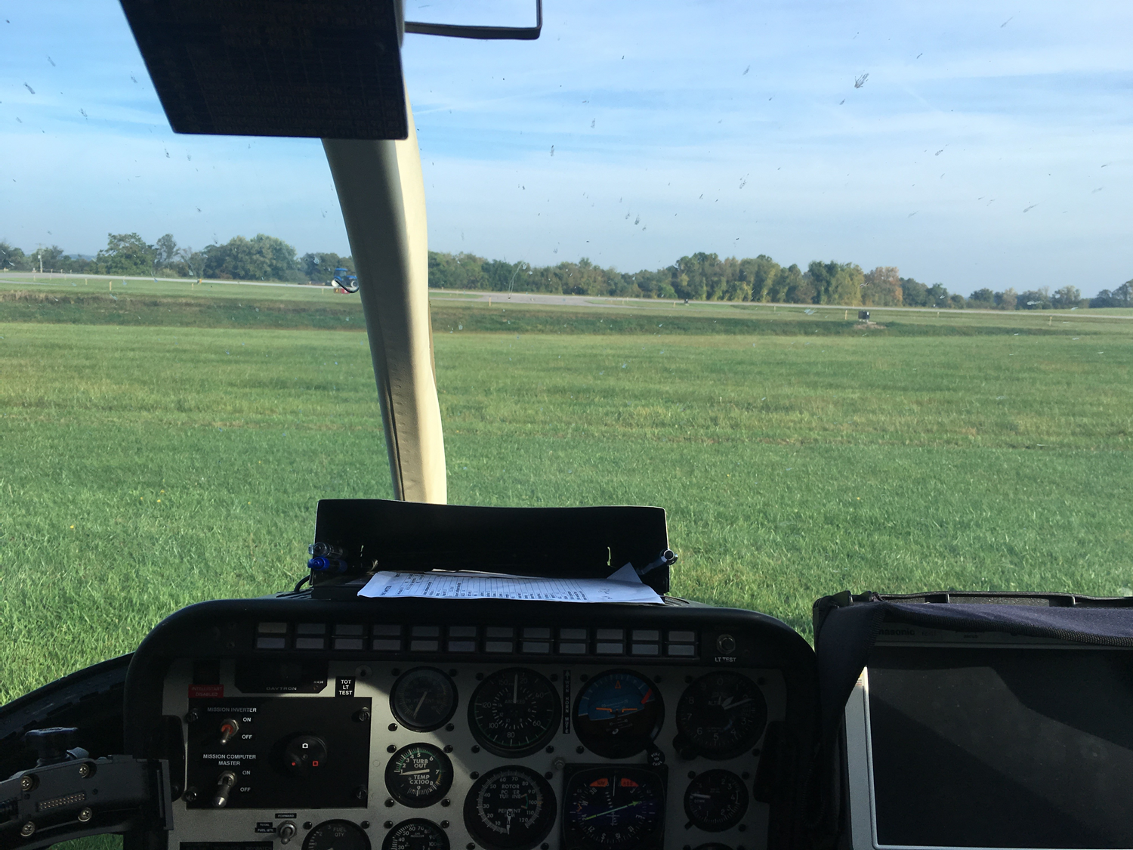

NEW END-DELIVERABLE
Updated
Thank You!
HUD
BV
Heading
HUD
BV
HUD
BV
-20 -10 0 10 20 30
Torque %
Alt (ft)
100
95
90
80
1,150
1,100
1,000
950
ASL
AGL
Scale = 300 ft

Slide 8
Backup

Slide 9
NEW Work Breakdown Structure
 | Sensing | UI/UIX | FlySense Validation
Algorithm | 3D mapping Flight envelope 2D obstacle map | Sound warnings Speech recognition (with noise cancellation) | NA
Software | Interface to AR Interfacing with sensors Mapping implementation Bird’s eye view image generation | Generate Sound Warnings Render Bird’s Eye view Render Std Instruments User Interface (Buttons, pop-up, speech) | NA
Hardware (procure, setup, test) | PDR LIDAR Jetson INS-GPS | Augmented Reality Headset up and running (Epson) | Flying Quadcopter with sensors Jetson to Helicopter computer
Integration | Jetson -> AR Jetson+LIDAR Jetson+GPS-INS Jetson+LIDAR+GPS/INS+PDB | Jetson communication protocol AR -> Jetson | Integrate with NEA LIDAR Datasets Integrate with Quadcopter Integrate with NEA Helicopter
Testing | LIDAR Static LIDAR Moving GPS/INS test PDB test | AR connected with PC AR connected with Jetson | Test with NEA LIDAR dataset Test with Quadcopter Test with NEA Helicopter

Slide 10
DETAILED WBS SCHEDULE (1/2)
Updated

Slide 11
DETAILED WBS SCHEDULE (2/2)
Updated

Slide 12
Previous features were segmented based on feedback gathered so far
Functional requirements were trimmed to address
4
First Year (MRSD Project)
First Person View Overlay
3
Map and path planning
2
“Auto Emergency Braking” possible as it becomes transparent to the pilot
Bird Eye View
1
Standard Instruments
0
Quick shortcuts interface additional to the AR standard interface needed
FlySense AR Interface
3D Sound can be added to further aid the pilot locating the obstacle
What pilots have seen before
What pilots are looking for today
What pilots do not yet understand but will be “the future”
Time

