Slide 1
FlySense Augmented Reality FPV assisted navigation (applied to a helicopter)
Team C
November 2017
Shivang Bhaveja
Harikrishnan Suresh
Nick Crispie
Joao Fonseca
Sai Nihar Tadichetty

Slide 2
FLASH UPDATE
Updated
Feature | Achievements this week | Target for next week
UI/UX | Upgraded version of HUD mode in AR Communication between AR and Jetson complete | Develop first version of Speech recognition using Google API (or Pocket Sphinx offline library)
Sensing | Software architecture complete Pre-processing node partially complete Theoretical model for the dynamic window ready and first C++ code being integrated and tested (translation only) Experimentation with AIR Lab code (results not promising) AR interface node complete and tested | DJI flight controller interface with Jetson Complete TF tree, pose and odometry Finish the testing and integration of the first code, for the dynamic window Finalize mapping algorithm and complete its implementation in ROS
System Int. & Testing | Sensor mounts and PDB for aerial subsystem ready Ground testing of DJI Matrice to check pose estimate | Complete bench-top hardware (aerial subsystem with all components mounted)

Slide 3
UI/UX – AR, Integration with jetson
AR – Jetson Interface
DEMO
ROSJAVA set up on AR device
AR subscribing to sensor data published from the Jetson
Updating the AR interface using messages from the Jetson

Slide 4
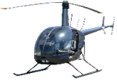
Taking into account simplified translation motion a rectangular window is obtained…
SENSING - DYNAMIC WINDOW
Type of trajectory
Window selected based on simplified model
Flight Envelope 1
(in t seconds)
Flight Envelope 2
(in t seconds)
V0 = 0
v0 ≠ 0
Based on the initial conditions and solving a first order approximation of the quadcopter differential equations, a maximum and minimum distance is identified…
… and a rectangular window is fitted in order to filter the “relevant” points that have been received in the registered point cloud sent to our FlySense Onboard Computer
Note: The dynamic window has an additional condition that it will always show (xmin,ymin,zmin) meters in a certain direction.

Slide 5
UI/UX – AR, Integration with jetson
Upgraded version of HUD
DEMO
Artificial horizon, Heading, Average Ground Speed Indicator, Average Wind Speed Indicator, Scrolls for dummy data

Slide 6
Architecture: Status
Onboard Sensing Software
Simulation mode
NEA flight data sets pushed from a laptop
Preprocessing node
Mapping node
Coloring node
SIM/FLIGHT mode:
Flight envelope
PCL Cropbox filter
Publish TF tree
Publish Odom
Octomap/Grid map implementation
Real time 2d obstacle map
Filter the map to remove spurious obstacles
Calculate time to impact to different obstacles
Color based on minimum time
Flight mode
Velodyne
VLP16
50% done
50% done
10% done
AR interface node
Publish HUD related data
Publish Sound warnings
Publish Bird’s eye view image
DJI flight controller
90% done
DEMO of PCL Cropbox filter

Slide 7
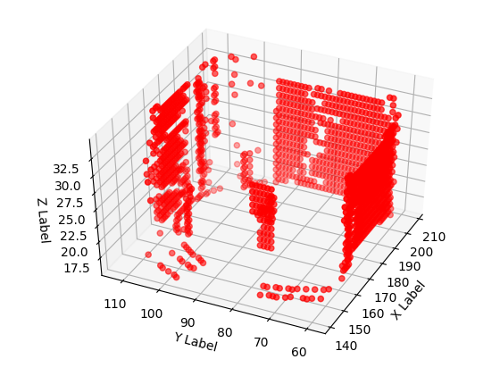
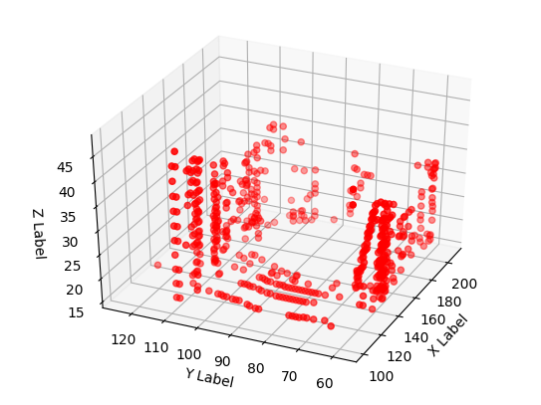
Experimented with AIR lab grid mapping algorithm on LIDAR data from bag file
SENSING - MAPPING
Octomapping not working with NEA flight data set (Optimized values for parameters highly sensitive to environment)
Set up a working code for AIR lab grid mapping package
Challenges faced –
No online documentation, which led to trouble in setting up a working code and debugging
AIR lab visualizer code not working
The mapping code results not as expected, and difficult to interpret

Slide 8
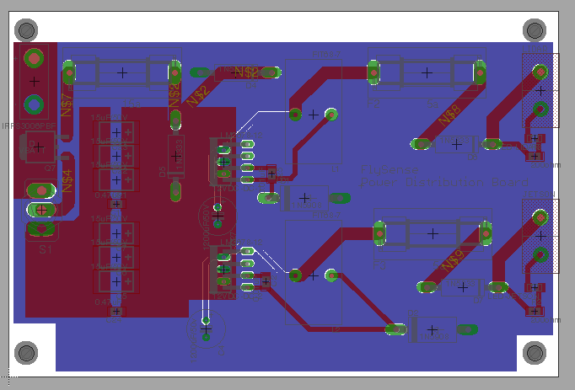
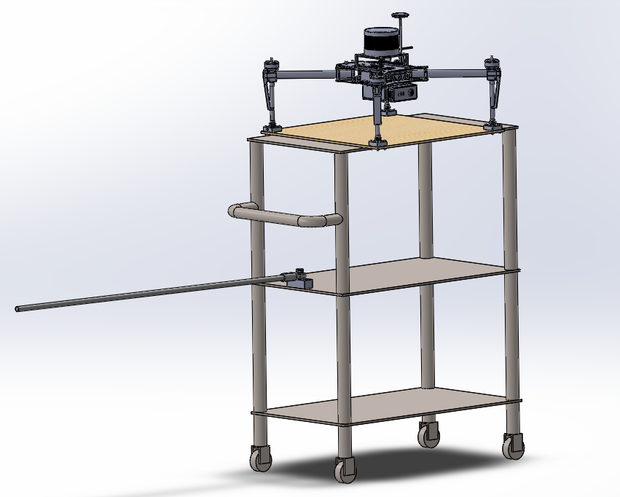
System integration and testing
Power Distribution Board
Aerial subsystem components
Velodyne VLP16
Wood Mounting Panel
DJI Matrice 100
Retaining blocks for Drone Legs
Component | Name/Description | Description/Value | Quantity | Price
Voltage Regulator | LM2678-12 Switching regulator | switching regulator | 1 | 5.83
Cboost | Ceramic Capacitor, 1206 SMD | 50V .01uF | 2 | 0.12
Cin | KEMET T495 Tantalum Cap | 35V 47uF tantalum | 6 | 2.53
Cout | Aluminum electrolytic Capacitor | 1200 uF / 50V | 2 | 2.07
diode | Schottkey Diode | 40V 3A | 2 | 0.84
inductor | P0849 coil inductor | 33uH | 2 | 3.99
zener diode | TVS zener diode | 28V 11A | 4 | 0.42
LEDs | 1206 SMD color LEDs |  | 2 | 0.52
resistors | 1206 SMD | 200 ohm | 2 | 0.44
switch | toggle switch |  | 1 | 2.11
MOSFET | P channel MOSFET |  | 1 | 3.35
connectors | Anderson Power Pole |  | 2 | 8
fuse |  | 5A | 2 | 0.39
fuse holder | Fuse Holder | 10A rating | 1 | 1.28
fuse |  | 10A | 1 | 1.52
Push rod on rod end
Rolling Utility Cat

Slide 9
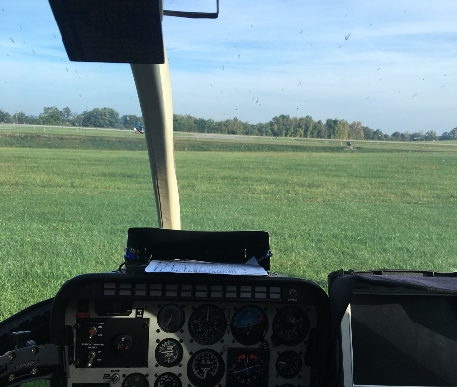
NEW END-DELIVERABLE
Updated
Thank You!
HM
HUD
BV
Heading
HM
HUD
BV
HM
HUD
BV
-20 -10 0 10 20 30
Torque %
Alt (ft)
100
95
90
80
1,150
1,100
1,000
950
ASL
AGL
Scale = 300 ft

Slide 10
Backup

