Slide 1
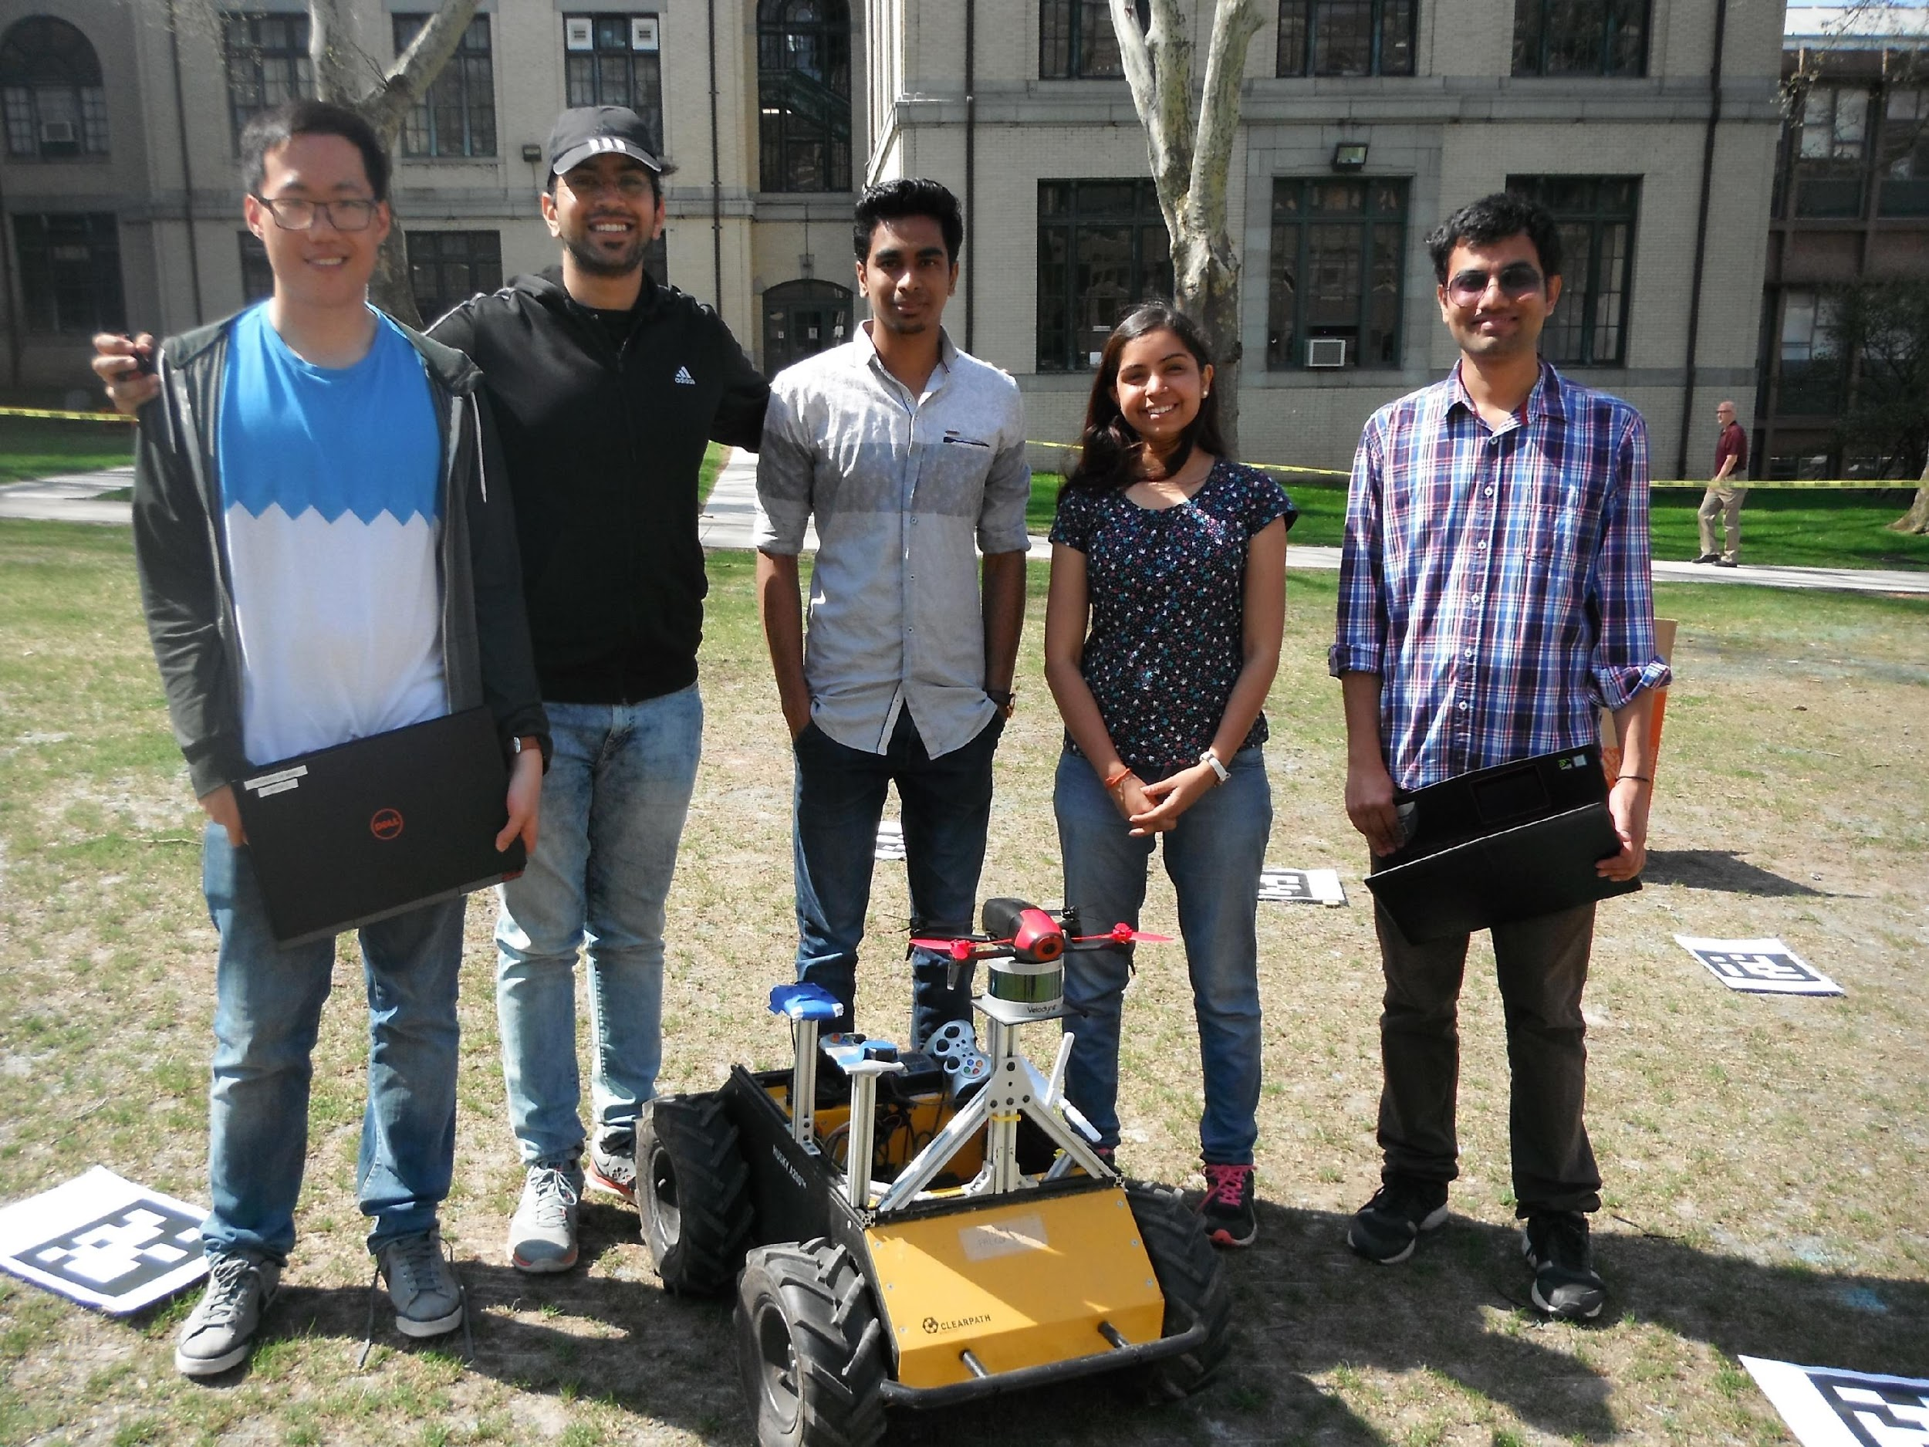
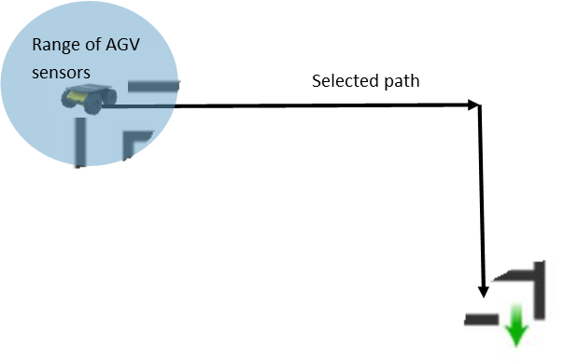
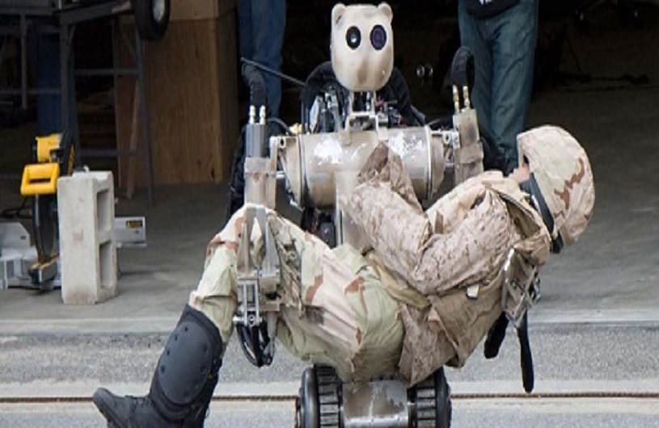
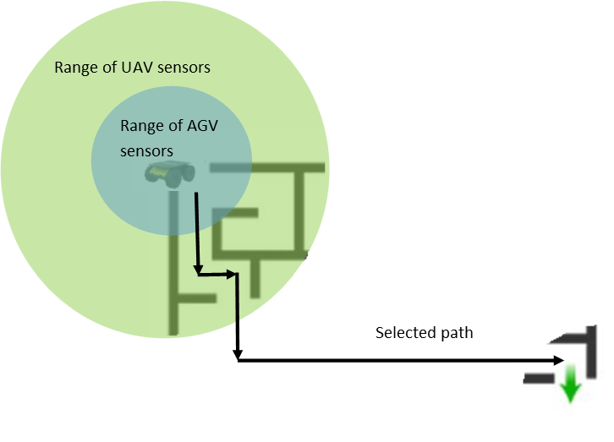
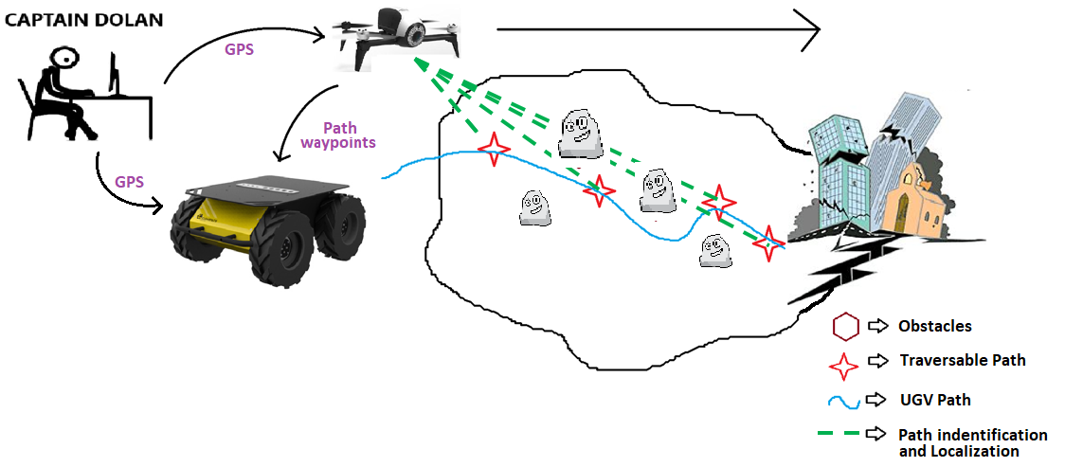
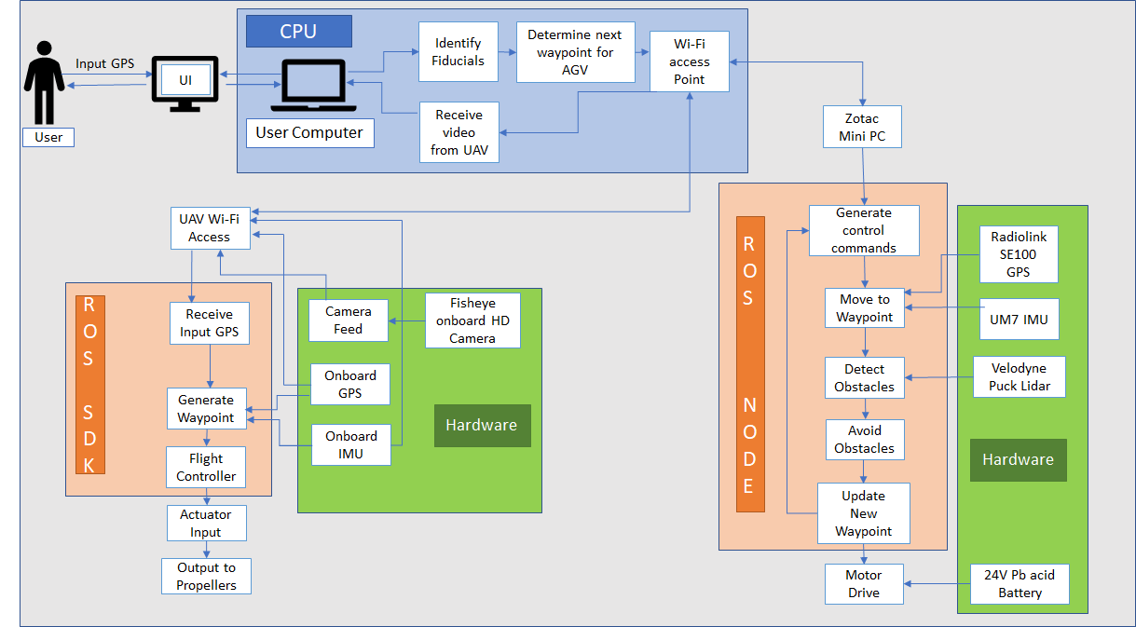
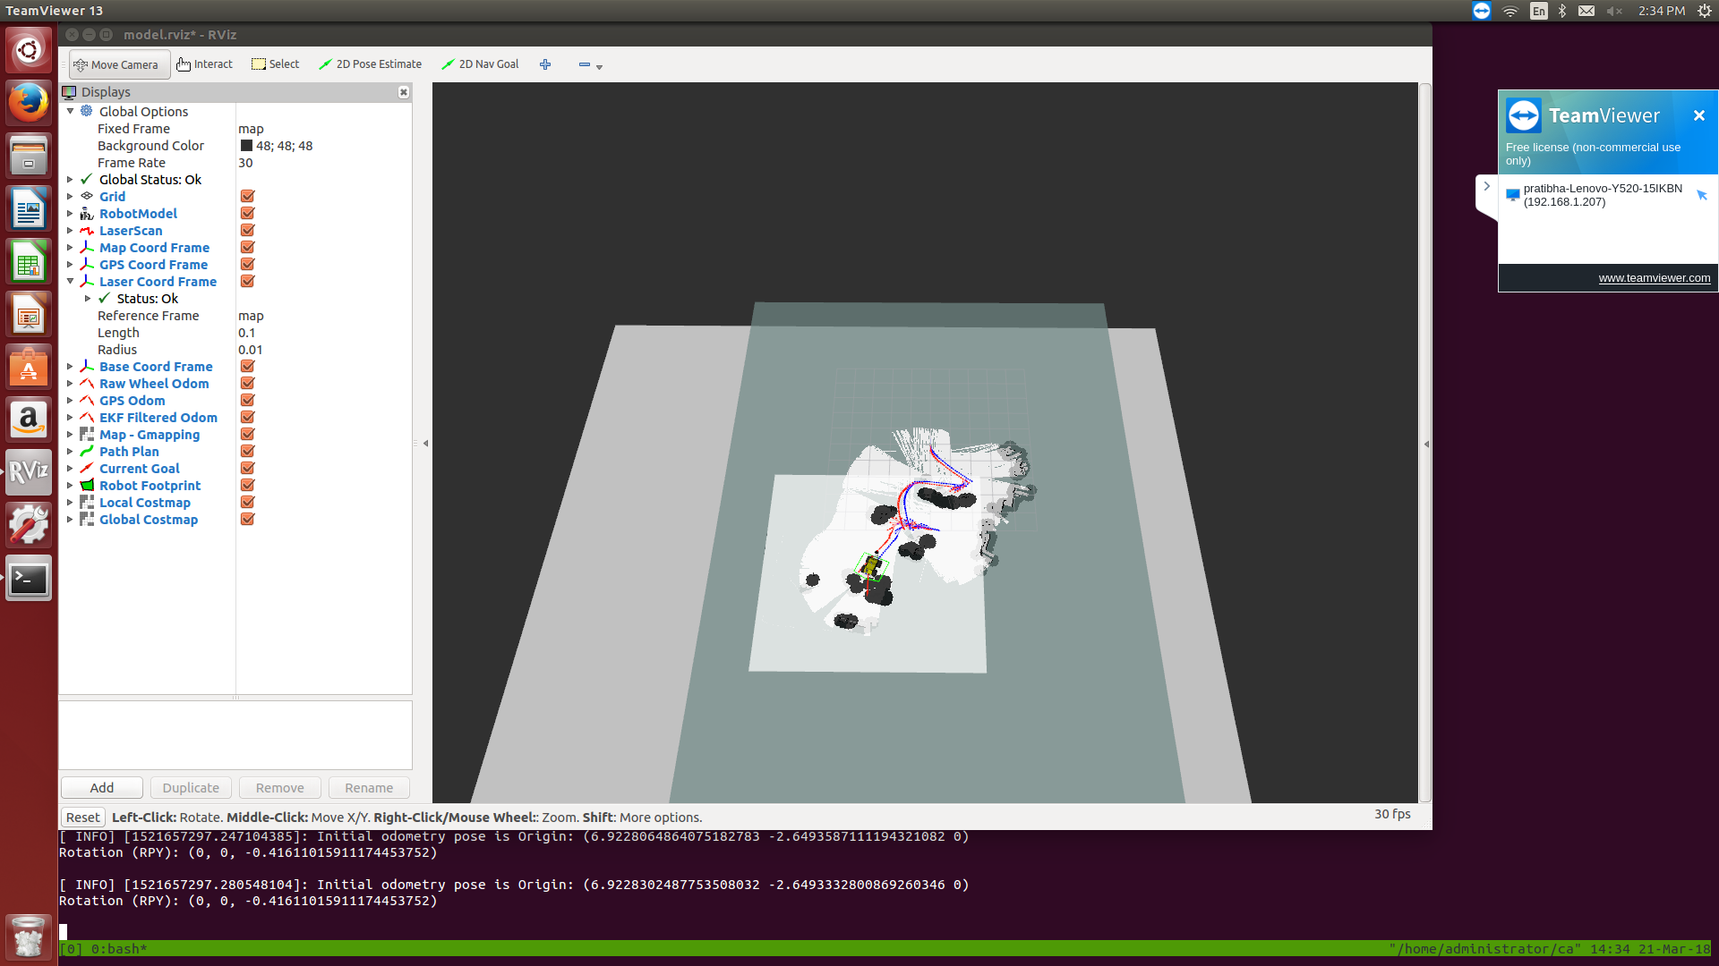
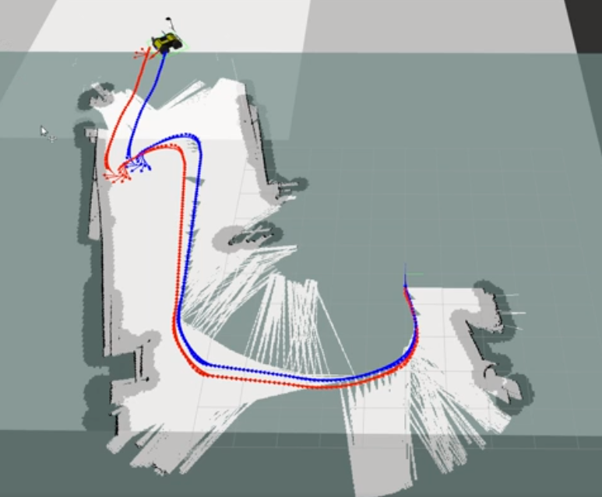
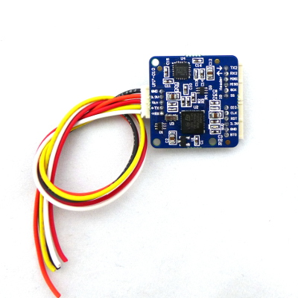
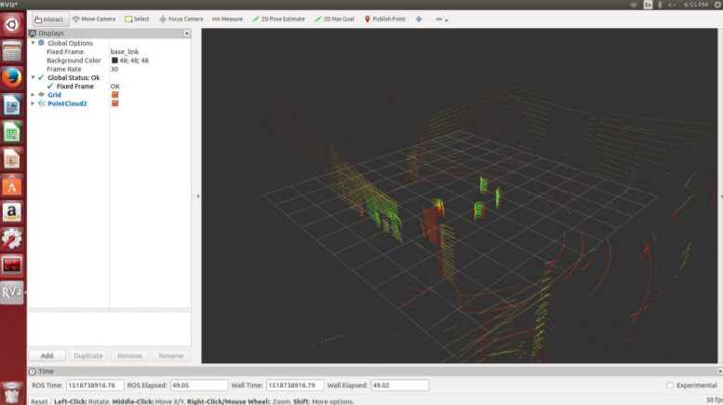
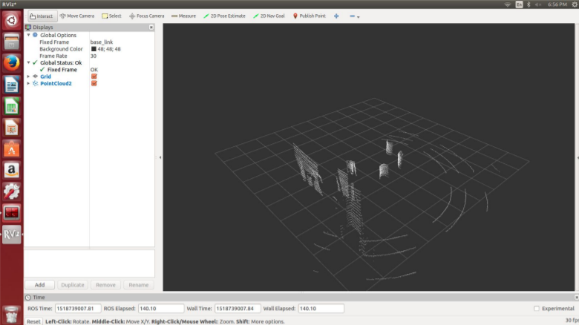
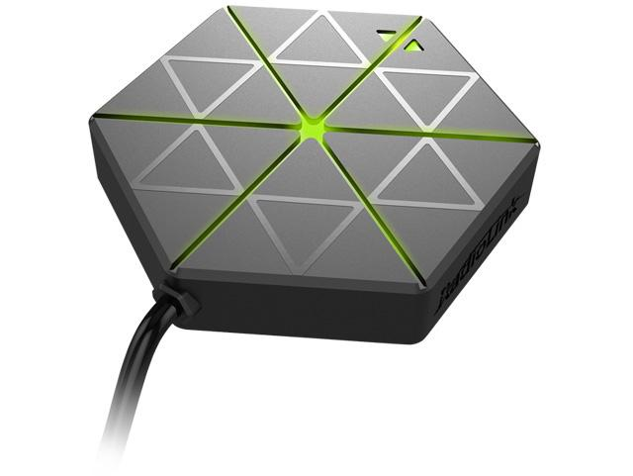
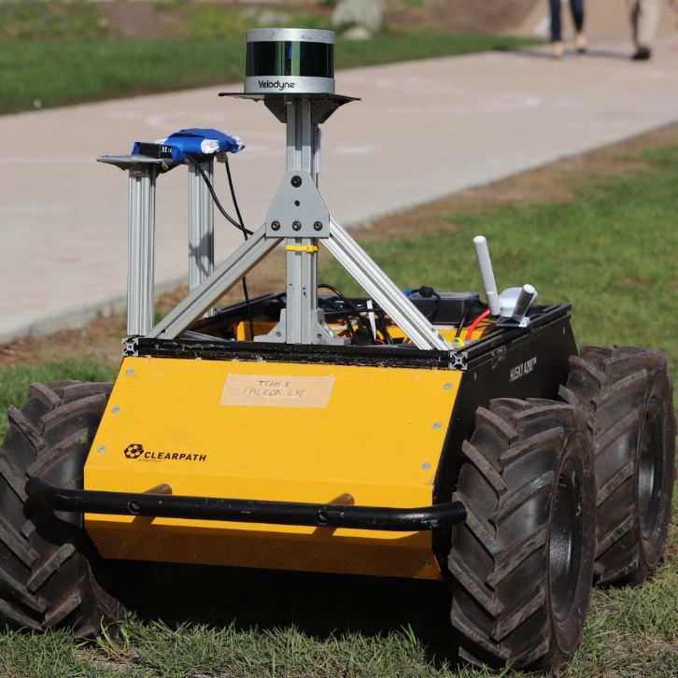
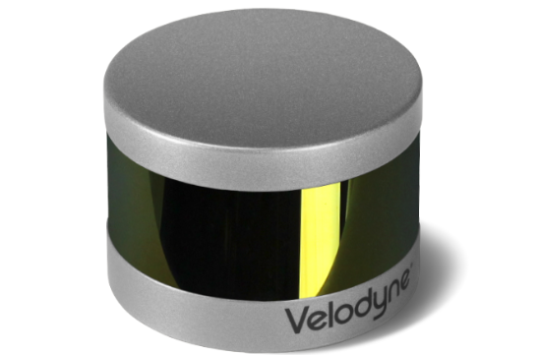
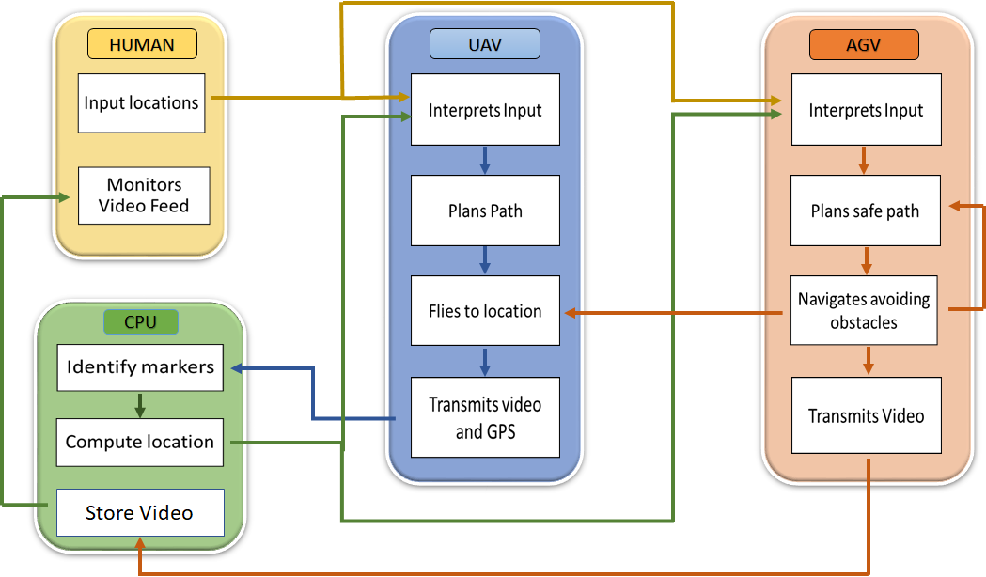
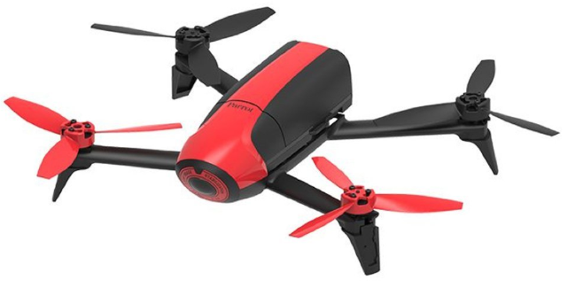
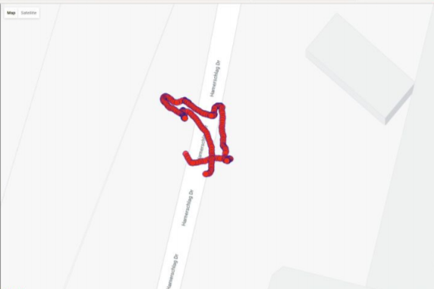
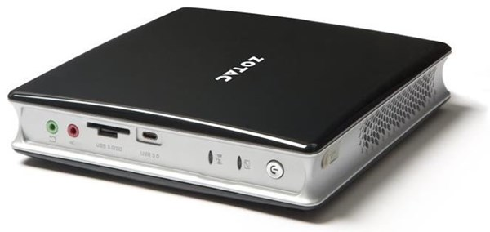
Multi-Agent Collaboration for navigation in disaster zone
Team F : Falcon Eye
{Yuchi, Danendra, Rahul, Pratibha, Pulkit}
MOTIVATION
TEAM
PROJECT DESCRIPTION
Human and Robots working in Collaboration for Disaster Response
Enhance the exploration and navigation capabilities of ground robots in unknown environments by integrating aerial information from drones
Path finding and localization using ground-level sensors is a difficult task when obstacles and dead ends are obstructed from the sensor’s field of view.
Leads to unacceptable performance in time-critical missions in unknown environments - such as disaster relief.
USE CASE
Augment the localization and path planning capabilities of AGV’s by integrating aerial sensor data from UAV’s.
SYSTEM DESIGN
SUBSYSTEM TESTING RESULTS
HARDWARE
Path Planning with Obstacle Avoidance (Dynamic and Static)
IMU 9DOF Razor
GPS - SE 100
Camera with Fisheye lens
Velodyne Puck Lidar
Velodyne Raw Point Cloud
Reduced Point Cloud
Internal GPU
Internal IMU
Zotac Mini-PC
Unify AC Mesh
GPS Variance

