Slide 1
Progress Review 11/23
Team D

Slide 2
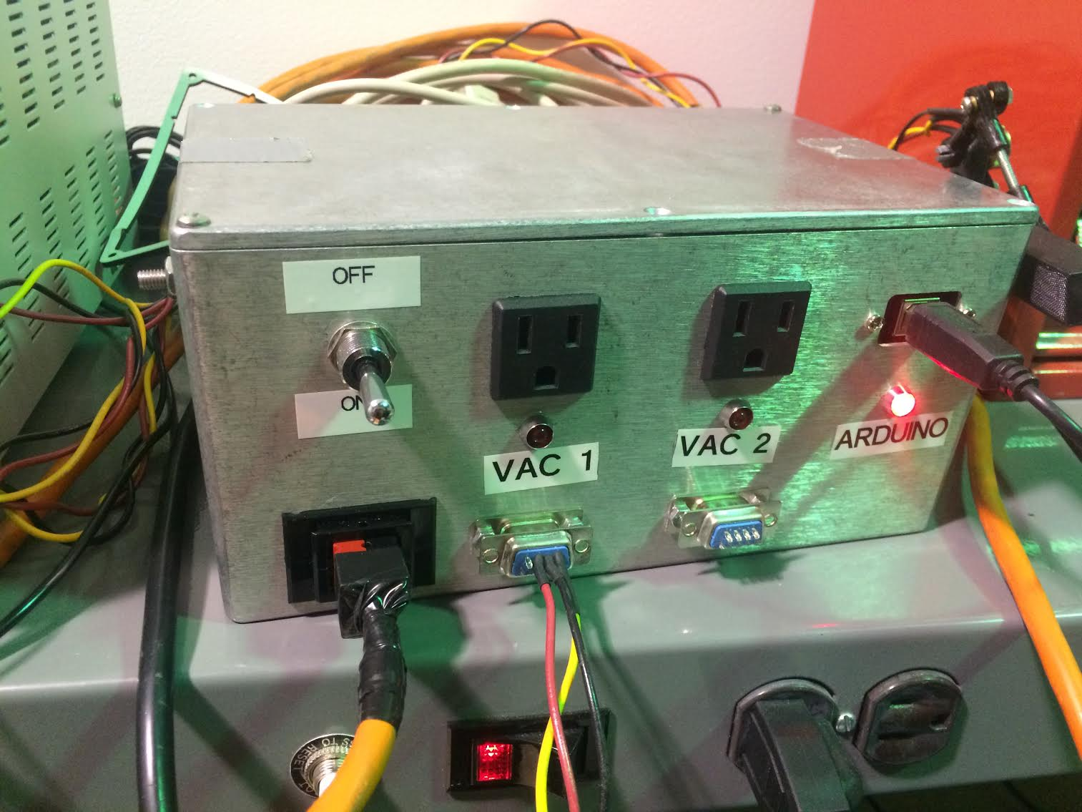
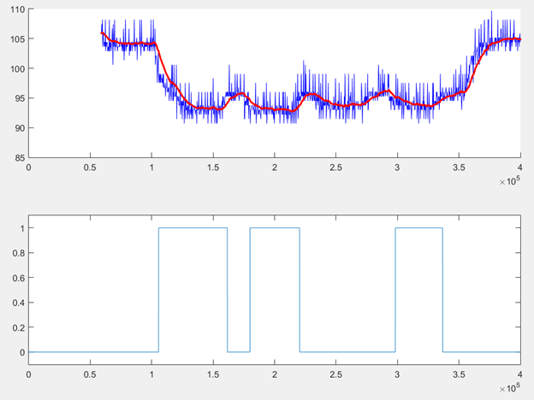
Suction Subsystem

Slide 3
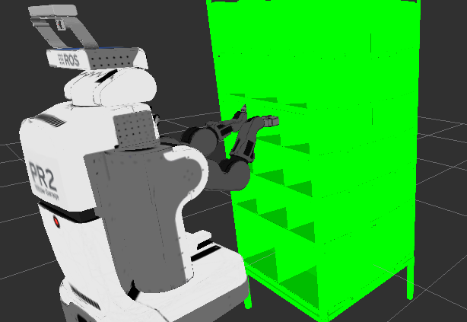
Platform
Shelf mesh is displayed as a marker
Each shelf bin was assigned a TF
Shelf was sunk in by 0.5m
Arm is programmatically moved to a shelf bin, base is moved towards the order bin and the arm is moved to the top of the order bin. This step is repeated for each shelf bin

Slide 4
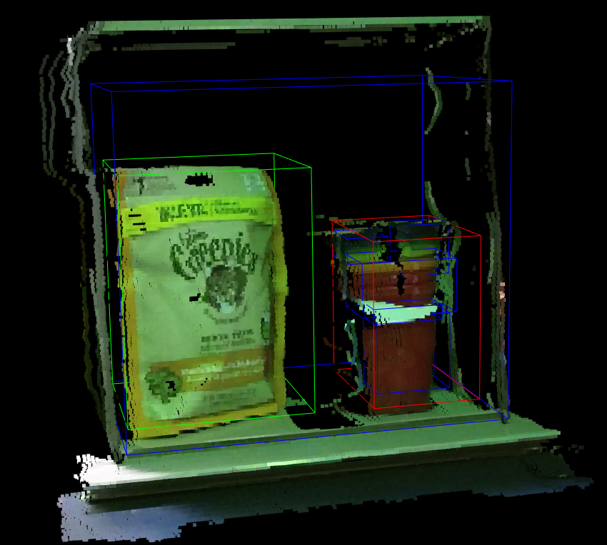
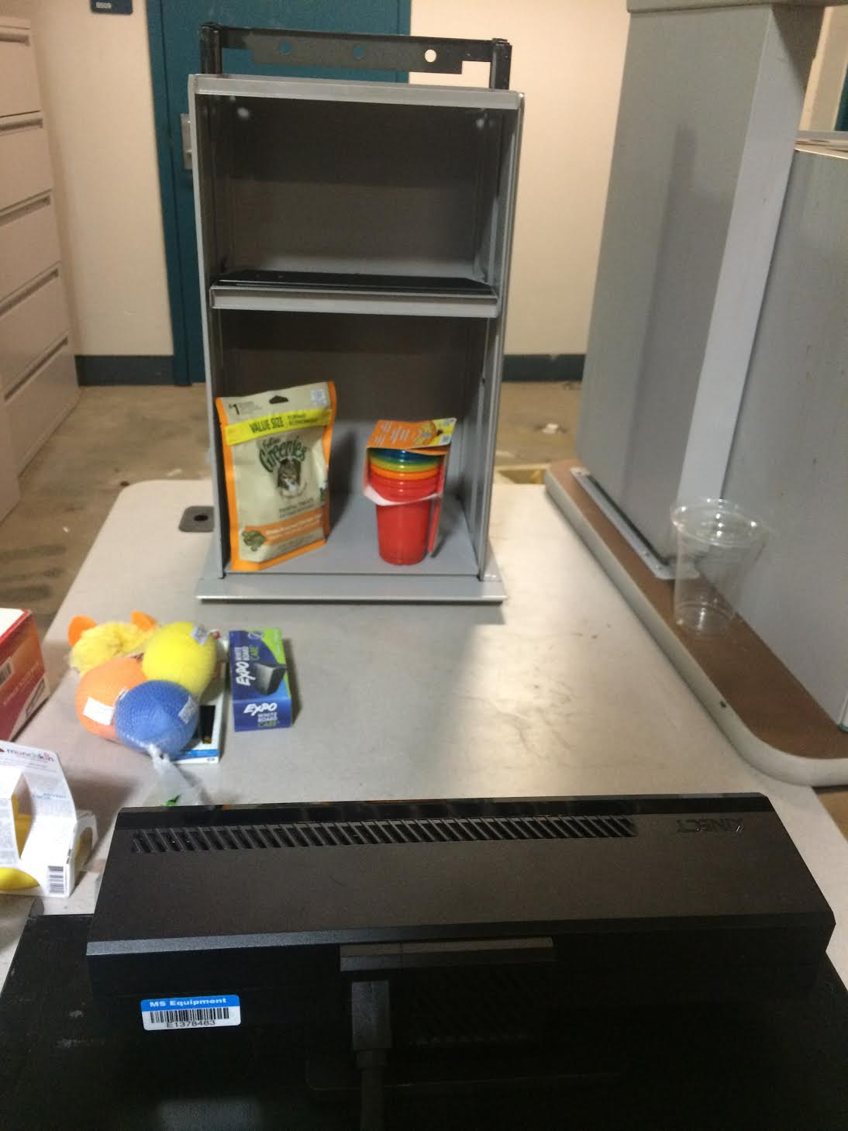
Perception Subsystem

Slide 5
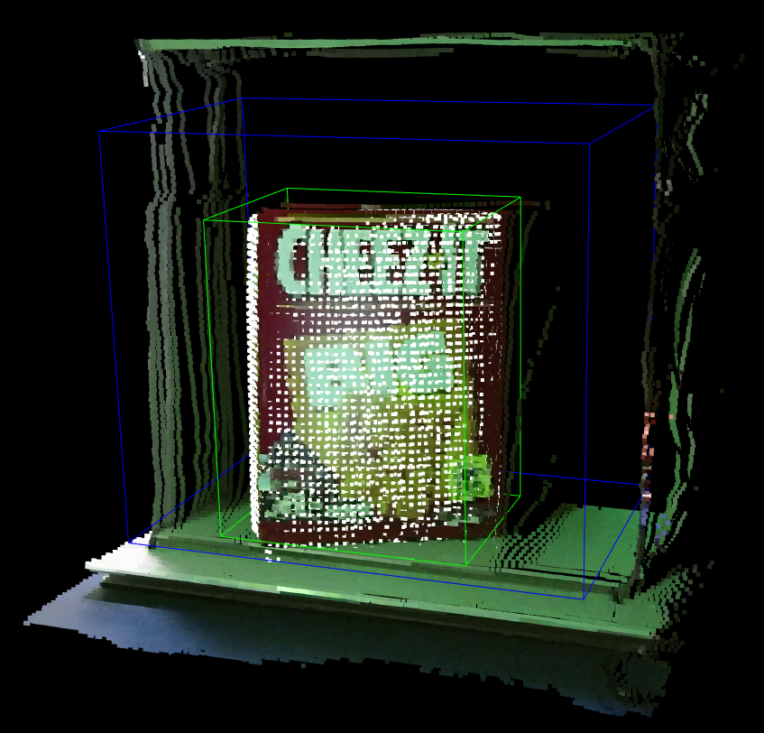
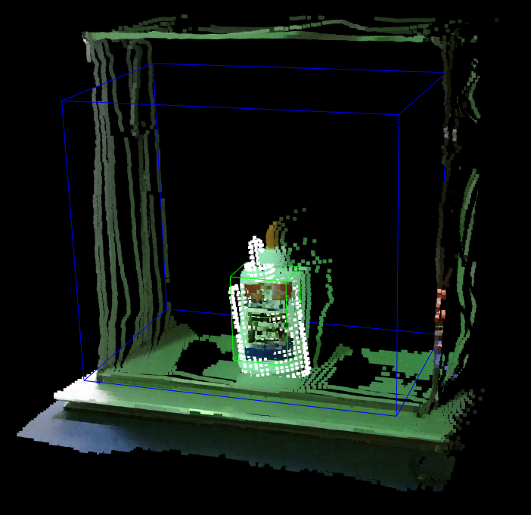
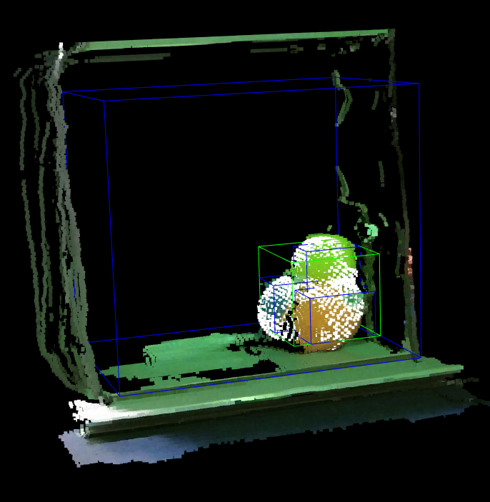
Perception Subsystem

Slide 6
Grasp Position

Slide 7
Work Before FVE
Platform
Add neck, spine, and gripper control
Perception
Improve algorithm performance to meet accuracy requirement
Gripper
Test pickup ability on newly acquired items
System
Integrate all actions into full hardware in the loop simulation
Testing
Work out unexpected bugs before FVE

